Slide 1
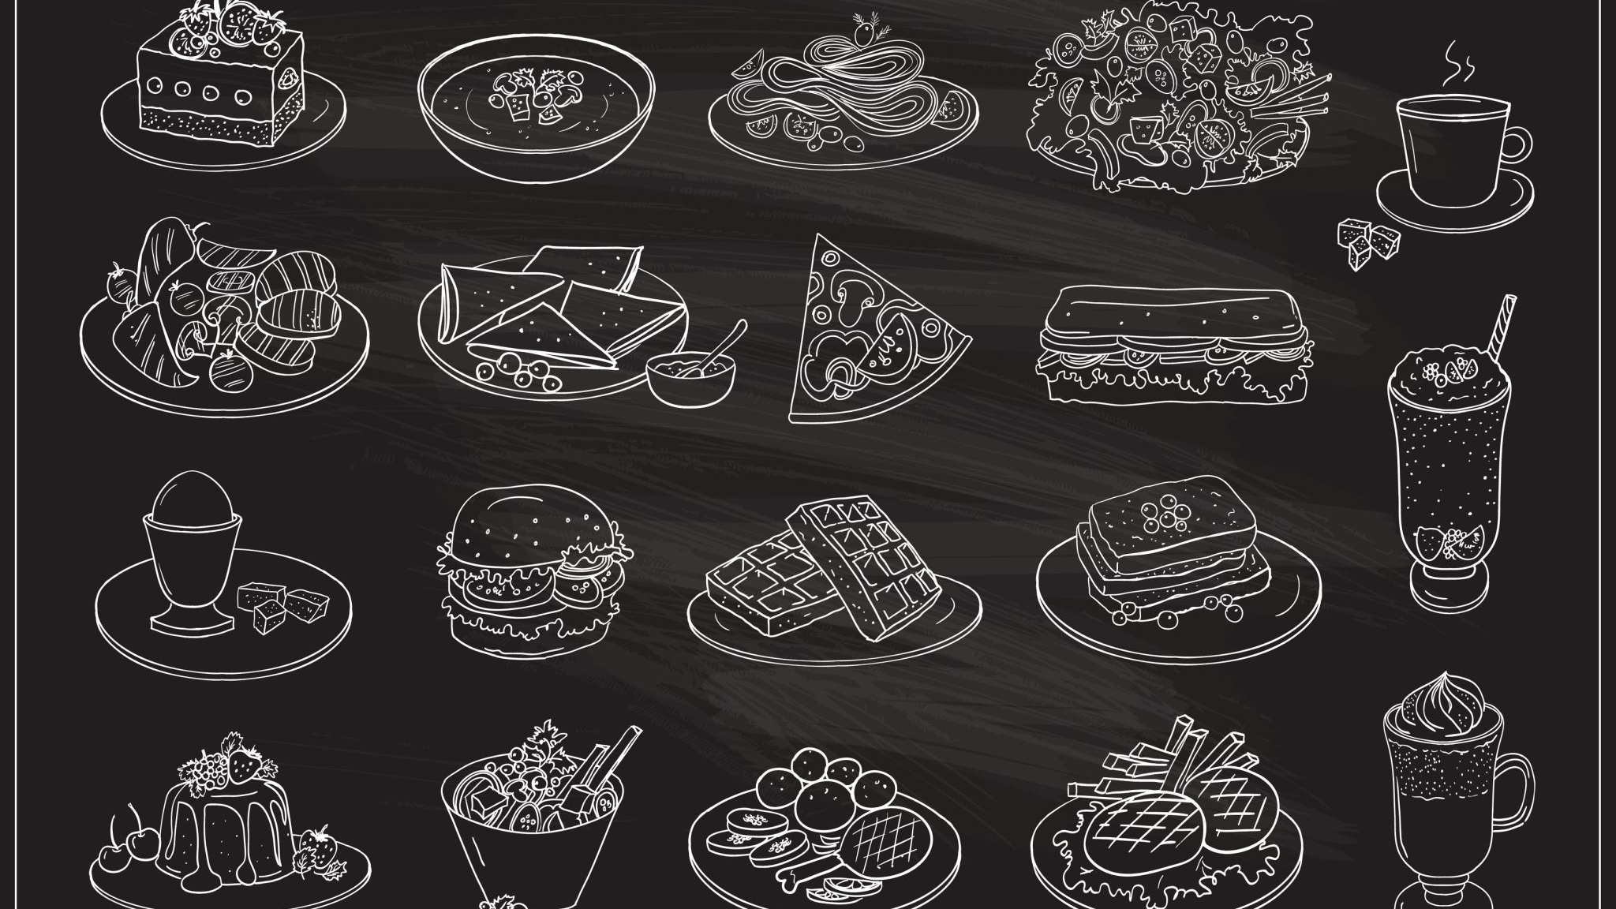


OPTIONS: hospitality & catering
WJEC Level 1/2 Vocational Award

Slide 2

What is a vocational course?
Vocational courses are education programs that focus on a specific trade/industry.
The WJEC Hospitality & Catering course is the equivalent of a GCSE.

Slide 3



Slide 4
Unit 1 & unit 2
ASSESSMenT requirements
Unit 1
Theory work covering the Hospitality and Catering Industry
80-minute external exam paper.
Exam taken at the end of Year 11.
Unit 2
Scenario based coursework project with practical cooking exam
Total of 12 hours-controlled assessment to complete:
A written report.
A practical exam to prepare, cook and serve 2 dishes with sides (3 hours)

Slide 5

Course overview
This course is designed to develop your practical cooking skills, as well as to give you an understanding of how the Hospitality and Catering industry works.
Unit 1
40%
Written External Exam Paper
80 minutes
Unit 2
60%
Written coursework
Including
3-hour practical

Slide 6

What will you learn?
Learn about a range of hospitality and catering providers; how they work and how they can be successful.
Issues related to health and safety, food safety, laws and legislations and how they affect successful hospitality and catering operations.
You will also have the opportunity to develop food preparation and cooking skills as well as your transferable skills of problem solving, organisation and time management, planning and communication.

Slide 7








What Specific areas will you study?
This course is graded:
L1 Pass
L1 Merit,
L1 Distinction
L1 Distinction*
L2 Pass
L2 Merit
L2 Distinction
L2 Distinction*
Vitamins & Minerals
Eatwell Guide
Coeliac Disease
As well as learning about how the industry works, food standards and ratings, environmental issues, you will also look at…
Lactose Intolerance
Anaemia
Sports Nutrition
Allergies
Diabetes

Slide 8
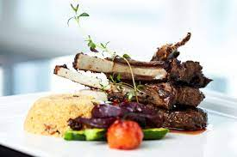
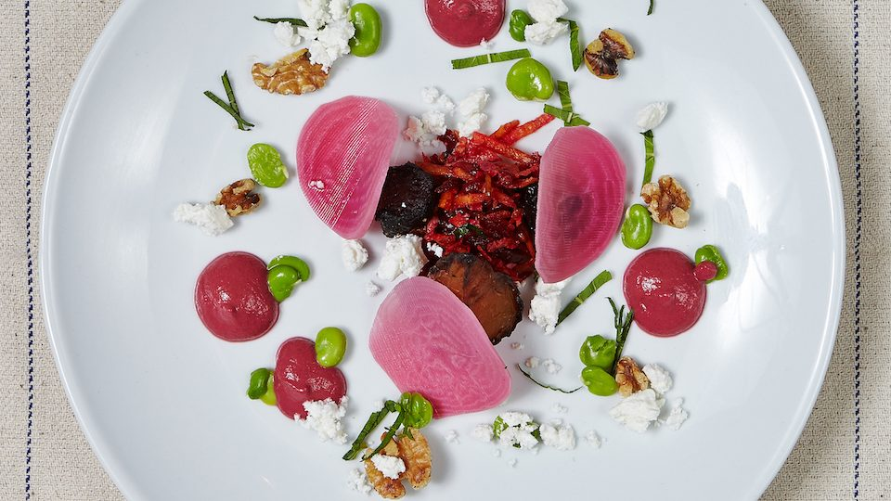

Practical skills
As well as learning new practical skills you will have some lessons where the focus is on presentation skills of a range of dishes.

Slide 9






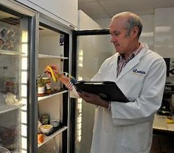


Career paths
Events Management
Product Development
Nutrition
There are many job opportunities in the Hospitality and Catering Industry, rather than being ‘just a chef’ or ‘just a waiter’.
Professional Cookery
Environmental Health
Education
Food Safety
Food Science
Catering

Slide 10

Thank you and good luck with your options!
Remember…
“ the choices you make today are what will shape your tomorrow”
What have you been working on?
The Design and Technology Department
‘Believe and Achieve’

