Slide 1
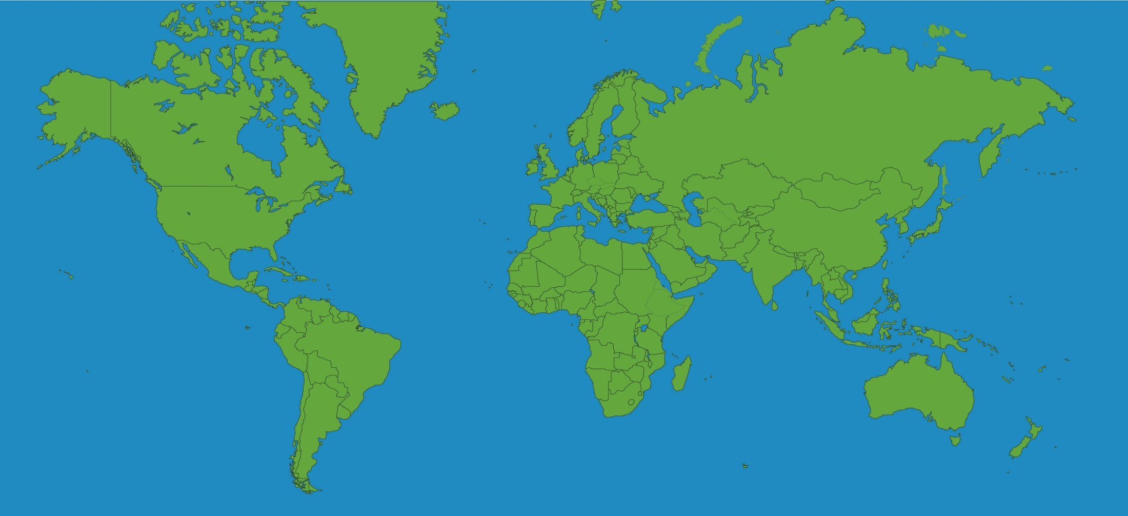
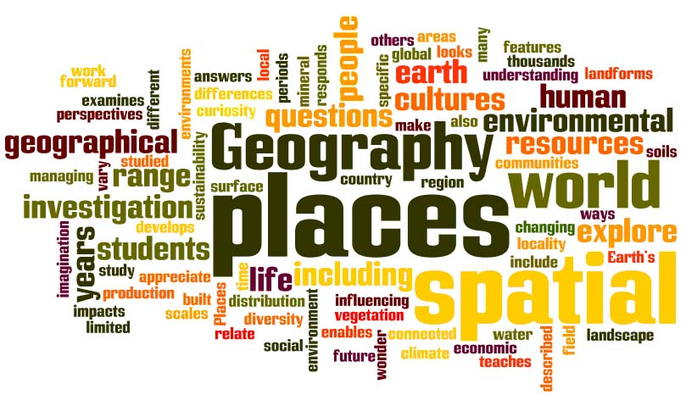
Welcome to Geography
AQA GCSE Geography (Syllabus code 8035)

Slide 2
Course content:
This GCSE Geography course covers areas in physical and human geography incorporated into a series of themes. Students will travel the world from the classroom, exploring case studies in the United Kingdom (UK), newly emerging economies (NEEs) and lower income countries (LICs). Topics of study include climate change, poverty, deprivation, global shifts in economic power and the challenge of sustainable resource use. Students are also encouraged to understand their role in society, by considering different viewpoints, values and attitudes.

Slide 3
The course and assessment structure
The course we follow at Hurstmere is AQA GCSE Geography (Syllabus code 8035). The examination format is 3 exams as follows:
Paper One (35%) : Living with the physical environment- The challenge of natural hazards, Physical landscapes in the UK, The living world, and Geographical skills.
Paper Two (35%): Challenges in the human environment-Urban issues and challenges, The changing economic world, The challenge of resource management, and Geographical skills
Paper Three(30%) : Geographical applications- Issue evaluation, Fieldwork, and Geographical skills

Slide 4
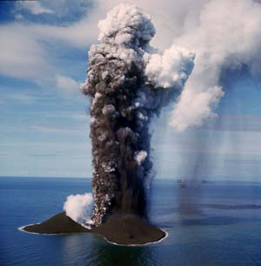
The Units of study
Over the course of the 2 years you will study physical and human geography incorporated into a series of themes and topics. Each will end with an exam style paper to assess understanding and track students progress.
The units of study are:
Living with the physical environment
Challenges in the human environment
Geographical applications
Geographical skills

Slide 5
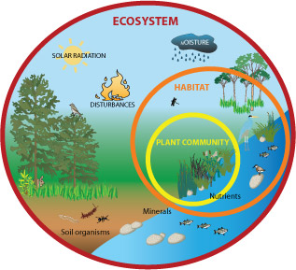
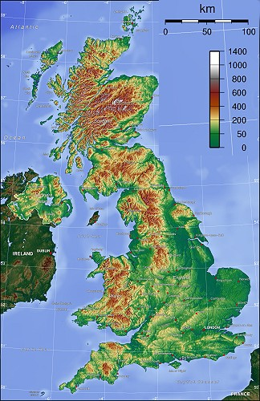
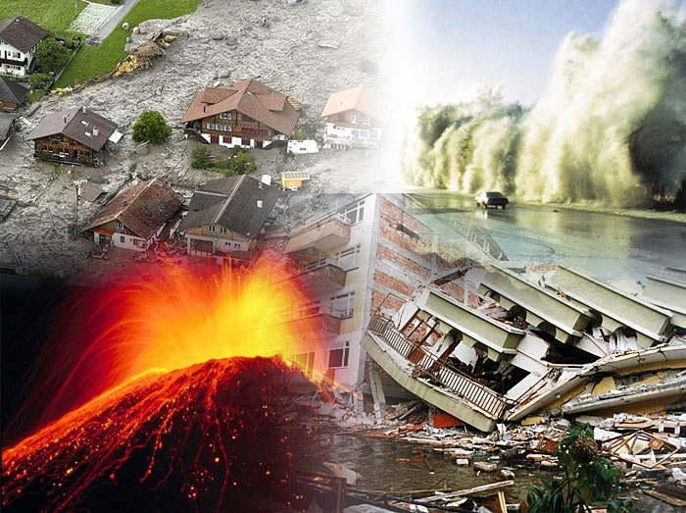
Living with the physical environment
The challenge of natural hazards
Physical landscapes in the UK
The living world

Slide 6
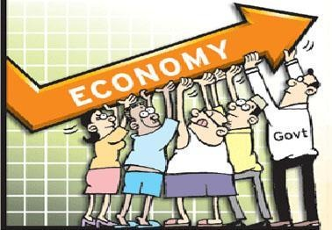
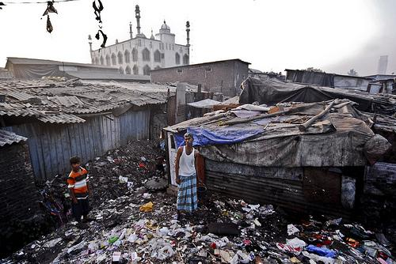
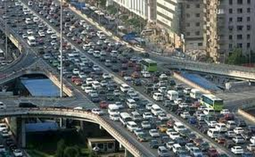
Challenges in the human environment
Urban issues and challenges
The changing economic world
Challenge of resource management

Slide 7
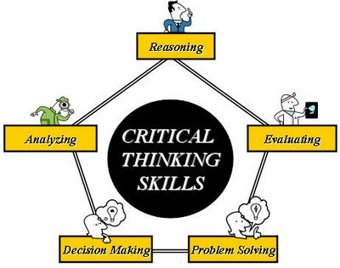
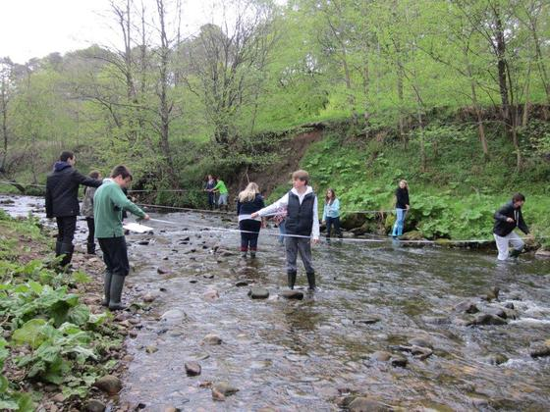
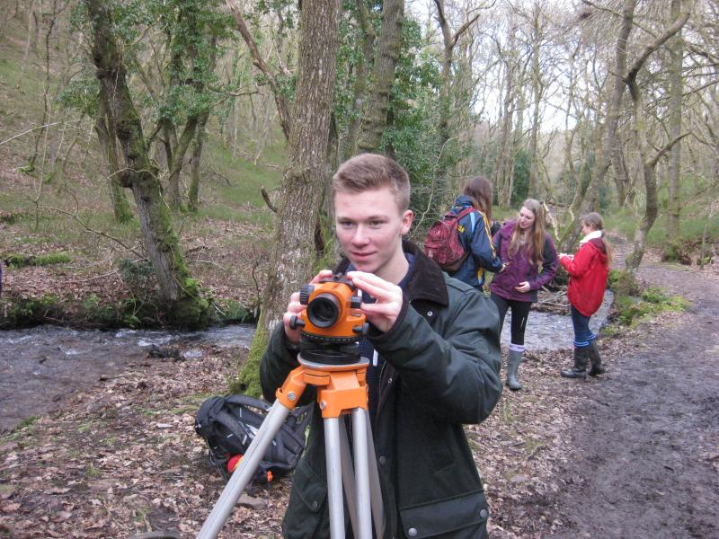
Geographical applications
Section A: Issue evaluation
Section B: Fieldwork

Slide 8
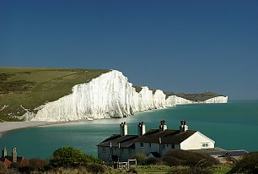
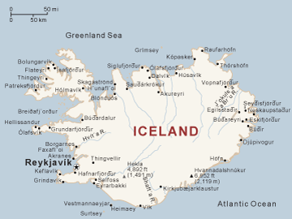
Fieldwork
Several opportunities for fieldwork will be in and around the school grounds however, as part of the course, students need to undertake two geographical enquiries in contrasting locations
This, therefore,means that fieldwork will have to take place away from the school (possibly a residential) and that there will be a cost implication for the cost of the fieldwork.
As a department we run a trip to Iceland in the Easter Holidays of Year 11 to look at lots of the things we learn about during the Geography course (however this trip is not exclusive to Geography students and is open to the whole year group).

Slide 9
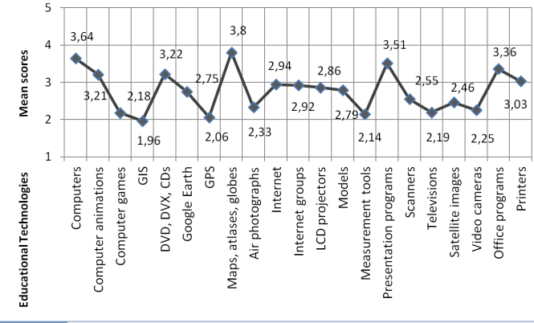
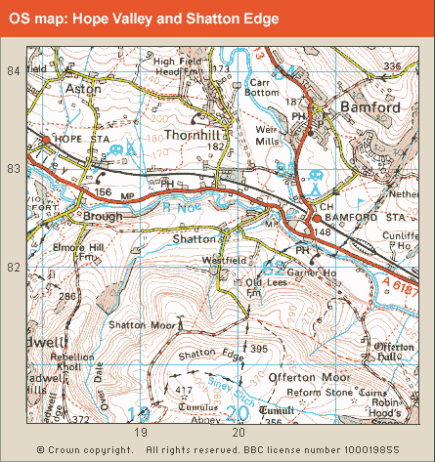
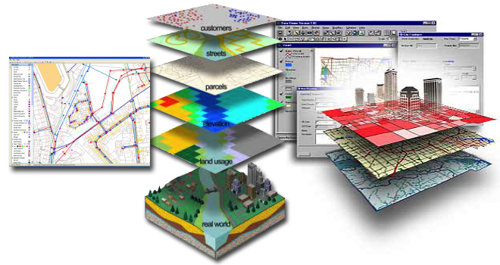
Geographical skills
Geographical skills (Ordnance Survey map work, photographic interpretation satellite imaging and data interpretation.)

Slide 10
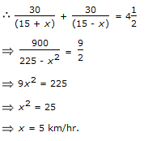
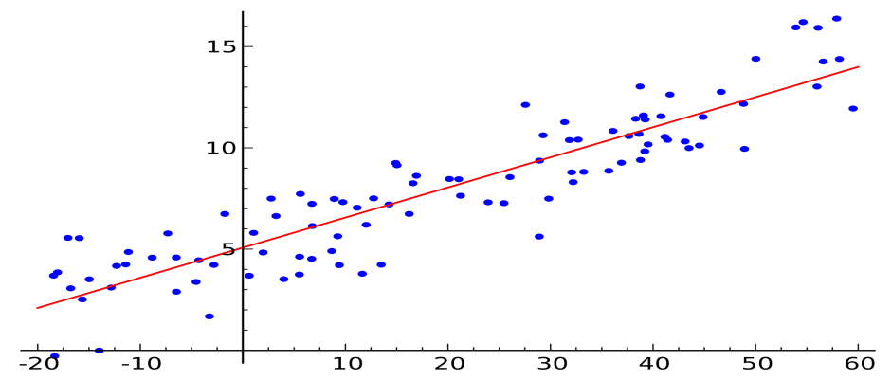
Geographical skills check list:
The following skills will be acquired by students studying GCSE Geography:
Cartographic skills
Graphical skills
Numerical skills
Statistical skills

Slide 11
Complementary subjects
There is quite a lot of overlap with what is studied on the Science Curriculum and what we do in Geography.

Slide 12
Progression and what Geography can do for you.
Geography (GCSE, A Level and Degree level) is highly regarded by employers as students cover real life and current issues in the world. Geographers also need good literacy skills for written communication and numeracy skills to analyse and produce data.
Some jobs that Geographers specialise in are…

Slide 13
Expedition leader
Travel agent
Exhibitions coordinator
Leisure centre management
Heritage site manager
Eco Tour guide
Tourist information officer
Visit (London) guide
Civil servant for DCMS
Travel writer
TV researcher
Holiday representative
Civil servant for DEFRA
Conservation worker
Environmental health officer
Architect or urban planner
Environmental engineer
Landscape architecture
Pollution analyst
Forestry manager
Environmental consultant
Environmental impact officer
Financial risk assessor
Banker
Accountant
Insurance
Transport/logistics manager
Retail management
Management consultant
Commercial sales
Lawyer
Economic adviser and analyst
Buyer
Location analyst
Planner
Housing manager
Surveyor
Estate agent
Town planner
Transport officer
Environmental engineer
Environmental consultant
GIS specialist
Census data specialist
Cartographer
Surveyor
Military GIS specialist
Remote sensing analyst
Geomatics software designer
CAD technician
Teacher
Social worker
Emergency services manager
FE or university lecturer
Exhibition designer and curator
Health education campaigner
Advertising executive
Human resources officer
Campaign organiser
Market research analyst
Public policy research
Marketing
PR Officer
Coastal engineer
Soil conservationist
Hydrologist
Earth scientist
Weather forecaster
Hazard prediction and management
Flood protection manager
Pollution analyst
Risk assessor
Weather presenter
Water supply coordinator

Slide 14
Expectations
We have high expectations in Geography.
GCSEs are VERY important for a student's future and each lesson is as important as every other one. ANYTHING you have learnt can come up on the exam!
Therefore behaviour and work ethic must be exemplary otherwise students fall behind and struggle to catch up or spoil other students' learning.

