Slide 1
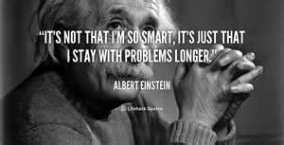
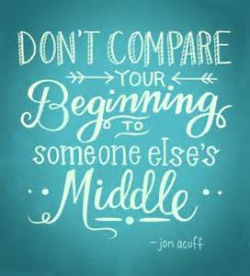
2025 Introduction
New AQA
GCSE Science
Trilogy and
Separate:
Biology, Chemistry, Physics

Slide 2
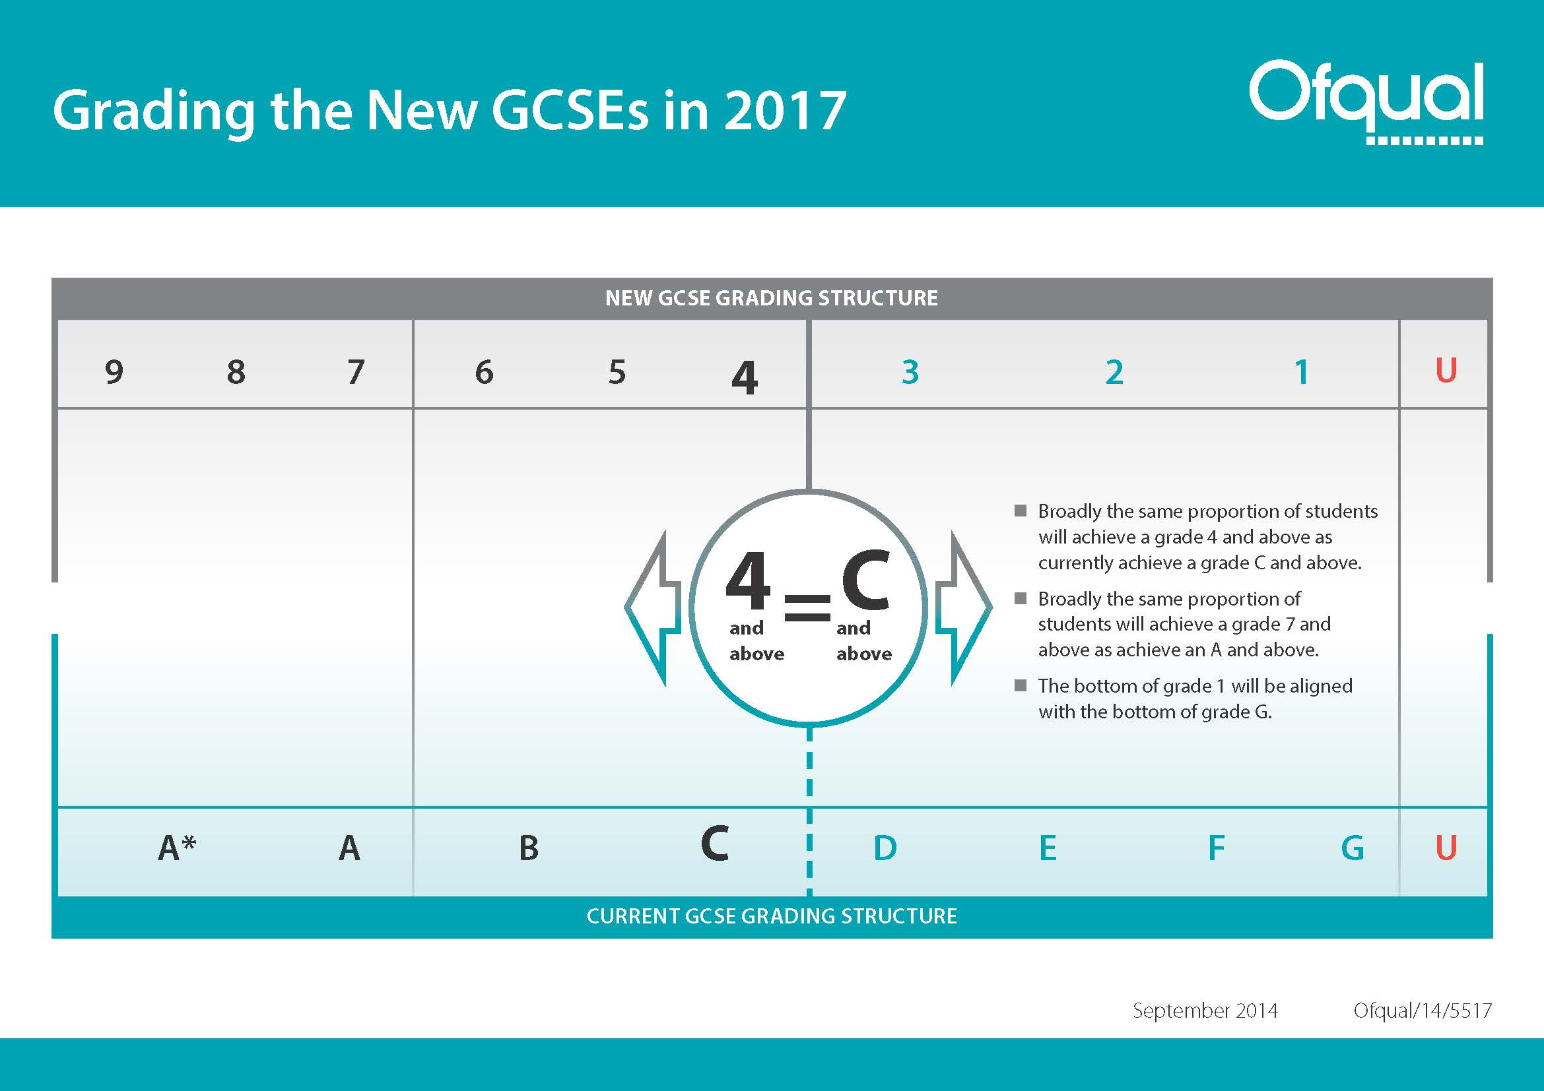
Higher Tier 9 - 4
Foundation Tier 5 - 1
Same tier of entry for all subjects
Notes:
4 = C
7 = A
Allows for more differentiation at the top end

Slide 3
Assessment Objectives and Maths
 | Assessment Objectives | Weighting
AO1 | Demonstrate knowledge and understanding of: Scientific ideas and processes Scientific techniques and procedures | 40%
AO2 | Apply knowledge and understanding of: Scientific ideas and processes Scientific techniques and procedures | 40%
AO3 | Analyse, interpret and evaluate scientific ideas, information and evidence to make judgements and reach conclusions | 20%
Notes:
Updated from information given on 16th July 2015
Importance of Assessment objectives and weighting as this will influence way you teach . Similar to current specifications
Balances in current specifications:
AO1 recall (37.5%)
AO2 Apply in practical and other context (35%)
AO3 Analyse and evaluate evidence , make reasoned judgements and draw conclusions based on evidence 27.5%
Working being done presently to support Maths teaching working with ASE and xampro have already tagged all the current questions to maths criteria so you can search on maths skills but more work will be done on this
ASE “Language of measurement” used throughout

Slide 4
Two options: Separate and Trilogy
9-9
9-8
8-8
8-7
7-7
7-6
6-6
6-5
5-5
5-4
4-4
4-3
3-3
3-2
2-2
2-1
1-1
Three GCSEs – separate sciences
Two GCSEs – double science
There is also a ‘Synergy’ version.
Combined GCSE is a double award, you will be awarded two grades.
A grading scale with 17 possibilities will be used.
Three separate grades are awarded.

Slide 5
Biology subject content
1. Cell biology
Within some units there is some exclusive separate science (biology only) content.
2. Organisation
3. Infection and response
4. Bioenergetics
5. Homeostasis and response
6. Inheritance, variation and evolution
7. Ecology

Slide 6
Biology subject content - Trilogy
1. Cell biology
Within some units there is some exclusive separate science (biology only) content.
2. Organisation
3. Infection and response
4. Bioenergetics
5. Homeostasis and response
6. Inheritance, variation and evolution
7. Ecology

Slide 7
Chemistry subject content
1. Atomic structure and the periodic table
2. Bonding, structure and the properties of matter
3. Quantitative chemistry
4. Chemical changes
5. Energy changes
6. The rate and extent of chemical change
7. Organic chemistry
8. Chemical analysis
9. Chemistry of the atmosphere
Within some units there is some exclusive separate science (chemistry only) content.
10. Using resources

Slide 8
Chemistry subject content - Trilogy
8. Atomic structure and the periodic table
9. Bonding, structure and the properties of matter
10. Quantitative chemistry
11. Chemical changes
12. Energy changes
13. The rate and extent of chemical change
14. Organic chemistry
15. Chemical analysis
16. Chemistry of the atmosphere
Within some units there is some exclusive separate science (chemistry only) content.
17. Using resources

Slide 9
Physics subject content
1. Energy
Within some units there is some exclusive separate science (physics only) content.
2. Electricity
3. Particle model of matter
4. Atomic structure
5. Forces
6. Waves
7. Magnetism and electromagnetism
8. Space physics
Space physics is only in separate GCSE Physics (8463)

Slide 10
Physics subject content - Trilogy
18. Energy
Within some units there is some exclusive separate science (physics only) content.
19. Electricity
20. Particle model of matter
21. Atomic structure
22. Forces
23. Waves
24. Magnetism and electromagnetism

Slide 11
Compulsory practical work, 15 % of exam - 10 investigations for each single GCSE,
21 investigations for Trilogy
Biology | Chemistry | Physics
1. Use a light microscope to observe, draw and label a selection of plant and animal cells. A magnification scale must be included. | 1. Preparation of a pure, dry sample of a soluble salt from an insoluble oxide or carbonate. | 1. Determine the specific heat capacity. Linking the decrease of one energy store to the increase in temperature.
2. Effect of antiseptics or antibiotics on bacterial growth using agar plates and measuring zones of inhibition. (Biology only). | 2. Titration – determining reacting volumes (HT only), determination of the concentration of one of the solutions in mol/dm³ and g/dm³ (Chemistry only) | 2. Effectiveness of different materials as thermal insulators and the factors that may affect the thermal insulation properties of a material. (Physics only)
3. Effect of a range of concentrations of salt or sugar solutions on the mass of plant tissue. | 3. Electrolysis of aqueous solutions. An investigation involving developing a hypothesis. | 3. Factors affecting the resistance of electrical circuits, including: length of a wire, resistors in series and parallel.
4. Use qualitative reagents to test for a range of carbohydrates, lipids and proteins. | 4. Variables that affect temperature changes in reacting solutions – acid plus metals, acid plus carbonates, neutralisation, displacement of metals. | 4. Investigate I-V characteristics of a filament lamp, a diode, and a resistor at constant temperature.
5. Effect of pH on the rate of reaction of amylase enzyme. | 5. Changes in concentration affecting the rates of reactions, methods involving: measuring the volume of a gas, change in turbidity. An investigation involving developing a hypothesis. | 5. Determine the densities of regular and irregular shaped objects. Dimensions to be measured using ruler, micrometer or Vernier callipers. Displacement technique for irregularly shaped objects.
6. Effect of light intensity on the rate of photosynthesis using an aquatic organism such as pondweed. | 6. Paper chromatography. Calculation of R_{f} values. | 6. Relationship between force and extension for a spring.
7. Effect of a factor on human reaction time. | 7. Use of chemical tests to identify the ions in unknown single ionic compounds covering the ions from sections FLAME TESTS through to SULFATES. (Chemistry only) | 7. Effect of varying the force on the acceleration of an object of constant mass. Effect of varying the mass of an object on the acceleration produced by a constant force.
8. Effect of light or gravity on the growth of newly germinated seedlings (Biology only) | 8. Analysis and purification of water samples from different sources, including pH, dissolved solids and distillation. | 8. Make observations to identify the suitability of apparatus to measure the speed of waves in a ripple tank and waves in a solid and take appropriate measurements.
9. Use sampling techniques to investigate the effect of a factor on the distribution of a common species. |  | 9. Reflection by different types of surface. Refraction by different substances (Physics only).
10. Effect of temperature on the rate of decay of fresh milk by measuring pH change. (Biology only) |  | 10. How the amount of infrared radiation absorbed or radiated by a surface depends on the nature of that surface.

Slide 12
Compulsory practical work, 15 % of exam - 10 investigations for each single GCSE,
Biology | Chemistry | Physics
1. Use a light microscope to observe, draw and label a selection of plant and animal cells. A magnification scale must be included. | 1. Preparation of a pure, dry sample of a soluble salt from an insoluble oxide or carbonate. | 1. Determine the specific heat capacity. Linking the decrease of one energy store to the increase in temperature.
2. Effect of antiseptics or antibiotics on bacterial growth using agar plates and measuring zones of inhibition. (Biology only). | 2. Titration – determining reacting volumes (HT only), determination of the concentration of one of the solutions in mol/dm³ and g/dm³ (Chemistry only) | 2. Effectiveness of different materials as thermal insulators and the factors that may affect the thermal insulation properties of a material. (Physics only)
3. Effect of a range of concentrations of salt or sugar solutions on the mass of plant tissue. | 3. Electrolysis of aqueous solutions. An investigation involving developing a hypothesis. | 3. Factors affecting the resistance of electrical circuits, including: length of a wire, resistors in series and parallel.
4. Use qualitative reagents to test for a range of carbohydrates, lipids and proteins. | 4. Variables that affect temperature changes in reacting solutions – acid plus metals, acid plus carbonates, neutralisation, displacement of metals. | 4. Investigate I-V characteristics of a filament lamp, a diode, and a resistor at constant temperature.
5. Effect of pH on the rate of reaction of amylase enzyme. | 5. Changes in concentration affecting the rates of reactions, methods involving: measuring the volume of a gas, change in turbidity. An investigation involving developing a hypothesis. | 5. Determine the densities of regular and irregular shaped objects. Dimensions to be measured using ruler, micrometer or Vernier callipers. Displacement technique for irregularly shaped objects.
6. Effect of light intensity on the rate of photosynthesis using an aquatic organism such as pondweed. | 6. Paper chromatography. Calculation of R_{f} values. | 6. Relationship between force and extension for a spring.
7. Effect of a factor on human reaction time. | 7. Use of chemical tests to identify the ions in unknown single ionic compounds covering the ions from sections FLAME TESTS through to SULFATES. (Chemistry only) | 7. Effect of varying the force on the acceleration of an object of constant mass. Effect of varying the mass of an object on the acceleration produced by a constant force.
8. Effect of light or gravity on the growth of newly germinated seedlings (Biology only) | 8. Analysis and purification of water samples from different sources, including pH, dissolved solids and distillation. | 8. Make observations to identify the suitability of apparatus to measure the speed of waves in a ripple tank and waves in a solid and take appropriate measurements.
9. Use sampling techniques to investigate the effect of a factor on the distribution of a common species. |  | 9. Reflection by different types of surface. Refraction by different substances (Physics only).
10. Effect of temperature on the rate of decay of fresh milk by measuring pH change. (Biology only) |  | 10. How the amount of infrared radiation absorbed or radiated by a surface depends on the nature of that surface.

Slide 13
Compulsory practical work, 15 % of exam - 10 investigations for each single GCSE,
21 investigations for Trilogy
Biology | Chemistry | Physics
1. Use a light microscope to observe, draw and label a selection of plant and animal cells. A magnification scale must be included. | 1. Preparation of a pure, dry sample of a soluble salt from an insoluble oxide or carbonate. | 1. Determine the specific heat capacity. Linking the decrease of one energy store to the increase in temperature.
2. Effect of antiseptics or antibiotics on bacterial growth using agar plates and measuring zones of inhibition. (Biology only). | 2. Titration – determining reacting volumes (HT only), determination of the concentration of one of the solutions in mol/dm³ and g/dm³ (Chemistry only) | 2. Effectiveness of different materials as thermal insulators and the factors that may affect the thermal insulation properties of a material. (Physics only)
3. Effect of a range of concentrations of salt or sugar solutions on the mass of plant tissue. | 3. Electrolysis of aqueous solutions. An investigation involving developing a hypothesis. | 3. Factors affecting the resistance of electrical circuits, including: length of a wire, resistors in series and parallel.
4. Use qualitative reagents to test for a range of carbohydrates, lipids and proteins. | 4. Variables that affect temperature changes in reacting solutions – acid plus metals, acid plus carbonates, neutralisation, displacement of metals. | 4. Investigate I-V characteristics of a filament lamp, a diode, and a resistor at constant temperature.
5. Effect of pH on the rate of reaction of amylase enzyme. | 5. Changes in concentration affecting the rates of reactions, methods involving: measuring the volume of a gas, change in turbidity. An investigation involving developing a hypothesis. | 5. Determine the densities of regular and irregular shaped objects. Dimensions to be measured using ruler, micrometer or Vernier callipers. Displacement technique for irregularly shaped objects.
6. Effect of light intensity on the rate of photosynthesis using an aquatic organism such as pondweed. | 6. Paper chromatography. Calculation of R_{f} values. | 6. Relationship between force and extension for a spring.
7. Plan and carry out an investigation into the effect of a factor on human reaction time. | 7. Use of chemical tests to identify the ions in unknown single ionic compounds covering the ions from sections FLAME TESTS through to SULFATES. (Chemistry only) | 7. Effect of varying the force on the acceleration of an object of constant mass. Effect of varying the mass of an object on the acceleration produced by a constant force.
8. Effect of light or gravity on the growth of newly germinated seedlings (Biology only) | 8. Analysis and purification of water samples from different sources, including pH, dissolved solids and distillation. | 8. Make observations to identify the suitability of apparatus to measure the speed of waves in a ripple tank and waves in a solid and take appropriate measurements.
9. Use sampling techniques to investigate the effect of a factor on the distribution of a common species. |  | 9. Reflection by different types of surface. Refraction by different substances (Physics only).
10. Effect of temperature on the rate of decay of fresh milk by measuring pH change. (Biology only) |  | 10. How the amount of infrared radiation absorbed or radiated by a surface depends on the nature of that surface.
1
8
14
2
9
15
3
10
16
4
11
17
5
12
18
6
19
13
20
7
21
Notes:
I have summarised the required practicals in order to make the descriptions ‘fit’ on one table. Please refer to the full descriptions in the specification. The red outline means that the practical has been added to the original draft specification.

Slide 14
Mathematics requirements: There are formulas that will have to be learnt.
The following mathematical skills are needed.
1. Arithmetic and numerical computation
Use decimals. Use standard form. Use ratios, fractions and percentages. Make estimates.
2. Handling data Use significant figures. Find arithmetic means. Construct and interpret frequency tables and diagrams, bar charts and histograms. Understand sampling (Biology questions only). Understand simple probability (Biology questions only) Understand mean, mode and median. Use a scatter diagram to identify a correlation (Biology and Physics questions only). Make order of magnitude calculations.
3. Algebra Understand and use symbols: =, <, <<, >>, >, α, ∼. Change the subject of an equation. Substitute numerical values into algebraic equations, using appropriate units (Chemistry and Physics questions). Solve simple algebraic equations (Biology and Physics).
4. Graphs Translate information between graphical and numeric form. Understand that y = mx + c represents a linear relationship. Plot two variables. Determine the slope and intercept of a linear graph. Draw and use the slope of a tangent to a curve as a measure of rate of change (Chemistry and Physics questions only). Understand the significance of area between a curve and the x-axis and measure it by counting squares as appropriate (Physics questions only).
5. Geometry and trigonometry Use angular measures (Physics questions only). 2D and 3D forms (Chemistry and Physics questions only). Calculate areas of triangles and rectangles, surface areas and volumes of cubes.
Notes:
The maths requirements have been summarised. The next slides have the full specification from the Trilogy specification.

Slide 16
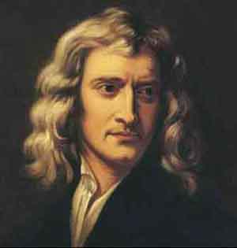
Working scientifically WS
Development of scientific thinking.
Experimental skills and strategies.
Analysis and Evaluation.
Scientific vocabulary, quantities, units, symbols and nomenclature.
“ If I have seen further
it is by standing on the
shoulder of giants.”
Sir Isaac Newton 1642-1727

Slide 21
Assessment – Exams at end of Y11
 | Biology | Chemistry | Physics
Paper 1 | Topics 1 – 4 | Topics 1 – 5 | Topics 1-4
Paper 2 | Topics 5 - 7 | Topics 6 – 10 | Topics 5-7 (+8 Physics only)
 | Trilogy | Separate Science
Number of papers per qualification | 6 | 2
Questions | Multiple choice, structured, closed short answer, and open response
Length of papers | 1 hour and 15 mins | 1 hour and 45 mins
Marks per paper | 70 | 100
Notes:
The aka refers to the topic numbers in the Trilogy specification.

