Slide 1

Curriculum Lead – Miss A Whiteland
Art and Design GCSE
Year 9 Options
Notes:
Class discuss to gain understanding of their current knowledge about the course...

Slide 2
Art and Design GCSE
Course structure…
AQA Art and Design (Fine Art) GCSE
60% Coursework + 40% Externally set task
Coursework (60%)…
AT LEAST two complete projects which include sketchbook investigations, record folder and final piece.
Externally set task (40%)…
AQA will issue an exam paper in the January of your Y11 studies. This exam paper will have different project headings. You will be required to choose 1 title and then you will have 10 weeks to create a sketchbook investigating this theme and exploring final piece ideas. Following this 10 week period, you will sit a 10 hour exam and during this time you will create the final piece you have planned in your sketchbook.

Slide 3
Art and Design GCSE
Important things to remember…
EVERY SINGLE THING you do from this point onward will affect your GCSE grade. Every lesson, every task and every homework is designed as part of your coursework project which means it requires 100% effort and you should always complete things to the very best of your ability.
Studying GCSE Art requires a high level of maturity and independence, we want each of you to create work which is personal and creative.
Organisation is KEY, ensure you keep all of your work safe, never throw anything away and keep your sketchbook in a clear, understandable order..
Enjoy yourself – this is your opportunity to be creative and express yourself whilst developing skills, knowledge and understanding that are very relevant to the modern world.
Your sketchbooks are worth 75% of your grade.

Slide 4
Art and Design GCSE
Why study Art and Design GCSE?
Art is a 100% practical based coursework subject
It allows you to use your imagination and creativity.
You will learn time management and organisation skills.
You will use a variety of different materials including oil pastels, acrylic paint and watercolours and be able to develop your own style.

Slide 5
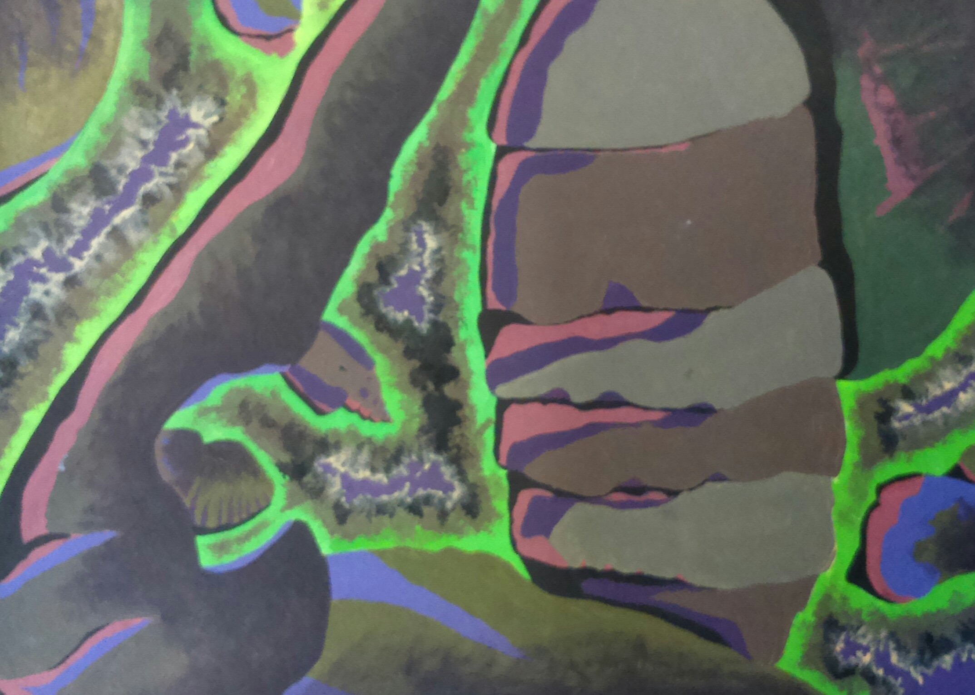
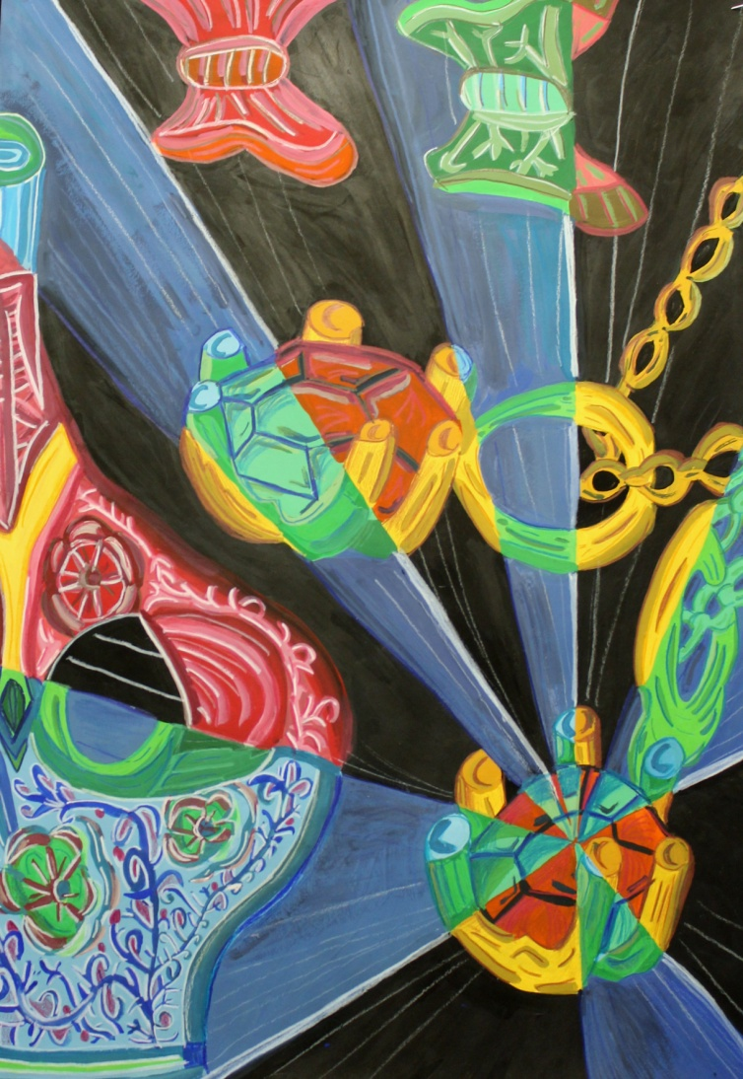
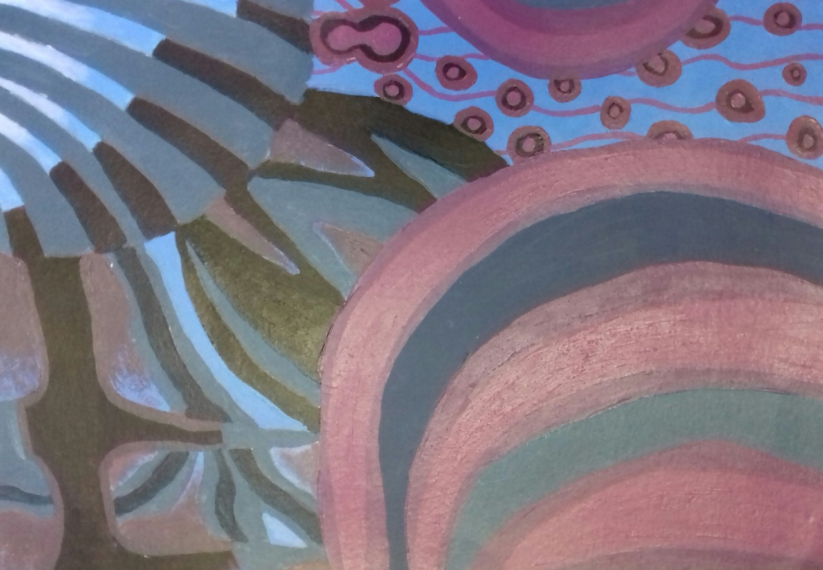
Assessment…
All of your work will be marked against four assessment objectives and it is really important that you know and understand these so that you know exactly how to achieve.
Research different artists, try out their style and write about their artwork.
Analyse the work that you create referring back to your theme.
Try things in lots of different ways.
Create artworks for different purposes.
Investigate and plan relevant ideas.
Record your visits to art galleries.
Assessment Objective 1 (AO1)
Develop ideas through investigations, demonstrating critical understanding of sources.
How can you achieve this?

Slide 6
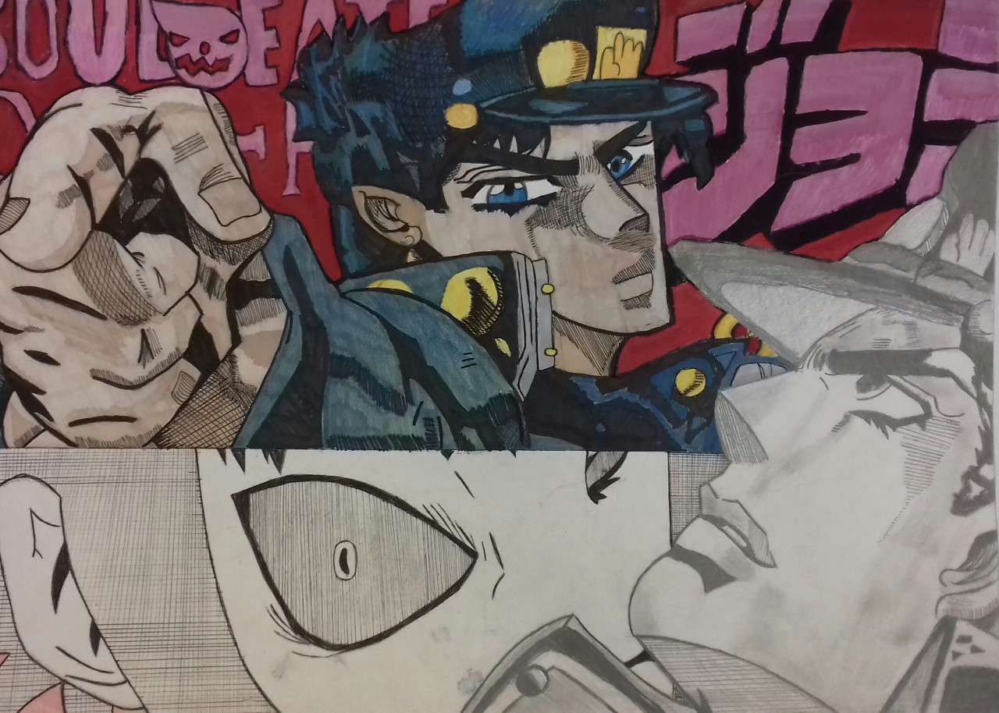
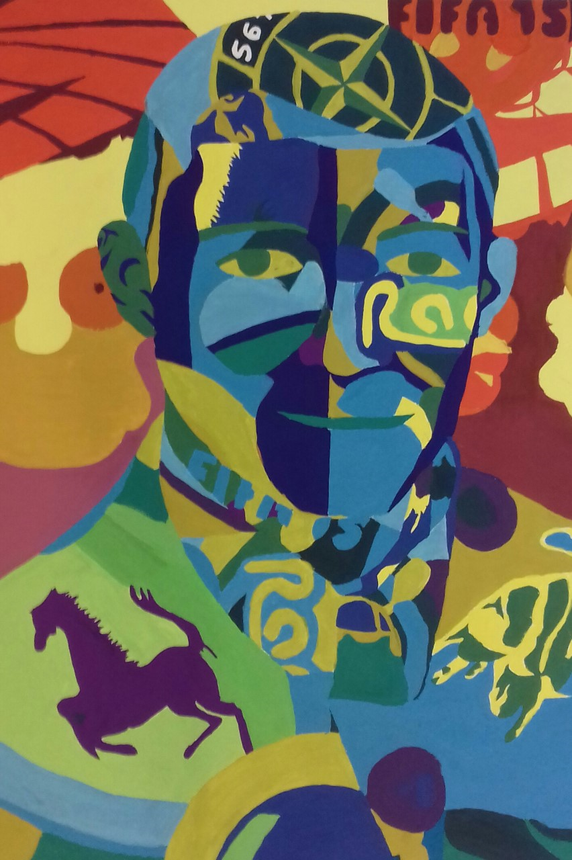
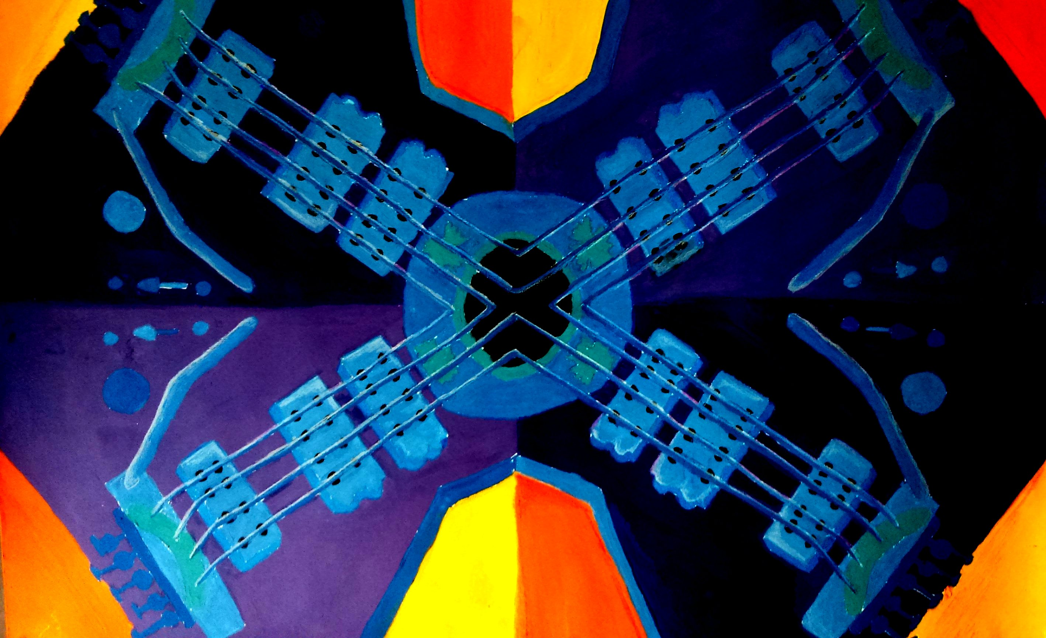
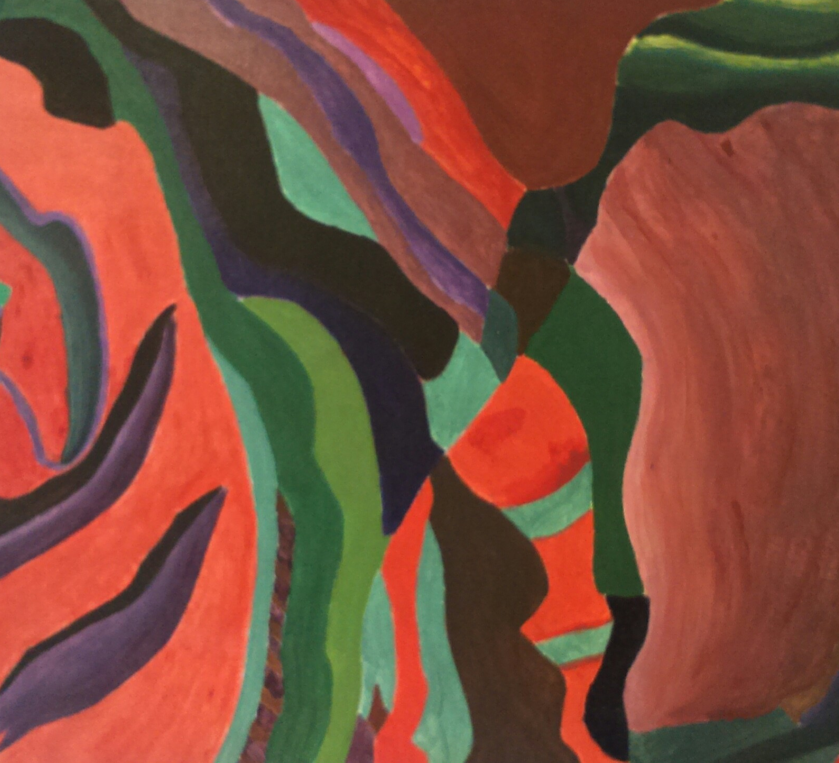
Assessment Objective 2 (AO2)
Refine work by exploring ideas, selecting and experimenting with appropriate media, materials, techniques and processes.
Create work using lots of different styles and techniques.
Analyse and evaluate your work, changing it as you go to make it better.
Refine and develop – Always think, how can this be more successful?
Take risks and, if something didn’t work, explain why to show your understanding.
Design a range of different ideas.
How can you achieve this?

Slide 7
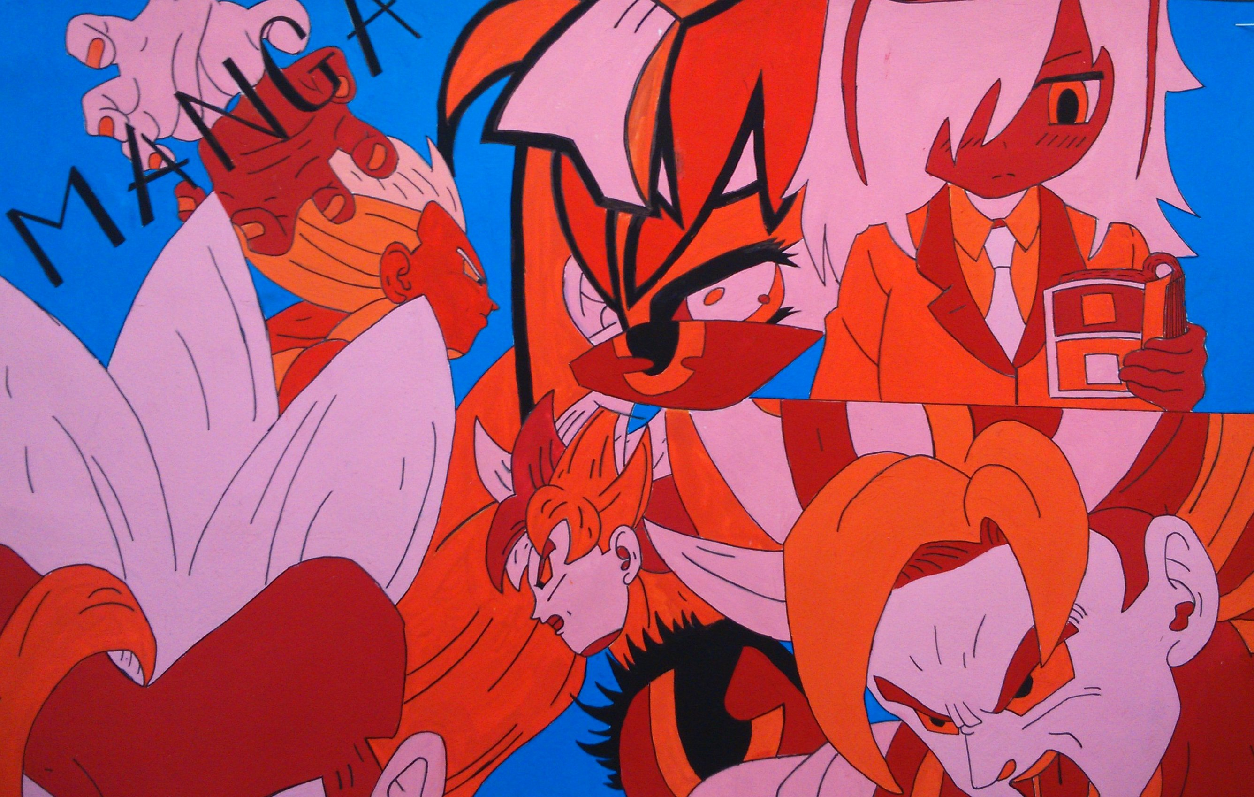
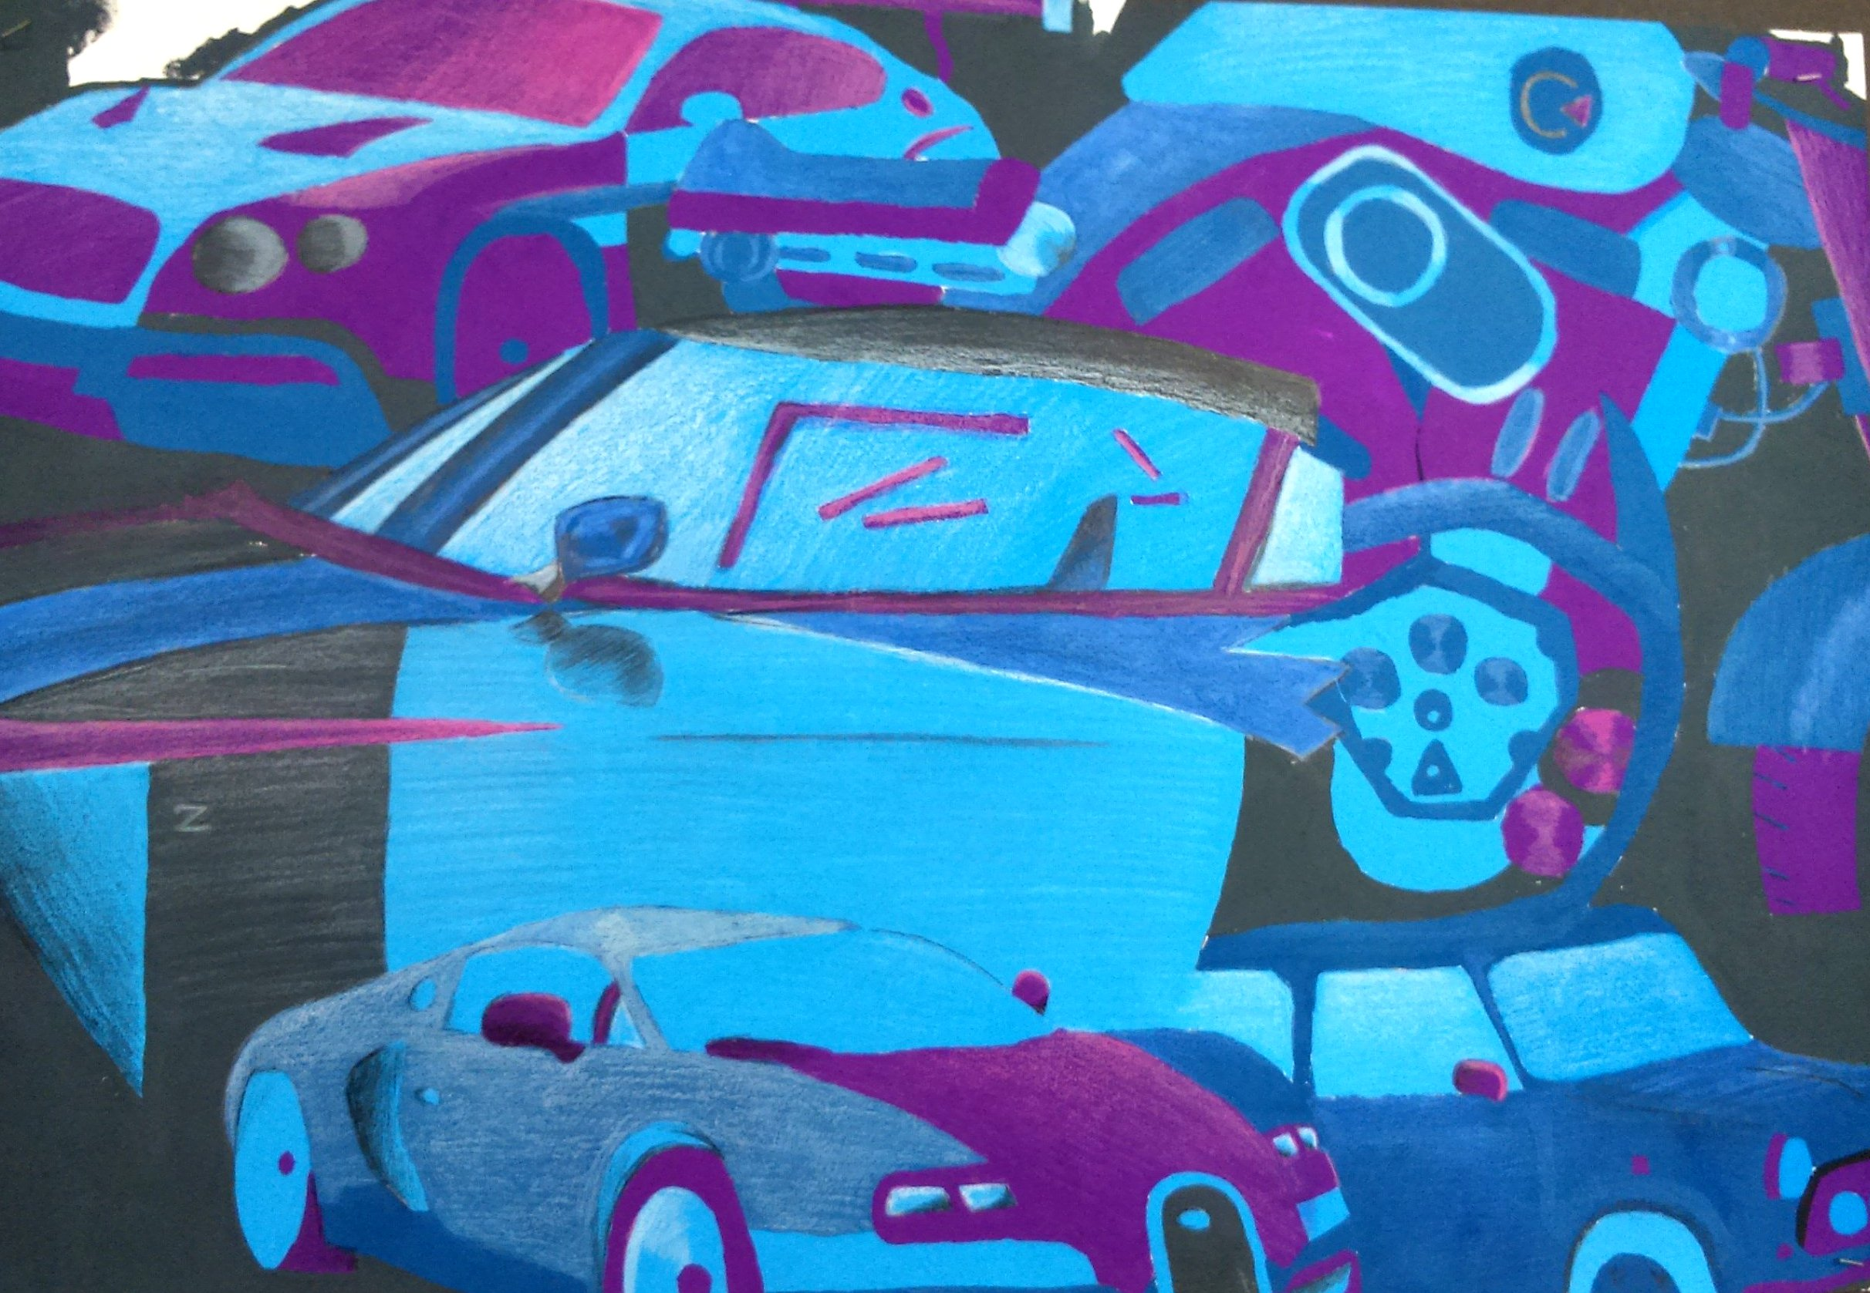
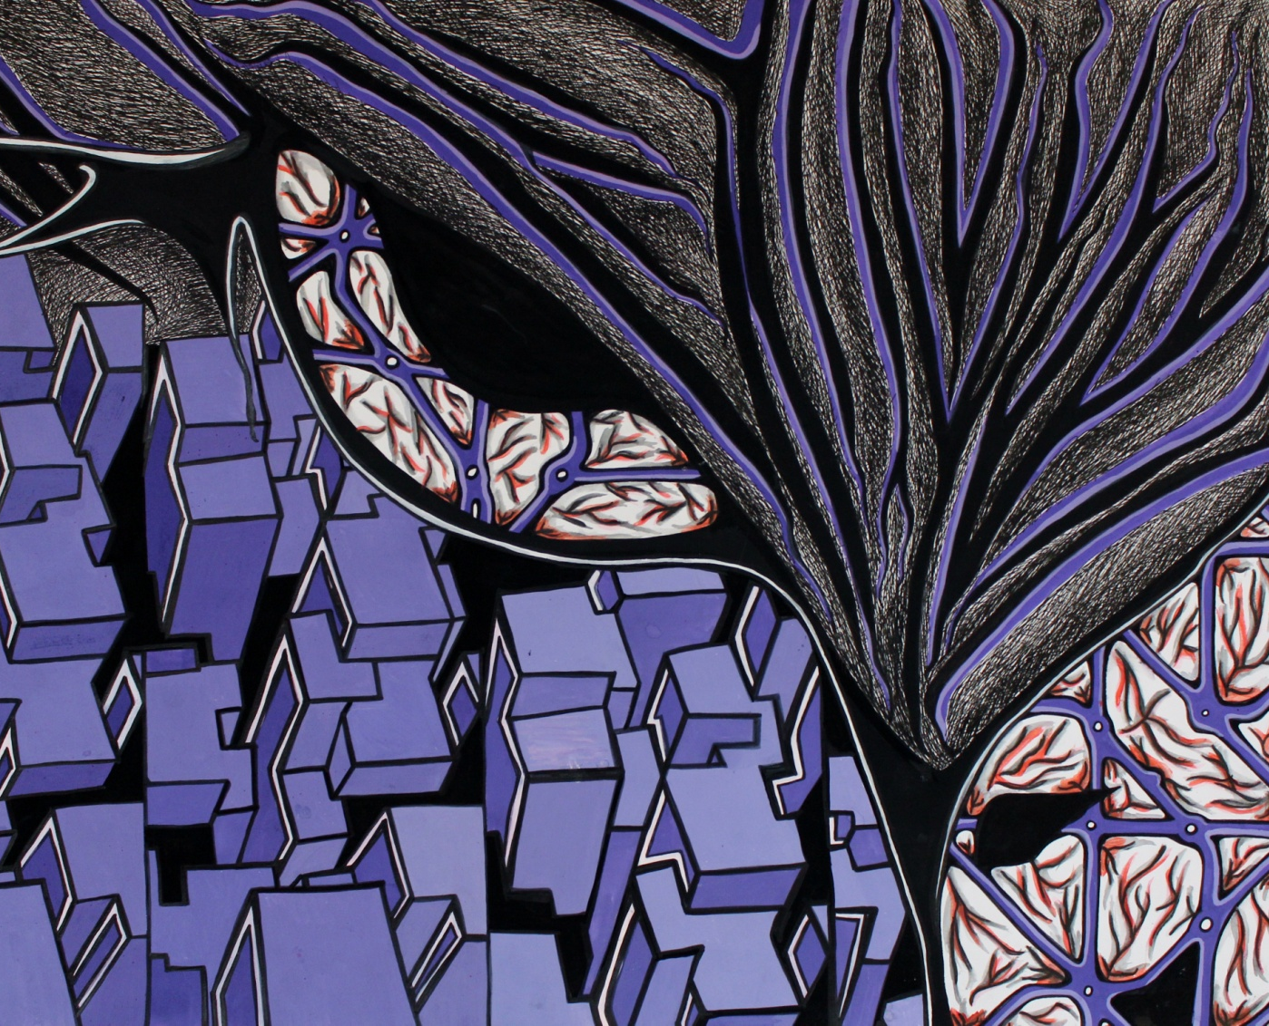
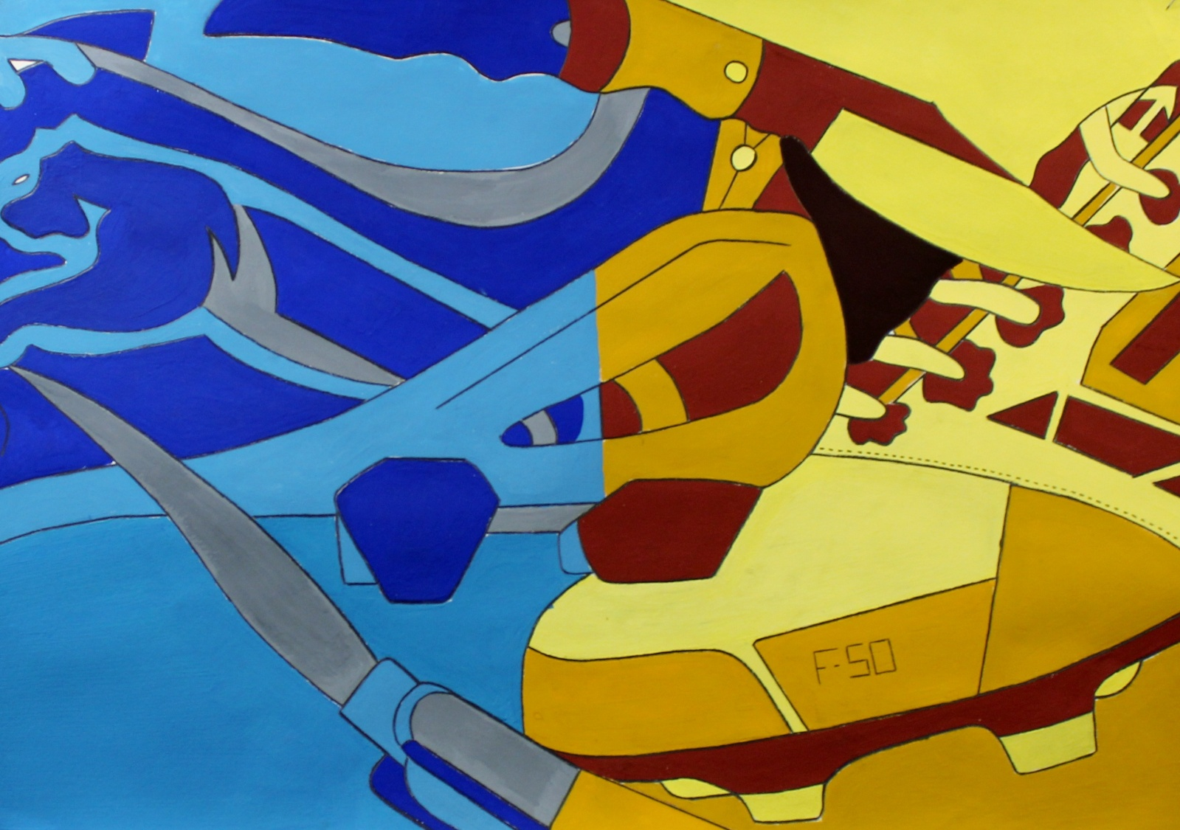
Assessment Objective 3 (AO3)
Record ideas, observations and insights relevant to intentions as work progresses.
Use art specific terminology and show you understand the technical side of drawing/painting.
Create high quality artworks relevant to your area of study.
Present your ideas and thoughts using drawing, writing and photographs.
Analyse your own work and the work of others.
Explain your thought process and the artistic decisions you make.
Ensure your work is clearly presented.
Ensure there is meaning and purpose behind your work – concept.
How can you achieve this?

Slide 8
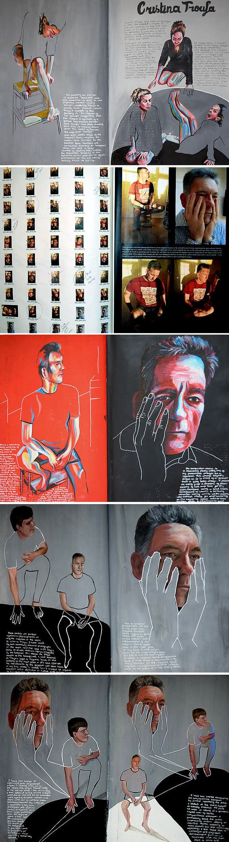
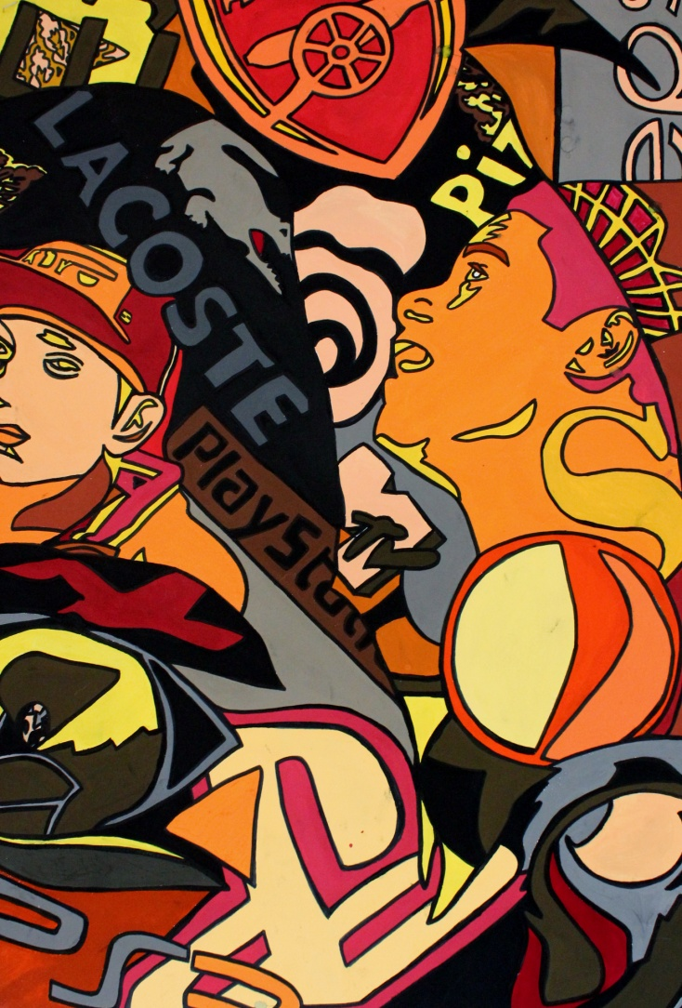
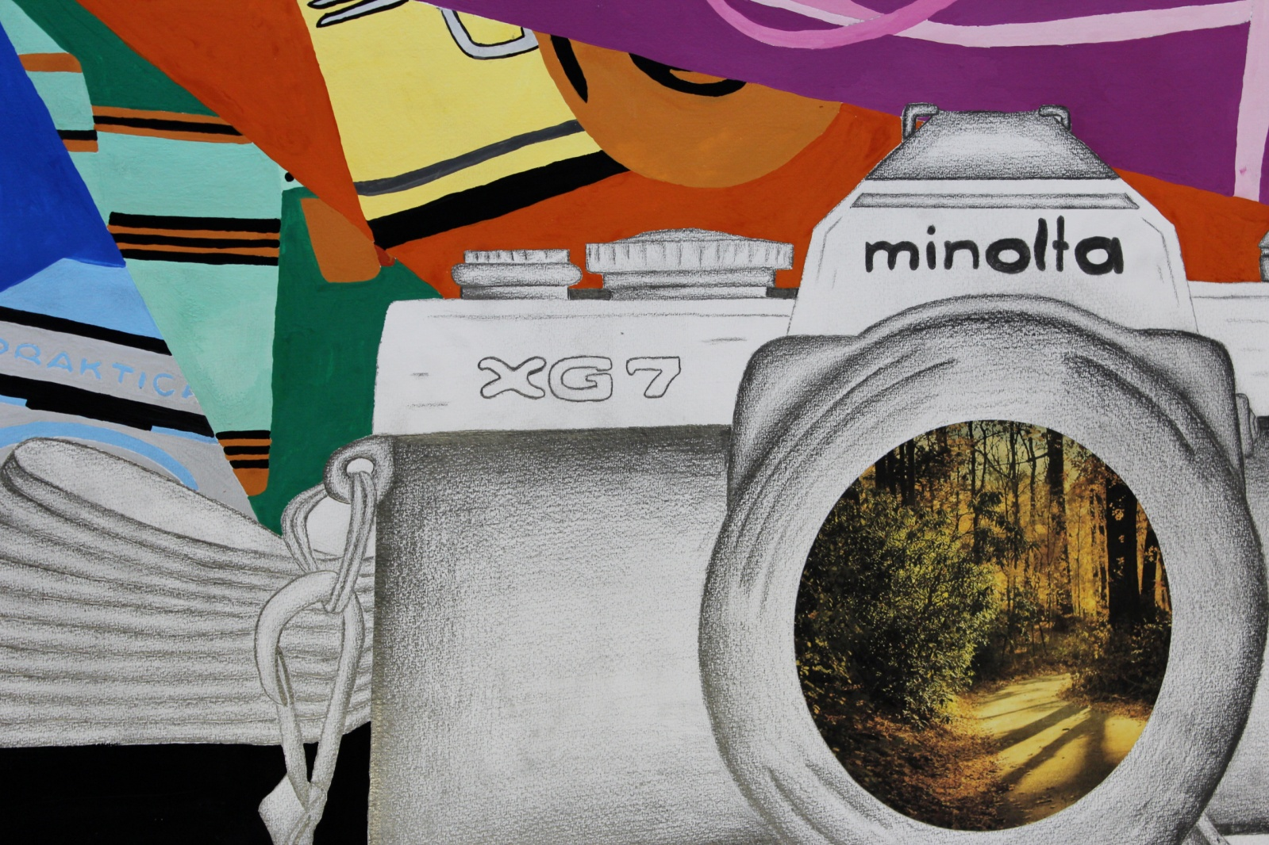
Assessment Objective 4 (AO4)
Present a personal and meaningful response that realises intentions and demonstrates understanding of visual language.
Plan possible ideas in your sketchbook.
Ensure your final piece has a clear meaning and purpose.
Experiment with different ways of communicating your meaning.
Create a highly skilled final outcome which is clearly linked to your sketchbook investigation.

Slide 9
Art and Design GCSE
Possible Career Paths – Art GCSE
Animation
Art Therapy
Architect
Artist
Education
Film
Graphic Design
Photography
Tattoo Artist
Interior Design
Website Designer
Notes:
Class discuss to gain understanding of their current knowledge about the course...

