Slide 1
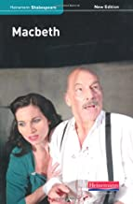
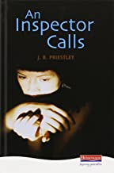
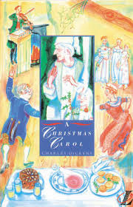
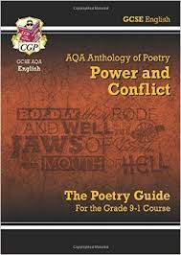

AQA
GCSE English Language and English Literature

Slide 2
The English course is compulsory and provides opportunities to develop skills in speaking, listening, reading and writing in a wide variety of contexts.
Pupils will be engaged in studying for two separate GCSE examinations in this subject: English Language and English Literature.
Exam Board: AQA
Syllabus Numbers:
Language 8700
Literature 8702

Slide 3

English Language

Slide 4
English Language GCSE
Paper 1: Explorations in Creative Reading and Writing | + | Paper 2: Writers' Viewpoints and Perspectives | + | Non-examination Assessment: Spoken Language
What's assessed Section A: Reading one literature fiction text Section B: Writing descriptive or narrative writing |  | What's assessed Section A: Reading one non-fiction text and one literary non-fiction text Section B: Writing writing to present a viewpoint |  | What's assessed (AO7-AO9) presenting responding to questions and feedback use of standard English
Assessed written exam: 1 hour 45 minutes 80 marks 50% of GCSE |  | Assessed written exam: 1 hour 45 minutes 80 marks 50% of GCSE |  | Assessed Teacher set throughout course Marked by teacher Separate endorsement (0% weighting of GCSE)
Questions Reading (40 marks) (25%) – one single text 1 short form question (1 x 4 marks) 2 longer form questions (2 x 8 marks) 1 extended question (1 x 20 marks) |  | Questions Reading (40 marks) (25%) – two linked texts 1 short form question (1 x 4 marks) 2 longer form questions (1 x 8, 1 x 12 marks) 1 extended question (1 x 16 marks)
Writing (40 marks) (25%) 1 extended writing question (24 marks for content, 16 marks for technical accuracy) |  | Writing (40 marks) (25%) 1 extended writing question (24 marks for content, 16 marks for technical accuracy)
All texts in the examination will be unseen

Slide 5


English Language Paper 1
1 hour and 45 minutes: includes 15 minutes reading time
Section A:
40 marks for reading (25% of the qualification)
4 reading questions: 4+8+8+20 marks
Section B:
40 marks for writing (25% of the qualification)
1 writing question: 24+16 marks

Slide 6
English Language Paper 2
1 hour and 45 minutes: includes 15 minutes reading time
Section A:
40 marks for reading (25% of the qualification)
4 reading questions: 4+8+12+16 marks
Section B:
40 marks for writing (25% of the qualification)
1 writing question: 24+16 marks

Slide 7
English Language Assessment Objectives
AO1:
identify and interpret explicit (obvious) and implicit (hidden) information and ideas
select and synthesise evidence from different texts
AO2: Explain, comment on and analyse how writers use language and structure to achieve effects and influence readers, using relevant subject terminology to support their views
AO3: Compare writers’ ideas and perspectives, as well as how these are conveyed, across two or more texts
AO4: Evaluate texts critically and support this with appropriate textual references.

Slide 8
AO5: Communicate clearly, effectively and imaginatively, selecting and adapting tone, style and register for different forms, purposes and audiences. Organise information and ideas, using structural and grammatical features to support coherence and cohesion of texts
AO6: Candidates must use a range of vocabulary and sentence structures for clarity, purpose and effect, with accurate spelling and punctuation
AO7: Demonstrate presentation skills in a formal setting
AO8: Listen and respond appropriately to spoken language, including to questions and feedback on presentations
AO9: Use spoken Standard English effectively in speeches and presentations.

Slide 9
English Literature

Slide 10
English Literature Paper 1
40% of Literature Grade
64 marks
1 hour 45 minutes
Section A: “Macbeth”
1 question
34 marks (4 for SPaG)
1 hour
Section B: "A Christmas Carol"
1 question
30 marks
45 minutes

Slide 11
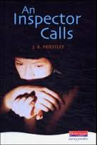
English Literature Paper 2
60% of Literature Grade
96 marks
2 hours 15 minutes
Section A: “An Inspector Calls”:
2 questions (answer 1 only)
34 marks (4 for SPaG)
45 minutes
Section C: Unseen Poetry:
2 questions 32 marks (Q1. 24 marks and Q2. 8 marks)
45 minutes
Section B: Poetry Anthology Power and Conflict :
1 comparative question (30 marks)
45 minutes

Slide 12
English Literature Assessment Objectives
AO1: Read, understand and respond to texts. Students should be able to:
maintain a critical style and develop an informed personal response
use textual references, including quotations, to support and illustrate interpretations.
AO2: Analyse the language, form and structure used by a writer to create meanings and effects, using relevant subject terminology where appropriate.
AO3: Show understanding of the relationships between texts and the contexts in which they were written.
AO4: Use a range of vocabulary and sentence structures for clarity, purpose and effect, with accurate spelling and punctuation.

Slide 13
I hope you found this presentation informative.

