Slide 1


‘Believe and Achieve’
Choose
Design & Technology
and make your mark…

Slide 2

"Design and Technology is logical, creative and practical, it’s the only opportunity that school students have to apply what they learn in maths and science – directly preparing them for a future in design and engineering.“
James Dyson

Slide 3
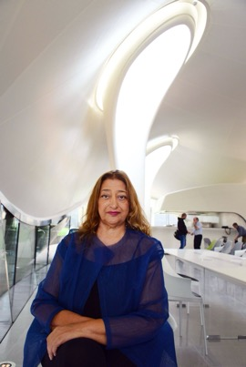
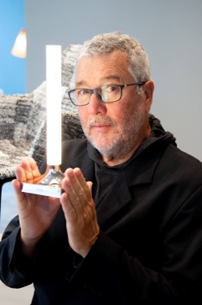



Why choose Design & Technology?
Our world is changing rapidly - your generation needs to prepare for the unknown.
This GCSE offers:
Transferable skills.
Creative skills.
Applied Maths and Science.
A starting point to drive change.
The opportunity to reinvent the wheel.
Turn heads.
Create something iconic.

Slide 4
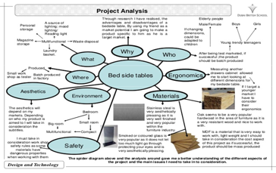
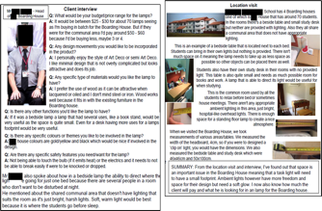
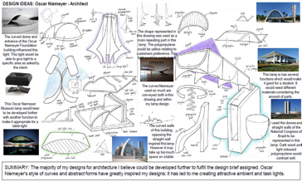
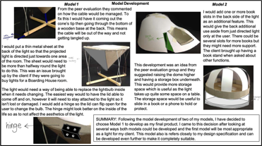
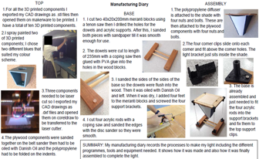
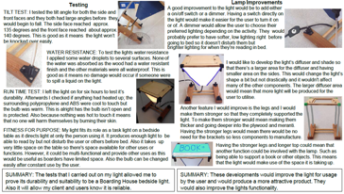
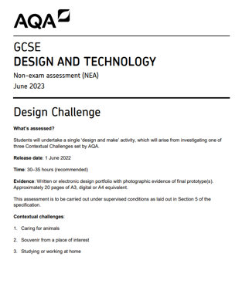
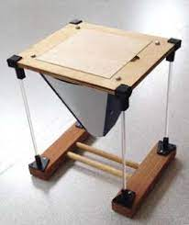
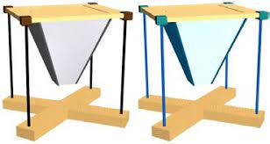
What will I be studying?
Across Y10 and Y11 students will develop both theory and practical knowledge and skills in the following areas:
Core technical principles
Specialist technical principles
Designing and making principles
The course is divided into two parts:
Non-exam assessment 50%
Written exam 50%

Slide 5
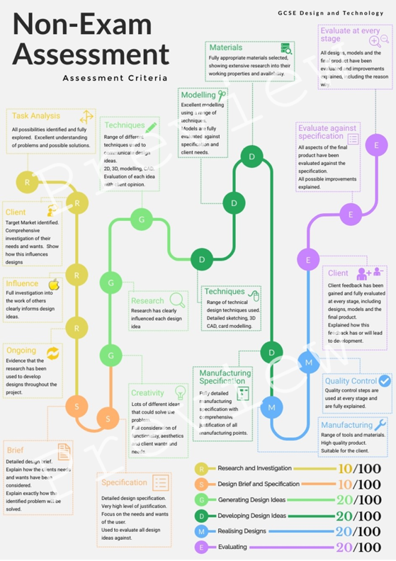
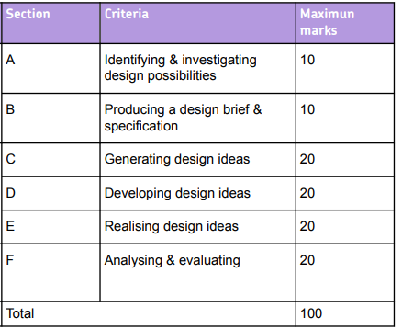
Course break down:
50% Non-exam assessment
How are you assessed?
You will be expected to complete a ‘design and make portfolio’ known as the Non-exam assessment (NEA) which is worth 50% of the overall GCSE in Design Technology.
You will be given the choice between 3 contextual challenges, which are released by the exam board in June of Y10.

Slide 6
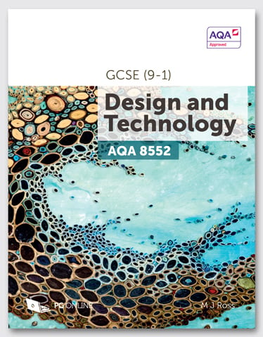
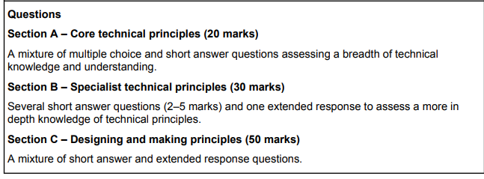
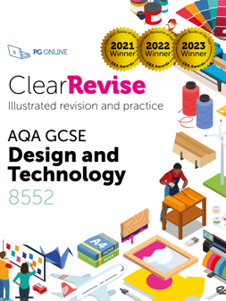
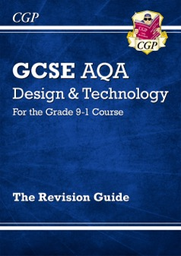
Course break down:
50% written exam
How are you assessed?
You will be assessed on your application of:
• Core technical principles
• Specialist technical principles
• Designing and making principles
In addition:
At least 15% of the exam will assess Math and 10% Science.

Slide 7

Common myths
‘’It’s all about making things’’
The course is 50% Design & Make – this includes research, analysis, development, evaluation. However, there is equal weighting for the examination.
‘’It’s not as important as other subjects’’
Universities (and employers) recognise it as a very important subject and a very challenging one.
‘’I have to be good at drawing and making’’
Drawing helps but you can communicate your ideas in other ways. Creativity and problem-solving skills are the most important alongside a relentless work ethic.
‘’What use is it? I don’t want to go into a D&T job’’
Look what universities and employers are looking for – Interchangeable skills, creativity, independence, problem solving, innovation = DESIGN AND TECHNOLOGY!
Notes:
You may wish to add more of your own, for example, gender balance in your school?

Slide 8

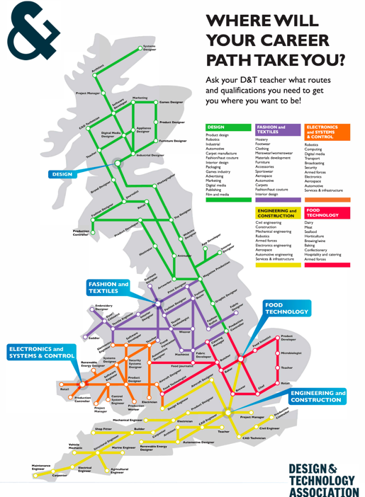
Where can DT take you?
Product designer
Industrial designer
Architect
Aerodynamicist
Automobile design
CAD/CAM operator
Engineer (civil engineer, mechanical engineer, design engineer...)
Project Manager
Fashion designer
Sportswear designer
Biomedical Engineering
Theatre/set designer
Interior designer
Computer game designer
Measurement & Control
Carpenter & Joiner
Cabinet & Furniture Making
Electrician
Also links well with careers in business, marketing and advertising.
Graphic designer
Jewellery designer
and many more…

Slide 9

Thank you and good luck with your options!
Remember…
“ the choices you make today are what will shape your tomorrow”
What have you been working on?
The Design and Technology Department
‘Believe and Achieve’

Slide 10
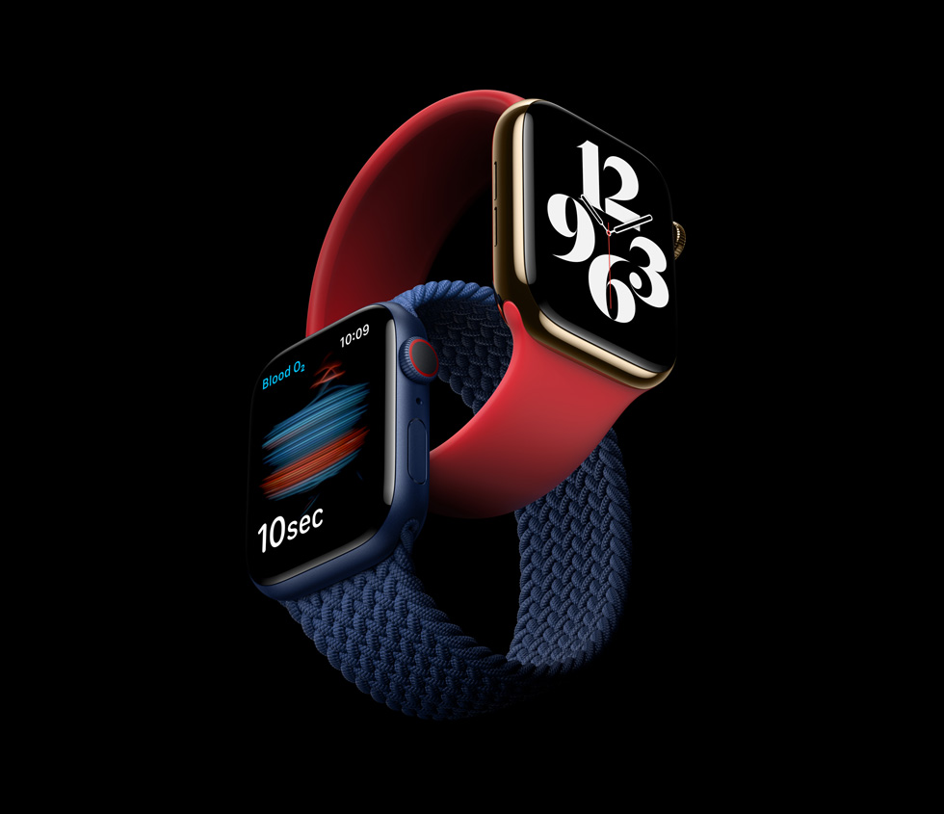

Sir Jonathan Ive, designer of many of Apple’s iconic products you have seen, used or maybe own, studied Design and Technology at school.

