Slide 1

What is a career?

Slide 2




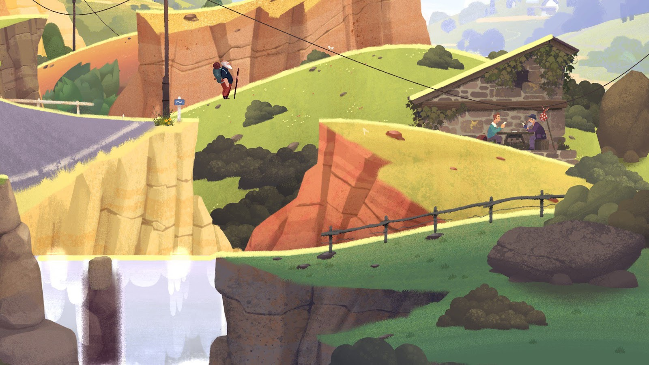
How do you define a career? (5 mins)
You might have heard people say things like:
1. “A career is where you stay in the same type of job for a long time.”
2.“A career is when you move up a career ladder and gain more money or responsibility.”
3. “A career is where you progress forward on a clear career path within one industry.”
4. “A career is a journey through life, learning and work. You can change direction into different jobs or industries.”
1. Write down which definition you prefer and why.
Notes:
Teacher’s notes:
Students may have heard people discuss ‘what is a career’ in the following ways:
A job: A career is where you stay in the same type of job for a long time.
A career ladder: A career is when you move up a career ladder and gain more money or responsibility.
A career path: A career is where you progress on a clear career path within one industry.
A career journey: A career is a journey through life, learning and work (CDI, 2022). You can change direction into different jobs or industries.
Students may be less familiar with the final definition but this is how career is defined by the CDI in the Career Development Framework.
Write down which definition you prefer and why?
Students may have different answers but click to the next slide to show why the final definition might be the most helpful to them.

Slide 3
How do you define a career?
You might have heard people say things like:
1. “A career is where you stay in the same type of job for a long time.”
2. “A career is when you move up a career ladder and gain more money or responsibility.”
3. “A career is where you progress forward on a clear career path within one industry.”
4. “A career is a journey through life, learning and work. You can change direction into different jobs or industries.”
Traditionally, people have thought of a career as staying in or moving upwards through a specific job. A better way of thinking about a career is a journey, which can take different directions.
Notes:
Teacher’s notes:
Supporting question: what are the benefits of defining career as a journey?
It gives you more freedom and opportunity.
The decisions you make now do not determine your whole life. You can change your mind.
You can move in different directions as your respond to life.

Slide 4
What makes up a career journey? (10 mins)
1. Make a list of at least five experiences that can help you build a career. Use the prompts to help come up with ideas.
Jobs/work experience
Enterprise activities
Education
Qualifications
Volunteering
Your interests
Achievements
Your skills
Notes:
Teacher’s notes:
Possible answers:
Jobs/work experience
Education
Qualifications
Enterprise activities
Volunteering
Your interests
Achievements
Your skills
Supporting exercise: are you surprised that any of these could be considered as part of your career journey? Which ones and why?
All of these experiences help build our understanding of who we are, what we’re good at, what we like doing and where our strengths lie. We need to develop these things to move through our career journey.

Slide 5
What makes up a career journey?
Here are some examples.
Jobs/work experience
Enterprise activities
Education
Qualifications
Your favourite subjects
Music grade certificate
Visiting a workplace
Skills & Enterprise Week
Volunteering
Your interests
Achievements
Your skills
Helping to pick litter
Riding your bicycle
Academic award
Speaking
Notes:
Teacher’s notes:

Slide 6
What makes up a career journey?
2. Finish the sentences.
Use the examples and prompts to help you.
Jobs/work experience
Education
Two things I’m doing now to support my career journey are … pursuing my interest in cycling and learning about bicycle design.
Two things I hope to do in the future to support my career journey are… to get work experience in a cycle repair shop and win a cycling competition.
Volunteering
Your interests
Qualifications
Enterprise activities
Achievements
Your skills
Notes:
Teacher’s notes:
Finish the sentences. Ask students to use the prompts to come up with ideas.
Examples:
One thing I’m doing now to support my career journey is…
Pursing my interest in cycling and learning about bicycle design.
Volunteering in my school Eco Club and planting trees in my local pack.
Taking my grade three in piano and music theory.
Attending extra support classes to work on my maths skills.
One thing I hope to do in the future to support my career journey is…
To get work experience in my local cycle repair shop.
Complete a MOOC on environmental sciences.
Audition for the National Youth Orchestra.
Gain a 7 in Maths and English so I can apply to an apprenticeship in accounting.

Slide 7
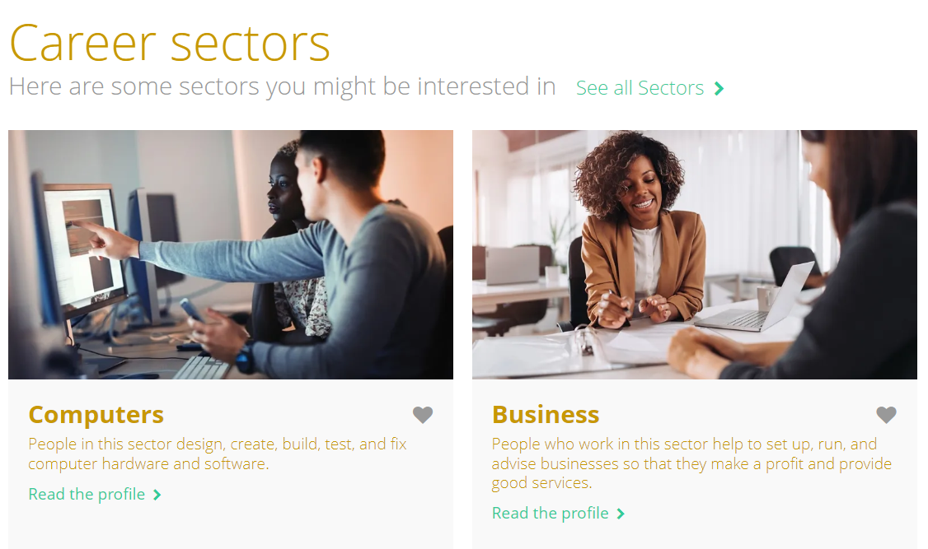
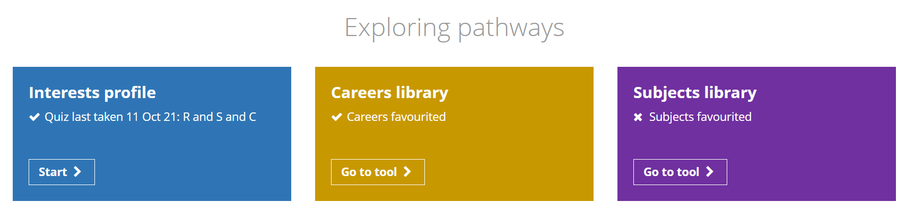
Searching for careers on the Careers library (2 mins)
You’re going to use the Unifrog Careers library to research jobs in career areas you’re interested in. Log on to Unifrog and:
Scroll to Exploring pathways and click on the Careers library.
Search by sector or by keyword.
Find the best careers for you and then save them for later.
Notes:
Teacher’s notes:
What is the Careers library tool
Students can use this tool to find the best careers for them and save them for later.
If you’re a student, you can use the Skills tool to:
Search for career sectors
Search for specific jobs
Read about specific jobs, salary, working conditions, qualifications, training routes and required skills.
Favourite profiles so you can come back and view them later.
If you're a teacher, you can use it to:
Keep track of what career areas your students are interested in.

Slide 8
What careers are you interested in? (20 mins)
Career sectors are groups of jobs or industries, such as medicine, education or sports.
Write down three career sectors you are interested in.
Use the icons as clues, or come up with your own ideas for sectors not included below.
Music
Film
Sports
Performing arts
Medicine
Science
Construction
Transport
Finance
Law
Art and design
Education
Notes:
Teacher’s notes:
Icon career sectors:
Music: People who work in this sector compose, perform, conduct, and teach music.
Film and photography: People who work in film and photography are involved in the process before, during or after a shoot.
Sports: People who work in this sector teach, play, and commentate on sport and fitness.
Performing arts: People who work in this sector perform dance, plays or comedy to an audience, or support those who do.
Medicine (general): People in this sector treat non-urgent medical conditions, and refer patients to specialists if needed. There are other specific sectors for specific conditions and specialisms.
Science: Can be split into sub sectors such as Natural sciences. People in this sector try to understand how the physical world works, and use their knowledge to solve problems.
Construction: People who work in this sector help to erect and repair buildings, roads and infrastructure.
Transport: People in the transport sector move people and goods to where they need to go.
Finance: People in finance help look after their clients' money and advise on things like investments, tax, and insurance.
Law: People who work in this sector are about making sure justice is done.
Art and design: Careers in Creative Art and Design involve making visual art, and making objects, spaces and displays look good.
Education/schools: People in this sector help students and schools achieve their goals.
Supporting exercise: did you students come up with any ideas not listed?
See examples below.
Students can search career sectors on Unifrog in the Careers library. Demo Student side> Exploring pathways > Careers library.
Computers: People in this sector design, create, build, test, and fix computer hardware and software.
Dentistry: People who work in dentistry treat and care for patients' teeth and gums.
Geographic and Environmental sciences: People in this sector try to understand how our planet works, and what we can do to protect it.
Horticulture and botany: People in this sector look after, sell, or study plants
Hospitality and Tourism: People who work in hospitality and tourism provide accommodation, food, drink, and leisure services.
Marketing: People who work in marketing help to boost the sales or reputation of a brand in creative ways.
Mathematical sciences: People who work in this sector use their maths skills to solve problems or analyse data.
Media and publishing: People who work in this sector are responsible for writing, assembling, editing or publishing books, articles, and digital content.
Museums and libraries: People who work in museums and libraries look after or sell books, art, and exhibits.
Police: People in the Police sector help to maintain the law and protect the public.
Politics: Jobs in this sector involve working out what's best for society and then trying to make those things happen.
Psychology and therapy: In psychology and therapy, you’ll be helping people with their mental health, and looking at how people’s brains or minds work.
Retail and Sales: People in this sector sell goods or services to individuals and businesses.

Slide 9
What careers are you interested in?
Using the Unifrog Careers library to help you, complete the task below.
2. Write at least two jobs you’ve found for each of your three career sectors.
Use the example to help you.
Here is an example:
Job 1: Doctor / GP
Job 2: A&E Nurse
(General Practitioner)
(Emergency medicine)
Sector: Medicine
Notes:
Teacher’s notes:
Ask students to write two jobs they’ve heard of for the three career sectors they’ve chosen. If you’re running short on time, ask students to complete this activity for one career sector.

Slide 10
What careers are you interested in?
Using the Unifrog Careers library to help you, complete the task below.
3. Pick one sector. For each job you’ve chosen, write down:
One skill you need for this job
One reward for doing this job
One challenge for doing this job
If you have time, repeat this exercise with a job from another career sector.
Here is an example:
Skill:
Caring
Reward:
Helping others
Challenge:
Long hours and stressful situations
Sector: Medicine
Job 2: A&E Nurse
Notes:
Teacher’s notes:
Pick at least one of the jobs you’ve chosen.
E.G.
Sector: Medicine
Job 2: A&E Nurse
Then write down:
One skill you need for the job - (E.G. Nurse: Caring)
One reward for doing this job - (E.G. Nurse: Helping others and saving lives)
One challenge that comes with doing this job - (E.G. Nurse: Long hours and shift work in a hospital A&E department. Stressful situations that could be emotionally challenging).
If you have more time, get students to repeat this exercise with another job.
Students can view more information about jobs and skills required within Careers library profiles on the Careers library.

Slide 11
Reflection: what careers are you interested in? (5 mins)
Using the Unifrog Careers library to help you, complete the task below.
4. Reflecting on what you’ve written down, finish the sentences.
Use the examples and prompts to help you.
I think I would be suited to a career as a ______________________ because…. _________________________________________________________________________
I can find out more information about this career by __________________________________________________________________
doctor
I’m interested in human biology and I really like helping others.
researching careers in medicine on the Careers library.
Notes:
Teacher’s notes:
Pick at least one of the jobs you’ve chosen.
E.G.
Sector: Medicine
Job 2: A&E Nurse
Then write down:
One skill you need for the job - (E.G. Nurse: Caring)
One reward for doing this job - (E.G. Nurse: Helping others and saving lives)
One challenge that comes with doing this job - (E.G. Nurse: Long hours and shift work in a hospital A&E department. Stressful situations that could be emotionally challenging).
If you have more time, get students to repeat this exercise with another job.
Students can view more information about jobs and skills required within Careers library profiles on the Careers library.

Slide 12
Adapting to career trends (10 mins)
Career trends change over time. The career trends when your parents and carers were at school would have looked very different to today’s trends.
Why do you think these four career trends are particularly relevant now?
1. Remote working
Working from anywhere, not just traditional office
2. Artificial intelligence
Using computers or technology to do things humans do
3. Protecting the environment
Companies have policies that help protect the planet
4. Upskilling
Employers are providing opportunities for workers to learn new skills
Notes:
Teacher’s notes:
A career trend is a change or shift in the way people work and pursue their careers that become popular and widespread over time.
Remote Work: This trend means that people can do their jobs from anywhere, not just in a traditional office. They can use technology to communicate which allows them to work from home or any other location.
Artificial Intelligence: Artificial intelligence, or AI, is the use of computers to do things that usually need humans to do them. As AI technology becomes more advanced, it may replace some human jobs, especially in industries like manufacturing or finance.
Protecting the planet: Being sustainable is about doing things that protect the environment and preserve natural resources. More and more companies realise how important it is to look after the planet.
4. Upskilling: Employers are providing opportunities for workers to learn new skills

Slide 13
Adapting to career trends (10 mins)
Career trends change over time. The career trends when your parents and carers were at school would have looked very different to today’s trends.
Why do you think these four career trends are particularly relevant now?
1. Remote working
2. Artificial intelligence
3. Protecting the environment
4. Upskilling
The COVID-19 pandemic
Advances in technology such as Chat GPT
The climate crisis
Job insecurity:
fear of losing jobs and having no money to live
Notes:
Teacher’s notes:
A career trend is a change or shift in the way people work and pursue their careers that become popular and widespread over time.
Remote Work: This trend means that people can do their jobs from anywhere, not just in a traditional office. They can use technology to communicate which allows them to work from home or any other location.
Artificial Intelligence: Artificial intelligence, or AI, is the use of computers to do things that usually need humans to do them. As AI technology becomes more advanced, it may replace some human jobs, especially in industries like manufacturing or finance.
Protecting the planet: Being sustainable is about doing things that protect the environment and preserve natural resources. More and more companies realise how important it is to look after the planet.
4. Upskilling: Employers are providing opportunities for workers to learn new skills

Slide 14
Adapting to career trends (10 mins)
1. Remote working
2. Artificial intelligence
3. Protecting the environment
4. Upskilling
The COVID-19 pandemic
Advances in technology such as Chat GPT
The climate crisis
Job insecurity:
fear of losing jobs and having no money to live
Which of these career trends are you most interested in and why?
Use the example to help.
I’m interested in the career trend of remote working. I’d like to work in healthcare and it’s interesting that doctors and nurses could maybe work remotely by talking to patients on video calls.
Notes:
Teacher’s notes:
A career trend is a change or shift in the way people work and pursue their careers that become popular and widespread over time.
Remote Work: This trend means that people can do their jobs from anywhere, not just in a traditional office. They can use technology to communicate which allows them to work from home or any other location.
Artificial Intelligence: Artificial intelligence, or AI, is the use of computers to do things that usually need humans to do them. As AI technology becomes more advanced, it may replace some human jobs, especially in industries like manufacturing or finance.
Protecting the planet: Being sustainable is about doing things that protect the environment and preserve natural resources. More and more companies realise how important it is to look after the planet.
4. Upskilling: Employers are providing opportunities for workers to learn new skills

Slide 15
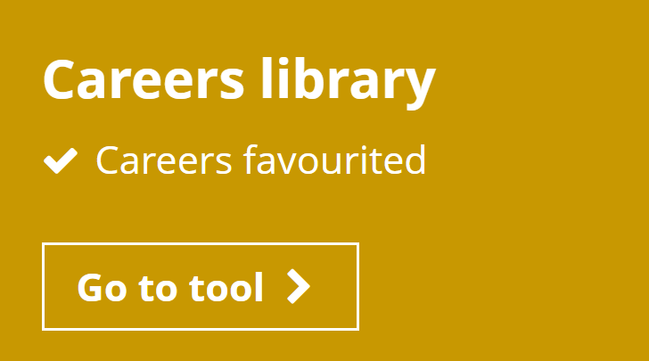
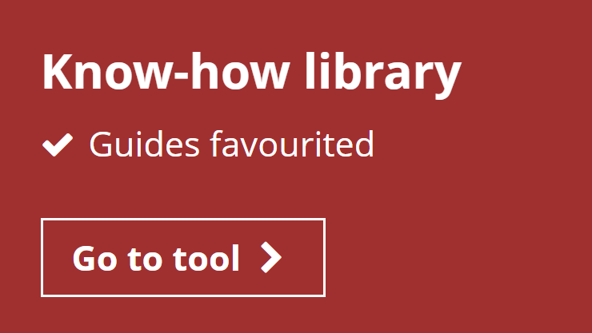
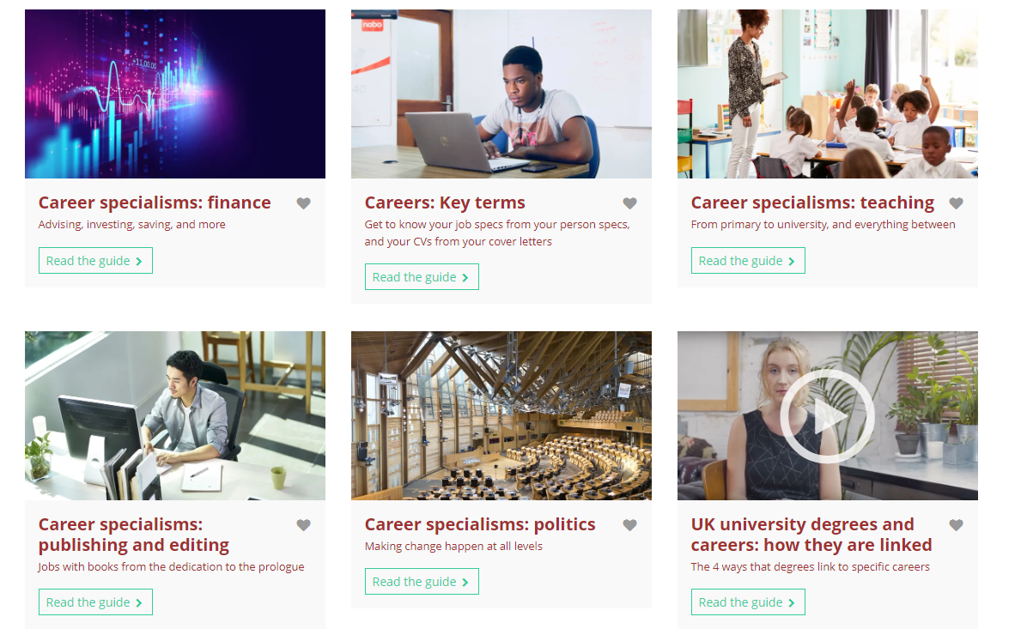
Independent learning slide (1 min)
You can find more about careers in the Unifrog Careers library.
You can read more about different career areas but searching ‘career’ on the Know-how library.
Check out the key terms and areas that interest you.
Notes:
Teacher’s notes:

Slide 16
Plenary (2 mins)
Imagine you’re talking to a primary school student about careers. They ask you:
‘What is a career?’
Write down:
  How you would describe a career
  Where they could get more information about career choices.
Notes:
Teacher’s notes:
The purpose of this activity is for students to reflect on how they’d define career and remind them where they can go for support or further information.
How would you describe a career
“A career is a journey through life, learning and work. You can change direction into different jobs or industries.”
Good definitions highlight a career as being a journey, which can take different directions, whilst poor definitions focus on a specific job with linear progression.
It gives you more freedom and opportunity.
The decisions you make now do not determine your whole life. You can change your mind.
You can move in different directions as your respond to life
You can learn more about careers on:
The Unifrog Careers library
Your school careers department
Your school careers advisor
Talking to friends and family about their careers
Attending in school career events, talks and workshops

Slide 17


