Slide 1
To personalise this lesson, here are some suggested actions:
Optional lesson content
Slide 12 | Edit this slide to contain a summary of the qualification type(s) on offer to students, e.g. GCSE, IB MYP, BTEC, National 5, etc. e.g. GCSE: GCSE stands for General Certificate of Secondary Education. It’s an academic qualification offered in a wide range of subjects. It’s graded using a number system from 1 to 9, with 9 being the top grade you can achieve.* It’s assessed by exams at the end of the two-year course. Some (not all) GCSEs are partly assessed by coursework, as well as exams. *Ungraded is awarded where a grade 1 is not met.
Slide 13 | Edit this slide to contain a list of the subjects on offer to students and information about any subject blocks, subject clashes, compulsory subjects, number of optional subjects that need to be selected, etc. Ideally, copy and paste an image of the subject timetable.
Slide 16 | Edit this slide to contain information about what students need to do in order to submit their subject choices. e.g. Before 1st April 3pm, return your subject choices form to Mr Smith via email.
Slide 18 | Edit this slide to contain the date, time, and location of any upcoming related events, such as an options evening or subject taster day. e.g. Your options evening will take place on 1st March at 4pm in the hall.

Slide 2

Decision making: choosing what to study at KS4
Notes:
This lesson is aimed at Year 9 students who are selecting their subject options for Key Stage 4. If students select their Key Stage 4 subjects earlier than this, then deliver this lesson when most appropriate.

Slide 3
Making decisions: factors to consider (10 mins)
Below are factors you might consider when choosing your Key Stage 4 subjects.
Which do you think are the three most important factors to consider and why?
Which do you think are the three least important factors to consider and why?
Friends’ choices
Siblings’ choices
Teachers’ opinions
Family and friends’ opinions
The subjects you currently enjoy studying
New subjects on offer you don’t currently study
A career you’d like to have
A degree you’re interested in
An apprenticeship you’re interested in
Your skills: what you’re good at doing
Your interests: what you enjoy doing
Post 16 qualifications you’re interested in
Type of assessment
Type of qualification (academic/vocational)
Subject timetable and potential clashes
Notes:
Teacher’s notes:
The purpose of this activity is for students to reflect on some of the factors that students may consider whilst choosing subjects to study in Key Stage 4.
It’s important that students know the subjects on offer to them and the subject timetable (including any subject blocks and potential clashes).
Example answers:
I think the most important factor is your interests: what you enjoy doing because it’s important that you enjoy the next two years of your education, studying subjects that interest you.
I think the least important factor is what your friends are choosing because everyone has different skills, interests, and career goals – so a subject that would suit your friend might not be a good match for you.

Slide 4
Making decisions: accessing support (10 mins)
Deciding what subjects to study might seem like a daunting task, but there are lots of people who can provide information to help you and offer support.
Who could support you with your subject choices?
Subject teacher
Form tutor
Careers adviser
Friend
Parent/carer
Older sibling
In pairs, select one of the people above (or think of someone else) and discuss:
Why might this person be a useful source of information to support you with your decision-making?
Why might this person not be a useful source of information to support you with your decision-making?
Notes:
Teacher’s notes:
If time permits, ask students to offer an example pro and con of each person in a whole-class discussion. An example answer is provided on the next slide.
Prompt questions:
What experience do they have?
What knowledge do they have?
Have they made a similar decision recently?
Have they supported other people in making a similar decision recently?
Do they know about your skills, interests, and career goals?
Could they be biased?
The role of a careers adviser:
You may wish to remind students that careers advisers are trained to provide impartial guidance to help you make decisions about your future. They might also be called a careers coach or careers consultant.
Example answers:
Subject teacher:
They’ll be knowledgeable about the subject they teach. They can tell you what the course is about and how it’s assessed. They’ll be knowledgeable about how their subject could help you in the future. They might currently teach you and be aware of your skills.
They could be biased towards wanting you to select their own subject!
Form tutor:
They’ll have experience supporting students with their subject choices. They might know you well as a person (your skills, interests, career goals, etc.)
Depending on how much time they spend with you 1:1, they might not know about your career goals.*
*You can help them with this by creating Unifrog shortlists and favouring career / subject profiles.
Careers adviser:
They’re trained to provide impartial advice. They’ll help you to make your own decision. They’ll have experience supporting students with their subject choices. They’ll be knowledgeable about how subjects link to future learning pathways and careers.
Depending on how much time they’ve spent with you, they might not know you and your skills well.*
*You can help them with this by completing the Unifrog quizzes!
Friend:
They’ll probably be going through the same decision-making process as you.
Their skills, interests, and career goals will likely be different to your own. Just because they want to study a subject, it doesn’t necessarily mean that you would enjoy it too.
Parent / carer:
They’ll be able to share information about the subjects they chose when they were at school and whether they enjoyed them or not. They likely know you and your skills well.
Their skills, interests, and career goals will likely be different to your own. There may be conflict between your career goals and what they’d like you to do. Different subjects may be on offer now compared to when they were at school.
Older sibling:
They might be useful because they may have recently experienced the same subject selection process as you. They’ll be able to share information about the subjects they chose and whether they enjoyed them or not.
They might not be useful because their skills, interests, and career goals will likely be different to your own. Just because they enjoyed studying a subject, it doesn’t necessarily mean that you would enjoy it too. Depending on their age, different subjects may be on offer now compared to when they were at school.

Slide 5
Making decisions: accessing support
Deciding what subjects to study might seem like a daunting task, but there are lots of people who can provide information to help you and offer support.
Subject teacher
Form tutor
Careers adviser
Friend
Parent/carer
Older sibling
For example…
This person will be a useful source of information for me because they’ll have gone through the same subject selection process as me.
This person might not be a useful source of information for me because their skills, interests, and career goals will probably be different to mine.
Notes:
Teacher’s notes:
Show students the example, before returning to the task instructions on the previous slide.

Slide 6
Making decisions: case study (15 mins)
Sport
Dance
Music
Drama
Health and social care
Business studies
Psychology
Design technology
IT
Media studies
Graphic design
Fine art
Ryan’s school has a set of core subjects he must study in Years 10 and 11. He must choose two other subjects from a list of twelve optional subjects.
‘I really enjoy being creative.’
‘I prefer practical assessments to written exams.’
‘I think I’d like to have a career in the performing arts sector.’
Based on the information you’ve got about Ryan, which subjects would you recommend he choose and why?
Notes:
Teacher’s notes:
Prompt questions:
Which subjects require creativity?
Which subjects do you think might involve practical assessments?
Which subjects relate to the performing arts career sector?
Suggested answers:
Dance
Music
Drama
Media studies
Stretching questions:
Why is it important to consider your skills whilst choosing subjects?
Why is it important to consider the way you like to learn / be assessed whilst choosing subjects?
Why is it important to consider your career goals whilst choosing subjects?

Slide 7
Making decisions: case study
Sport
Dance
Music
Drama
Health and social care
Business studies
Psychology
Design technology
IT
Media studies
Graphic design
Fine art
Sport
Dance
Music
Drama
Health and social care
Business studies
Psychology
Design technology
IT
Media studies
Graphic design
Fine art
Ryan decided to choose drama and music as his two optional subjects.
Later, Ryan finds out that they clash in the school timetable, and he can only study one of them, alongside a different subject. Ryan then decides on drama and media studies as his final choices.
Why is it important to consider ‘reserve’ subjects alongside your main subject choices?
Notes:
Teacher’s notes:
The purpose of this activity is to get students to think about the importance of considering reserve subjects, alongside their main choices.
The activity also allows students to reflect on other ways they can pursue an interest if they are unable to study the subject at school.
Suggested answers:
Reasons to prepare ‘reserve’ subject choices:
Changing your mind about your main choices
The timetable means your choices clash
Your main subjects are oversubscribed
There are entry requirements you don’t fulfil
Subjects get removed from the timetable

Slide 8
Making decisions: case study
Sport
Dance
Music
Drama
Health and social care
Business studies
Psychology
Design technology
IT
Media studies
Graphic design
Fine art
Sport
Dance
Music
Drama
Health and social care
Business studies
Psychology
Design technology
IT
Media studies
Graphic design
Fine art
Ryan decided to choose drama and music as his two optional subjects.
Later, Ryan finds out that they clash in the school timetable, and he can only study one of them, alongside a different subject. Ryan then decides on drama and media studies as his final choices.
How else could Ryan pursue his interest in music alongside his chosen school subjects?
Notes:
Teacher’s notes:
The purpose of this activity is to get students to think about the importance of considering reserve subjects, alongside their main choices.
The activity also allows students to reflect on other ways they can pursue an interest if they are unable to study the subject at school.
Suggested answers:
Other ways to pursue music:
Joining any extracurricular music clubs at school or outside of school
Starting/joining a band
Having music tutoring lessons
Gaining music qualifications outside of school
Completing music-related MOOCs

Slide 9
Subjects, careers, and skills (10 mins)
Some (but not all!) jobs, degrees, and apprenticeships require you to have studied specific school subjects.
There are three sets of instructions, depending on your current career goals.
I don’t know what I’d like to do after school
I know what I’d like to study at university or what apprenticeship I’d like to do
I know what career I’d like to have
A
B
C
Notes:
Teacher’s notes:
Encourage students to select option A, B, or C.
Instructions follow on the next slide.

Slide 10
Subjects, careers, and skills
I know what I’d like to study at university or what apprenticeship I’d like to do
Create a mind map with the university subject or apprenticeship theme you’d like to study in the middle.
Add examples of subjects that you think would prepare you well for this degree / apprenticeship.
e.g. Law: English, law, history…
Create a mind map with the career you’d like to have in the middle.
Add examples of subjects that you think would prepare you well for this career.
e.g. Architect: maths, graphics…
Create a mind map with your three strongest skills in the middle.
Add examples of subjects that you think require these skills.
e.g. Problem solving: science, psychology, computer science…
I know what career I’d like to have
I don’t know what I’d like to do after school
A
B
C
Notes:
Teacher’s notes:
A
Encourage students to think about the skills required for this career and which subjects would develop these skills.
e.g. Architect: maths, graphic design, art and design, IT, creative media, engineering, design technology, etc.
B
Skills students may wish to identify:
Communication, critical thinking, digital literacy, practical skills, technical skills, creativity, physical abilities, independence, teamwork, numeracy, reading, writing, problem solving, speaking.
e.g. Problem solving / critical thinking / digital literacy: psychology, sociology, religious studies, citizenship, computer science, IT, graphic design.
C
Encourage students to think about the skills required for this university subject / apprenticeship and which school subjects would develop these skills.
e.g. Law and legal studies: law, English, maths, history, psychology, sociology, etc.

Slide 11
Qualifications and subjects on offer to you (10 mins)
PE
Art
History
Geography
Triple science
French
Music
Media
Business
Food tech
Design tech
RE
Notes:
Teacher’s notes:
You can either delete this slide or add a summary of the different qualification types on offer to students.
For example:
GCSE
BTEC
IB MYP
National 5
Example qualification summary:
GCSE
GCSE stands for General Certificate of Secondary Education.
It’s an academic qualification offered in a wide range of subjects.
It’s graded using a number system from 1 to 9, with 9 being the top grade you can achieve.*
It’s assessed by exams at the end of the two-year course.
Some (not all) GCSEs are partly assessed by coursework, as well as exams.
*Ungraded is awarded where a grade 1 is not met.

Slide 12
Qualifications and subjects on offer to you
Edit this slide to contain information about the subjects on offer to students and the option block timetable.
Review the subjects on offer and sort them into three lists:
A. Would love to study B. Undecided C. Don’t want to study
Notes:
Teacher’s notes:
You can either delete this slide or add an image of the subject choices that your students have. Try to include any relevant information about the number of subjects students need to choose, subject blocks and potential clashes, and any compulsory subjects.
Reiterate to students that they aren’t making their final subject decisions in this session! This purpose of this activity is to encourage students to be proactive about finding out more information about the subjects they are currently undecided on.
Students may like to consider:
The topics covered in the course
How it links to their previous study of the subject
Whether it’s a new subject they haven’t already studied
The careers related to the subject
The skills they would develop during the course
The skills they’d be expected to have already
The assessment of the course

Slide 13
Qualifications and subjects on offer to you
For at least one subject you’d love to study, write down one reason why you’re keen to study it. You can use the examples below to help you.
Sport
Health and social care
Business studies
I really enjoy PE lessons and I’m keen to learn more about fitness.
This course involves lots of practical learning, which I love.
This subject will help me prepare for a career in marketing.
Notes:
Teacher’s notes:
Reiterate to students that they aren’t making their final subject decisions in this session!
Students may like to consider:
The topics covered in the course
How it links to their previous study of the subject
Whether it’s a new subject they haven’t already studied
The careers related to the subject
The skills they would develop during the course
The skills they’d be expected to have already
The assessment of the course

Slide 14
Qualifications and subjects on offer to you
For the subjects you’re currently undecided about, write down one reason why
you’re undecided about them. You can use the examples below to help you.
History
Sociology
Graphic design
I’m not sure what topics we’d cover and whether they’d interest me.
I’m not sure what this subject is about as I don’t study it now.
I’m not sure whether this subject would suit my skills.
Notes:
Teacher’s notes:
Reiterate to students that they aren’t making their final subject decisions in this session! This purpose of this activity is to encourage students to be proactive about finding out more information about the subjects they are currently undecided on.
Students may like to consider:
The topics covered in the course
How it links to their previous study of the subject
Whether it’s a new subject they haven’t already studied
The careers related to the subject
The skills they would develop during the course
The skills they’d be expected to have already
The assessment of the course

Slide 15
Qualifications and subjects on offer to you
Edit this slide to contain information about subject choice deadlines.
Notes:
Teacher’s notes:
You can either delete this slide or add instructions to explain what actions students need to take to submit their subject choices.
For example: Before 1st April 3pm, return your subject choices form to Mr Smith via email.
Setting an interaction
You can set an interaction on Unifrog to remind students of their subject choices deadline.
Go to Manage > Advanced > Select the relevant students (e.g. all students in the year group) > + interaction.

Slide 16
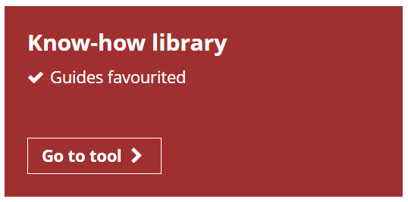

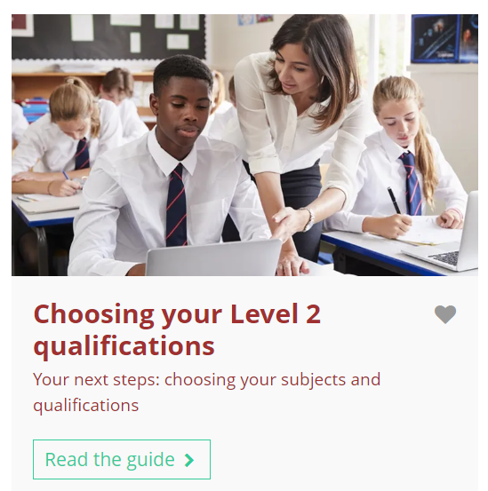
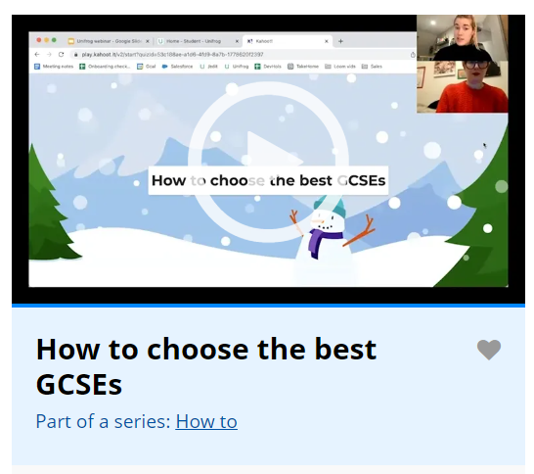
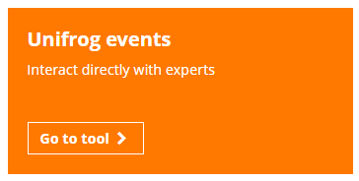
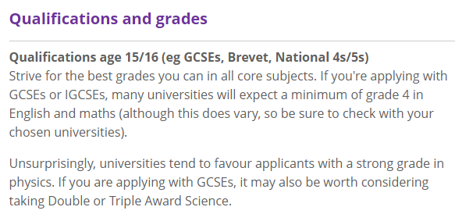
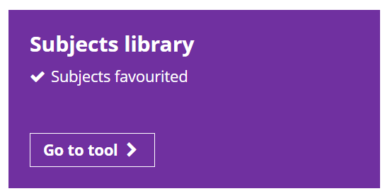
Finding out more about subject options
After this lesson, you may wish to explore the following Unifrog tools:
Know-how library
Unifrog events tool
Subjects library
Notes:
Teacher’s notes:
Know-how library
Students can favourite and read guides relating to subject choices:
Choosing your level 2 qualifications
How to... use the Subjects library
How to… use the Careers library
BTECs: busting myths
For parents and caregivers: helping your child make their Level 2 qualification choices
You can track student progress with favouriting guides by clicking Advanced>Sort by>Library profiles in Favourites.
Unifrog events tool
Students can browse upcoming and past events about subject choices, such as ‘How to choose the best GCSEs.’
You can track student progress with signing up to events by clicking Advanced>Sort by> Webinar signups.
Subjects library
Students can explore subject profiles and scroll down to the section called ‘Qualifications and grades’ to explore required/relevant Key Stage 4 subjects.
You can track student progress with favouriting subject profiles by clicking Advanced>Sort by>Library profiles in Favourites.

Slide 17
What would I like to find out next? (5 mins)
Your options evening will take place on….
To prepare, write down at least three questions you’d like to ask at this event.
Use the notes you made about your undecided subjects and the examples to help you.
Geography
French
Media studies
Is there any required fieldwork?
What equipment will I learn how to use?
What do current students find most challenging about the course?
Notes:
Teacher’s notes:
Edit this slide with the date, time, and format of your school’s options evening / other related event. Or you can delete the blue text box.
If there are no such events planned, or they have already taken place, students can still think about questions they might like to ask to teaching staff at the school via email or in person.

Slide 18


