Slide 1

Quick task: Exploring the Careers library

Slide 2


Using the Unifrog Careers library
The next few slides will show you how to use the Careers library tool.
After logging into your Unifrog account, scroll down to ‘Exploring.’
If you don’t see the Careers library tool straight away, click ‘All tools’.

Slide 3
Using the Unifrog Careers library
You can search the Careers library by:
Keyword, e.g. Computers
Subject group, e.g. Animals
School subjects, e.g. Biology
Theme, e.g. Green jobs
Career sectors, e.g. Transport
Personality type, e.g. INTJ
Career area, e.g. Arts and Media
Interests, e.g. Artistic
Skill, e.g. Accountability
Work environments, e.g. No long hours

Slide 4
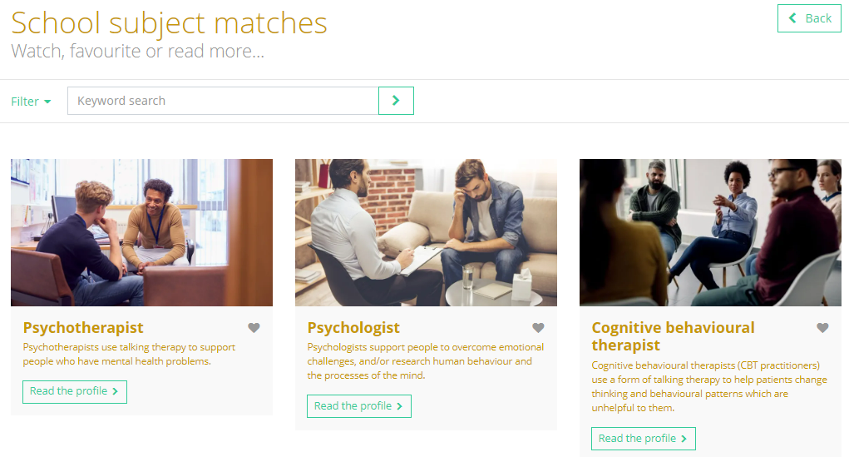
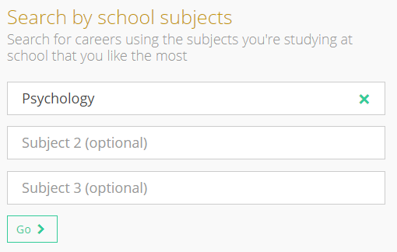
Using the Unifrog Careers library
You will then see career profiles that are matches for your search.
Psychology as a school subject has been used as an example here:

Slide 5

Using the Unifrog Careers library
Click ‘Read the profile’ to find out more.
Click the heart button to add the profile to your Favourites.
Return to your search results at any time by clicking ‘Back’ on the career profile.

Slide 6
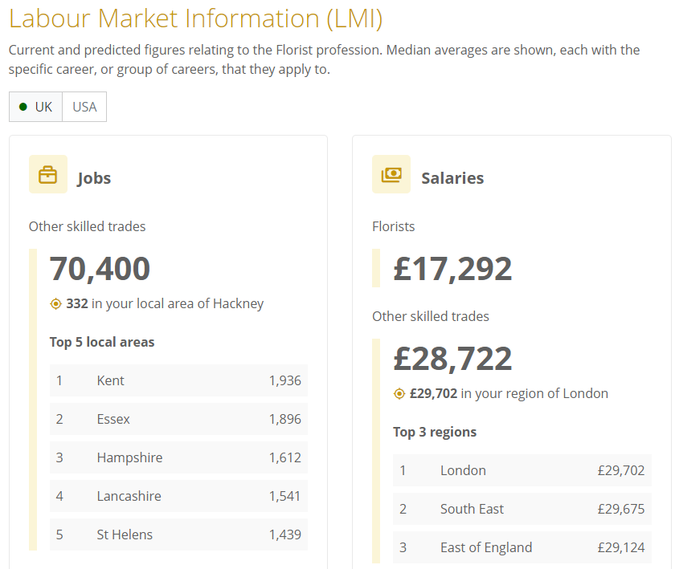
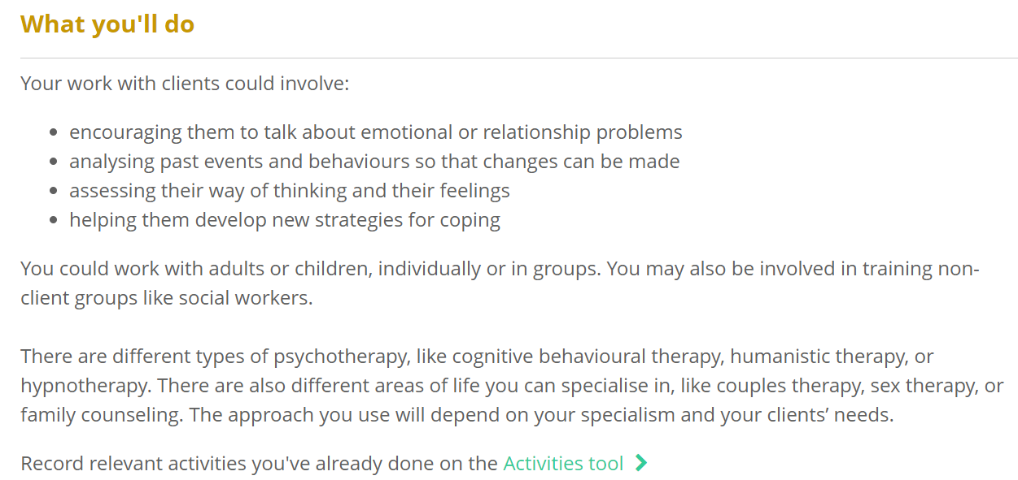
Using the Unifrog Careers library
You’ll be able to explore the following sections of the profiles:
Video (where relevant)
What you’ll do
Working hours and environment
Career path and progression
Skills required
Entry requirements
Related know-how guides
Related courses
Related university subject profiles
Related career profiles
Explore
Labour Market Information

Slide 7
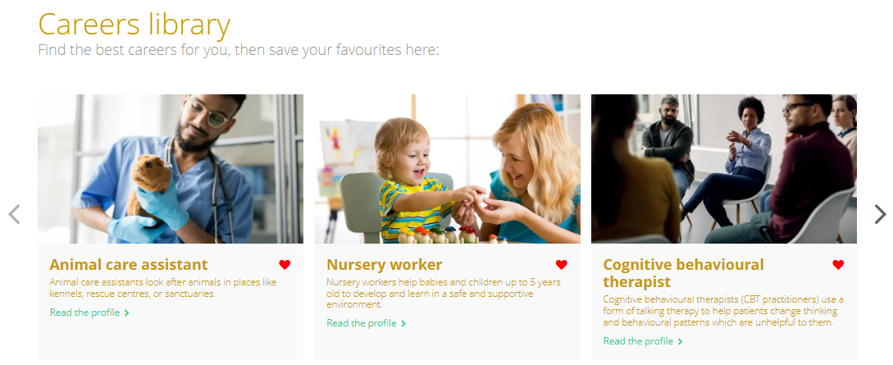
Using the Unifrog Careers library
Next time you visit the Careers library, you will see your favourite career profiles at the top of the page, so you can find them again easily.
You can also find them by clicking ‘Favourites’ at the top of your screen, then ‘Library tools.’

Slide 8
Exploring the Careers library
Now it’s your turn to explore careers!
If you’re unsure where to start, search by school subjects and select up to three of your favourite subjects that you’re currently studying.
Remember to click the heart button to add a career profile to your Favourites.

Slide 9


