Slide 1

Exploring possibilities: dream jobs

Slide 2
Your dream job (5 mins)
If you could have any job in the world, what would it be and why?
If I could have any job, I’d be a _____________________ because…
Think about what appeals to you about this job, such as the…
Skills you’d develop
Responsibilities you’d have
Life it would allow you to live
Flexibility it would give you
Day-to-day tasks you’d do
People you’d work with
Salary you’d earn
Opportunities it would give you

Slide 3
What makes a dream job appealing? (2 mins)
Read this example of Emily’s dream job:
‘If I could have any job, I'd be a chocolatier because making chocolate masterpieces would combine my love of chocolate with being creative and artistic. I'd travel all over the world to run chocolate-making workshops for aspiring chocolatiers.’
Let’s look at what it is about this job that appeals to Emily.

Slide 4
What makes a dream job appealing?
‘If I could have any job, I'd be a chocolatier because making chocolate masterpieces would combine my love of chocolate with being creative and artistic. I'd travel all over the world to run chocolate-making workshops for aspiring chocolatiers.’
The job requires the following skills:
Practical skills
Creativity / innovation
Artistic skills

Slide 5
What makes a dream job appealing?
‘If I could have any job, I'd be a chocolatier because making chocolate masterpieces would combine my love of chocolate with being creative and artistic. I'd travel all over the world to run chocolate-making workshops for aspiring chocolatiers.’
The job covers the following themes:
Making things
Travel
Helping people

Slide 6
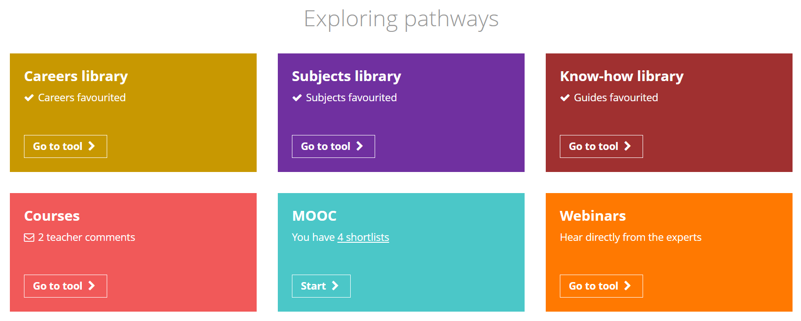
Exploring the Unifrog Careers library (10 mins)
Log in to your Unifrog account and open the Careers library.
Depending on your school, you might see the Careers Sectors library instead – you can still follow the same set of instructions.

Slide 7
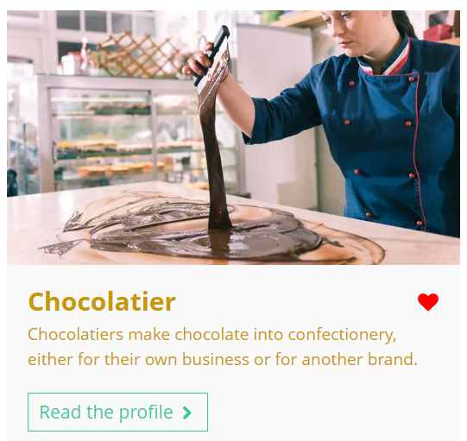
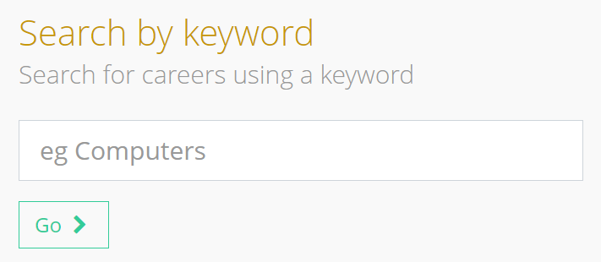
Exploring the Unifrog Careers library
Your dream job might be in Unifrog’s Careers library!
Use the keyword search function to find out.
chocolatier
Remember to click the heart icon to add a career profile to your favourites.

Slide 8
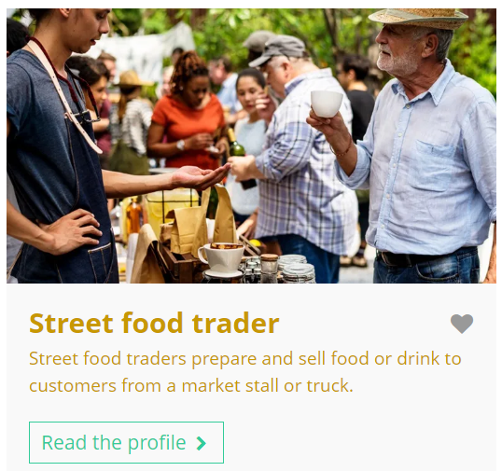
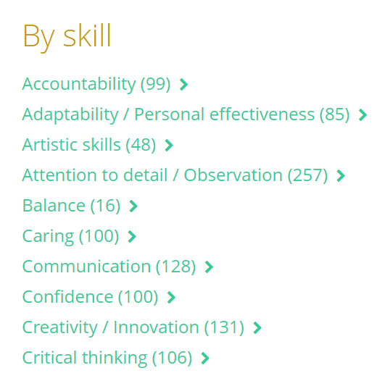
Exploring the Unifrog Careers library
You can also explore careers that use similar skills and have similar themes to your dream job.
Scroll down to search ‘by skill’ or ‘by theme.’

Slide 9
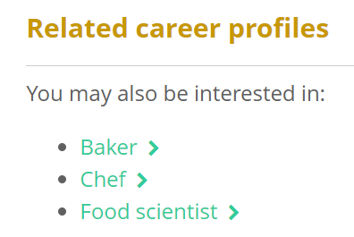

Exploring the Unifrog Careers library
You might discover related careers you haven’t thought about yet.
When you have a career profile open, scroll down to ‘related career profiles’ to explore other careers that you might be interested in too.

Slide 10
Exploring a career or sector profile (15 mins)
Select one of the careers / sectors you’ve favourited. This might be your dream job, or a new related career you’ve discovered today.
Then, read the profile to help you answer the following questions:
What do you think you’d enjoy the most about this career / sector and why?
What do you think you’d enjoy the least about this career / sector and why?
What do you like or dislike about the working hours and environment for this career / sector and why?
What are the entry requirements and annual median salary for this career / sector?

Slide 11
Exploring a career or sector profile
Based on your research, rate the career / sector out of 10 and explain your decision.
I think I’d hate it!
I think I’d love it!
I rated this career as _____ out of 10 because…
5 although it sounds fun to travel around the world, the working hours are irregular and I’d have to spend long periods of time away from my friends and family.

Slide 12
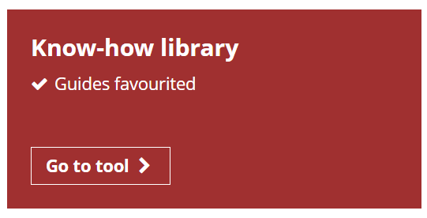
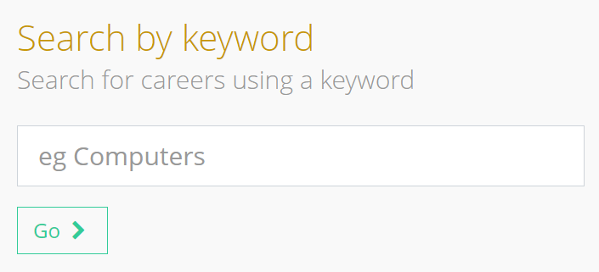

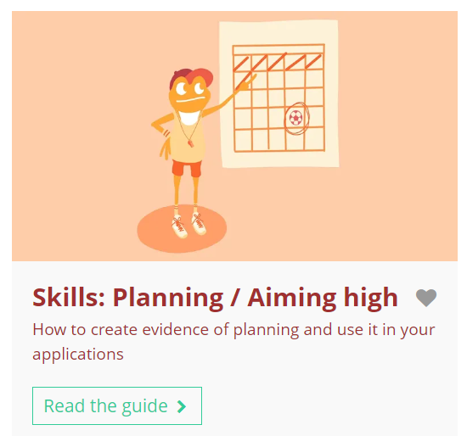

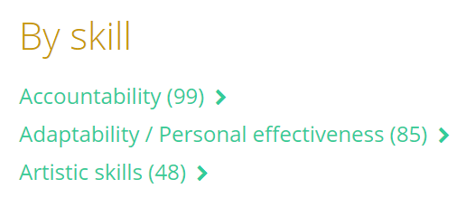
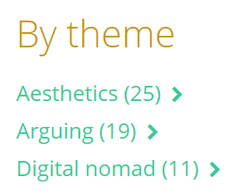
Exploring and discovering dream jobs using Unifrog
After this lesson, you may wish to explore the following Unifrog tools:
Know-how library
Careers library

Slide 13
Having a dream job vs. exploring other careers (8 mins)
Discuss the questions below with the person next to you and write down at least two benefits for each.
1.
What are the benefits of identifying a dream job?
2.
What are the benefits of exploring other careers as well?

Slide 14


