Slide 1

What comes after school: the main learning pathways

Slide 2
Looking beyond school (5 mins)
After school, some options for the next steps of your career journey are:
FE college
Sixth form
Apprenticeship
University
Employment
Volunteering
For each pathway, write down your rating of how much you know about it.
I know nothing about this pathway
I know a little about this pathway
I know quite a bit about this pathway
I know lots about this pathway
Finished? For the pathway you know the most about, try to summarise it in under 30 words, to help someone who doesn’t know much about it.

Slide 3

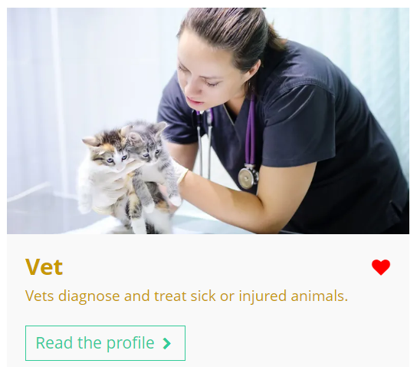
Using the Unifrog Careers library (10 mins)
Log in to your Unifrog account and open the Careers library.
Browse the library to identify a career you’d like to have at some point in your life and write it at the top of your page.
Vet
Remember to click the heart icon to add the career profile to your favourites.

Slide 4
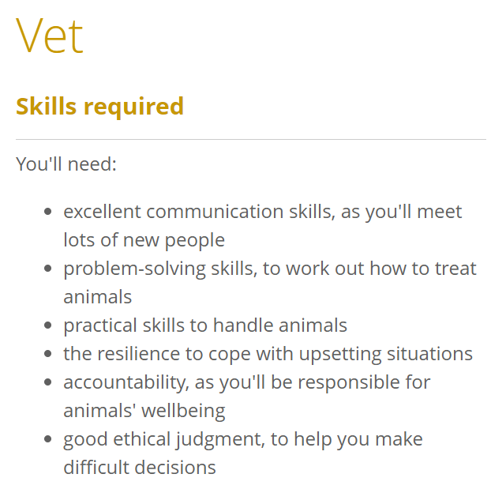
Using the Unifrog Careers library
Read the career profile, paying particular attention to the following sections:
Career path and progression
Skills required
Entry requirements
Related university subject profiles
You’ll use this information in the next activity!

Slide 5
Careers and learning pathways (15 mins)
Split your page into three columns, with the following headings:
Learning pathways
Qualifications and skills
Progression opportunities
Vet
Learning
pathways
Qualifications and skills
Progression opportunities
You can keep the career profile open during this activity.

Slide 6
Careers and learning pathways
Task 1: Note down the different learning pathways that might help you to prepare for this career.
Task 2: Note down any qualifications that are required for this career and the key skills that would help you in this career.
Task 3: Note down the progression opportunities that might be available to you in this career path.
Vet
Learning
pathways
Qualifications and skills
Progression opportunities
You can keep the career profile
open during this activity.

Slide 7
Careers and learning pathways: an example
Vet
Learning pathways
Sixth form / college
Work experience in a veterinary practice
University
Qualifications and skills
2 level 3 science subjects
Pass entry exams
Veterinary degree
Registration with an accredited veterinary organisation
Communication, problem-solving, practical skills, accountability, ethical judgement
Progression opportunities
Specialise in areas like dermatology or specialise in treating particular animals
Career in environmental conservation
Career in research / teaching

Slide 8
Incorrect assumptions (10 mins)
Select at least one of the following (incorrect!) statements from school students who don’t see the value of researching different learning pathways and draft a reply.
A
B
C
‘I need to go to university to get a good job. It’s the only way.’
‘My brother got the job he wanted straight after school, so I’ll be able to do the same.’
‘All the different learning pathways are the same – it doesn’t matter which one you follow.’
Have they thought about different learning pathways?
Have they thought about required skills and qualifications?
Have they thought about their career goals?

Slide 9
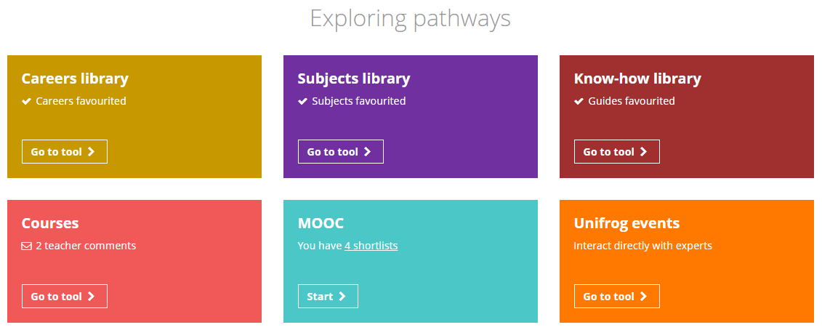

Finding out more about learning pathways
After this lesson, you may wish to find out more about learning pathways.
In the Know-how library, you can read more about the pathways available to you and how to apply for them.
Using the search tools, you can browse specific opportunities.

Slide 10
Looking beyond school – next steps (5 mins)
Which of the following pathways would you like to learn more about, and why?
FE college
Sixth form
Apprenticeship
University
Employment
Volunteering
I would like to find out more about __________________________ because…
I’m going to research this pathway by…
university
I’d like to study a veterinary degree in the future.
asking my teachers which university they attended and what they liked most about it.

Slide 11


