Slide 1

Launching Unifrog
11-14

Slide 2
How to launch Unifrog with your students
Use the student-facing slides of this PowerPoint to:
Show students a launch video to introduce them to Unifrog
Help students sign in to the platform for the first time
Guide students to the Courses tool to complete the Unifrog 101 course
If you’d like to send the Unifrog 101 course directly to students, or you’d like to ask them to complete any unfinished tasks in the course for homework, you can do this using the interactions feature. The next slide explains how.

Slide 3
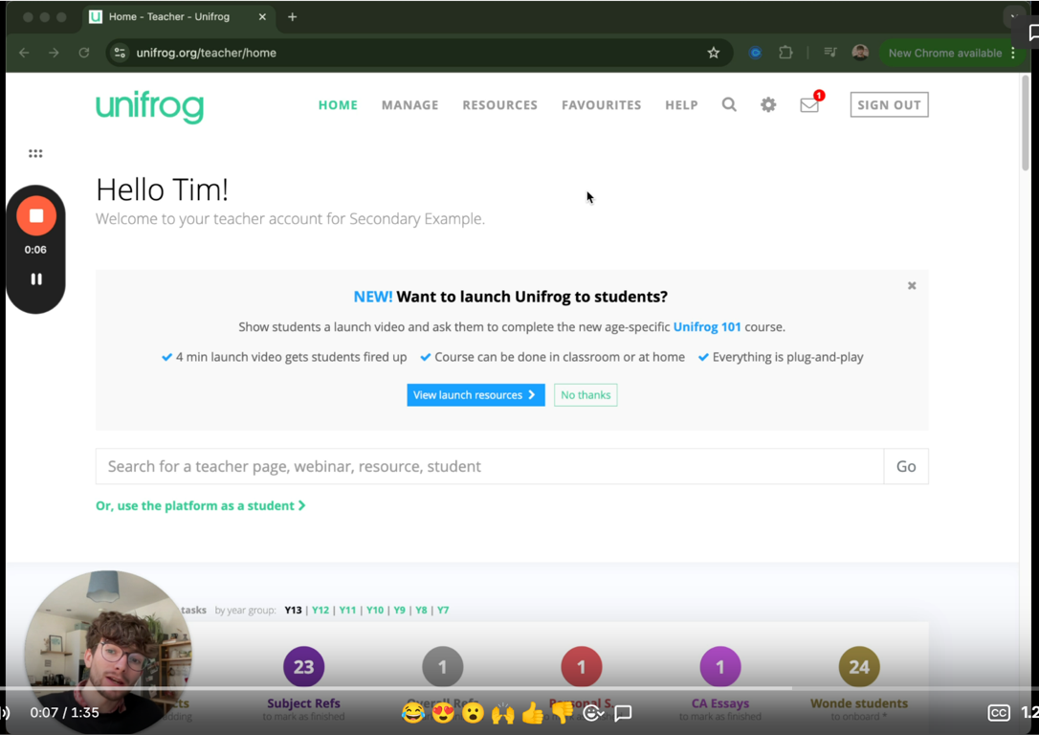
How to set the Unifrog 101 course as an interaction

Slide 4
Student-facing slides

Slide 5
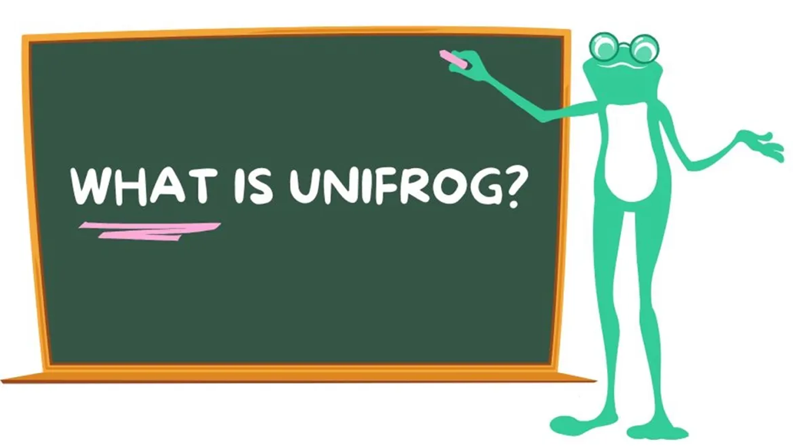
Welcome to Unifrog!
During today’s session, we will…
Watch a video to find out about Unifrog
Sign in to Unifrog
Complete the ‘Unifrog 101’ course to learn how to use the platform

Slide 6
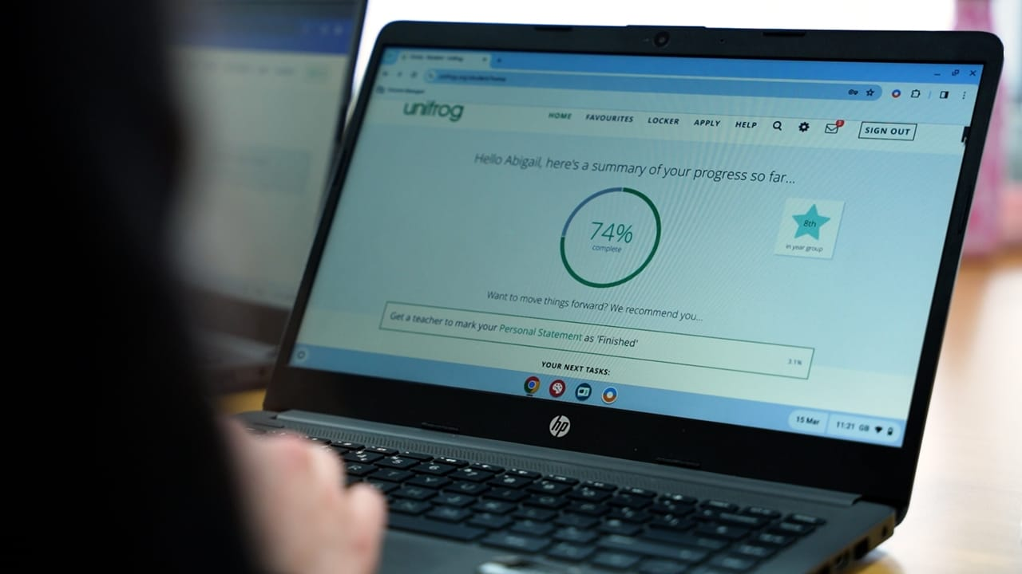
Click the image above to open the Unifrog launch video

Slide 7
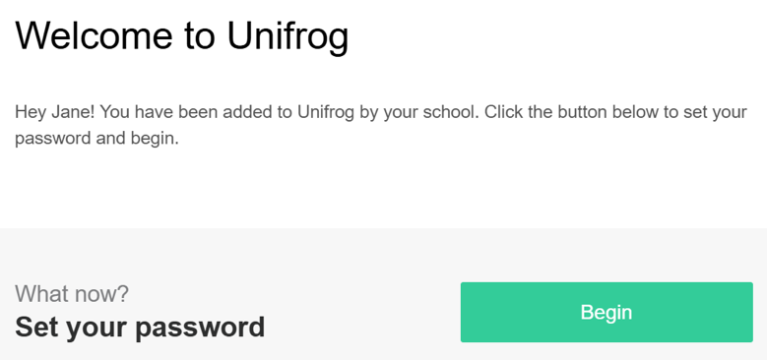
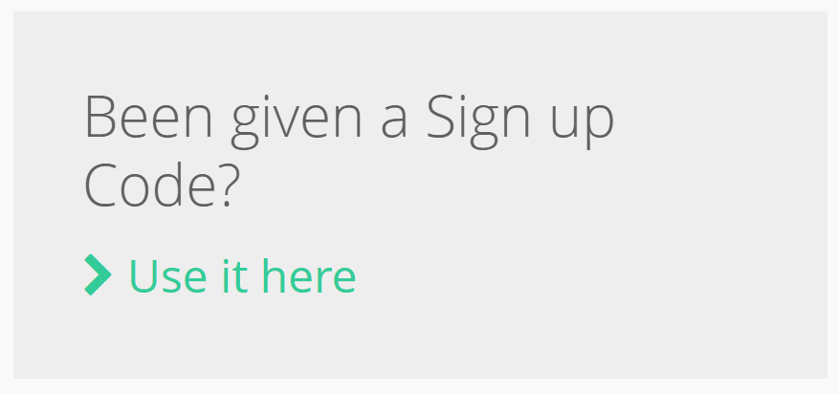
Creating your Unifrog account
How are students creating Unifrog accounts?
Click the method you’re using below.
Welcome email method
(student bulk upload or Wonde)
Sign up Code method

Slide 8
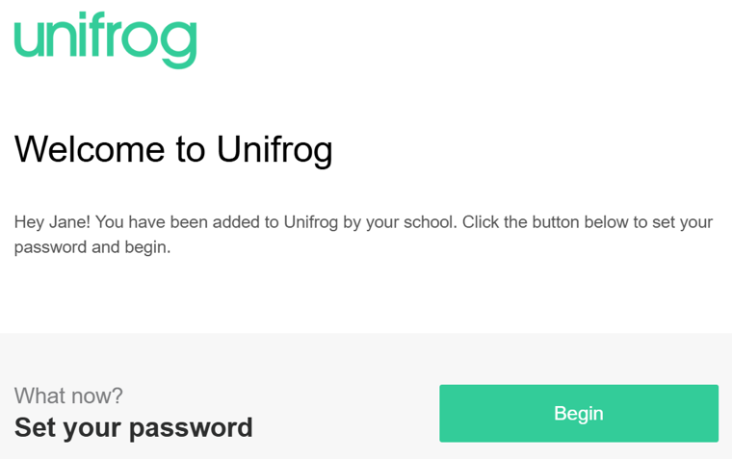
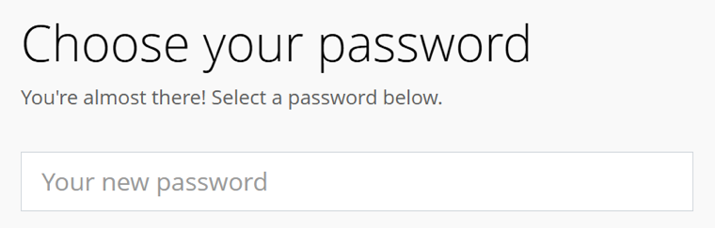
Creating your Unifrog account: Welcome email
An email has been sent to your school email address (check your junk/spam folders).
Click ‘Begin’ and follow the instructions.
Create a memorable password and make a note of it!

Slide 9
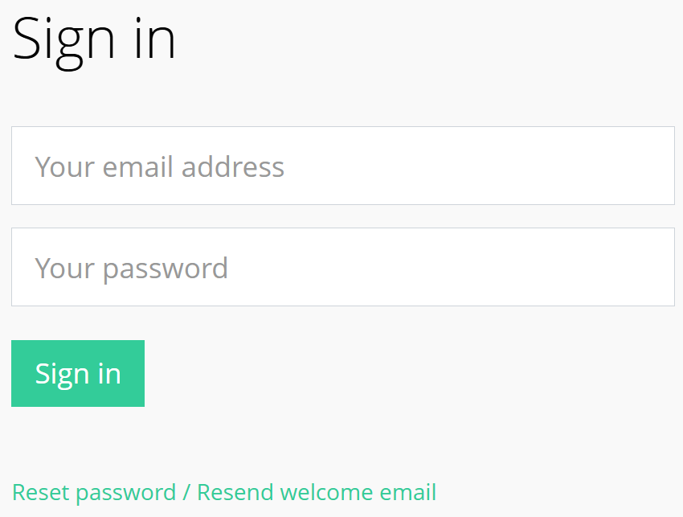
Signing in to your Unifrog account
Now you’re registered, you’ll sign in to Unifrog with your email address and password.
If you forget your password, click the link to reset (remember to check your junk/spam folders just in case!)

Slide 10
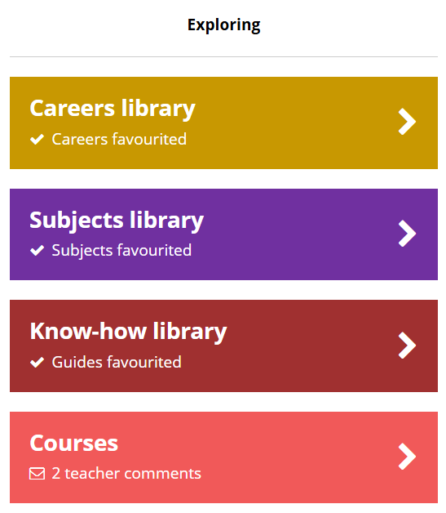

Learning how to use Unifrog
From your Unifrog homepage, scroll down to ‘Exploring.’
If you don’t see the Courses tool straight away, click ‘All tools’.

Slide 11
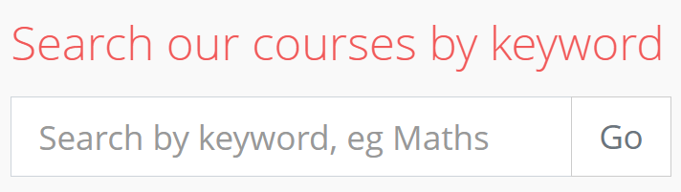
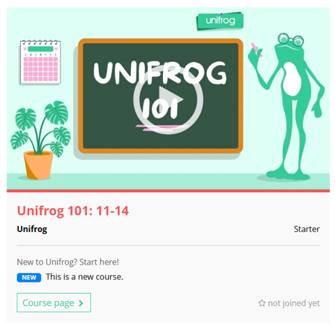
Learning how to use Unifrog
When you’re on the Courses tool, scroll down to the keyword search bar.
Type in ‘101’ and click ‘Go’.
101
You’ll then see the Unifrog 101 course! Click ‘Course page’.

Slide 12
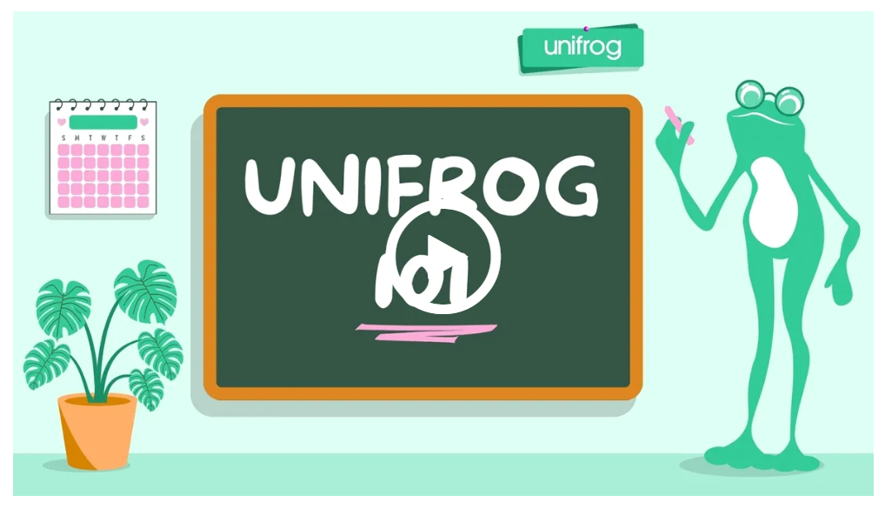
Learning how to use Unifrog
On the course page, you can watch a short intro video about the 101 course.

Slide 13
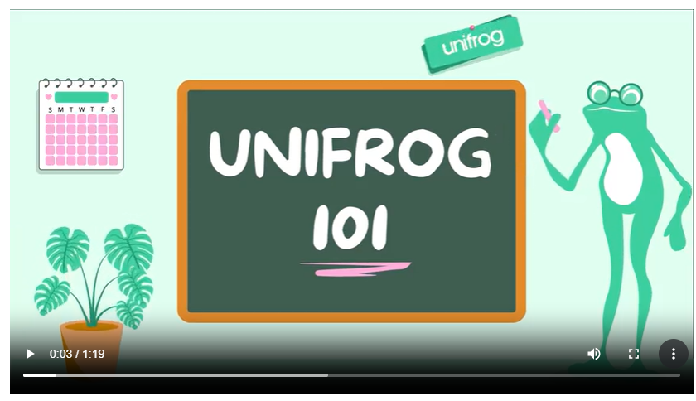
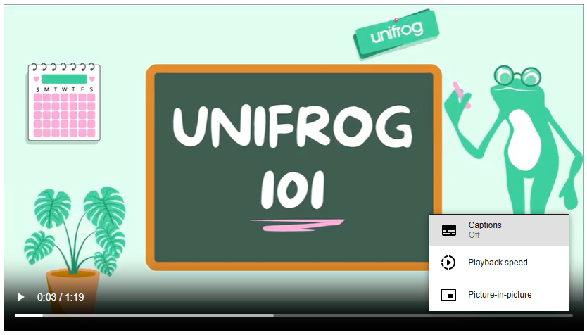
Learning how to use Unifrog
Once the video starts to play, you can turn on the captions using the three dots.

Slide 14
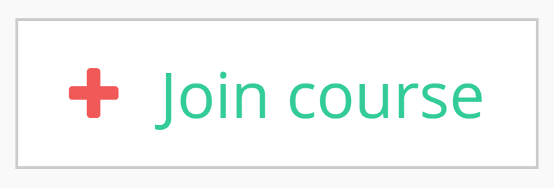
Learning how to use Unifrog
When you’re ready to get started, click ‘Join course’.

Slide 15
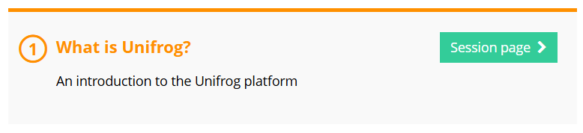
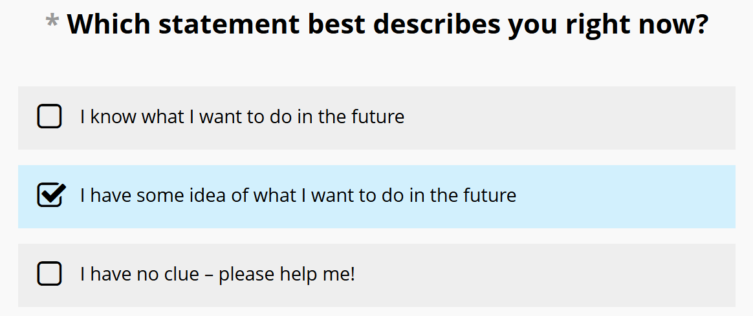
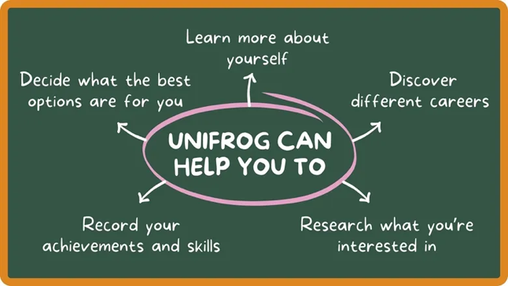
Learning how to use Unifrog
You’ll then have access to session 1! Click ‘Session page’.
Each session has some short videos to watch, things to read, and activities to complete to help you explore Unifrog.

Slide 16
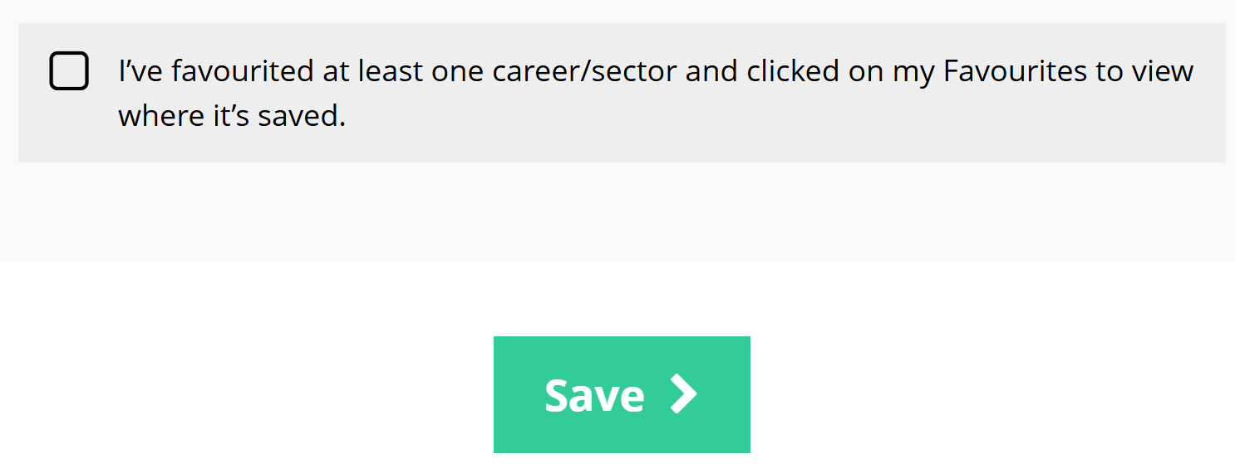
Learning how to use Unifrog
Once you’ve finished the activities in the session 1, tick the checkbox and click ‘Save’.

Slide 17
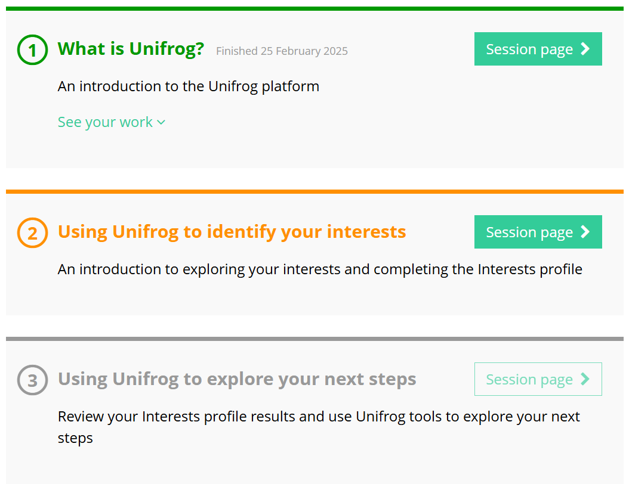
Learning how to use Unifrog
You’ll then be able to access session 2.
Keep going until you’ve completed all sessions!

Slide 18
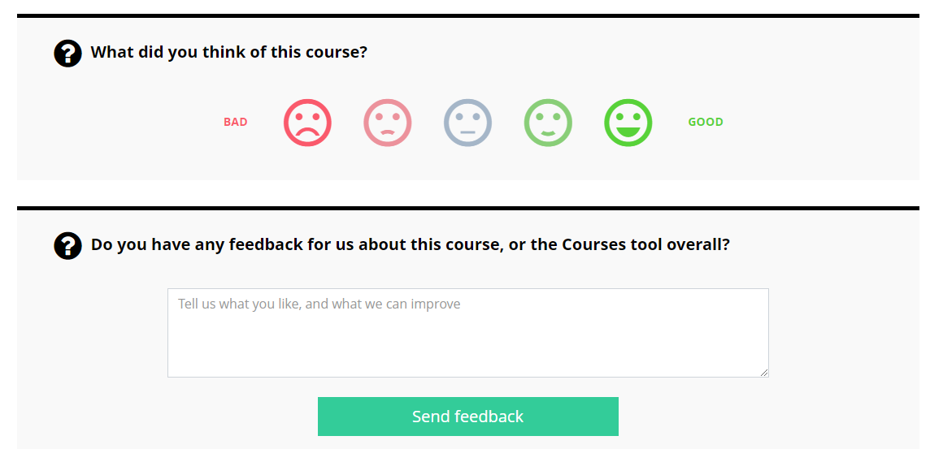
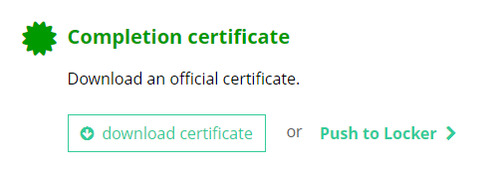
Learning how to use Unifrog
Once all sessions are completed, you’ll be asked for some feedback and you can download your course completion certificate.
I think this course was…

Slide 19
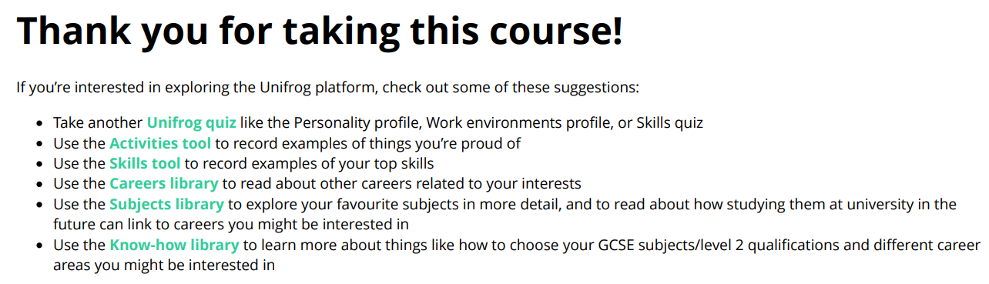
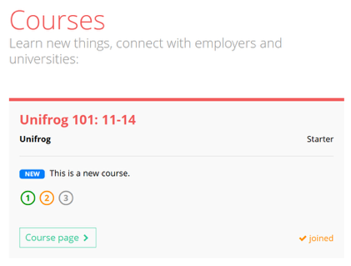
Learning how to use Unifrog
Finished the Unifrog 101 course early?
Check out the last page of your completion certificate for more ways to explore what Unifrog has to offer!
Didn’t get time to finish today?
Don’t worry – you can pick up where you left off next time you log in to Unifrog.

Slide 20


Slide 21
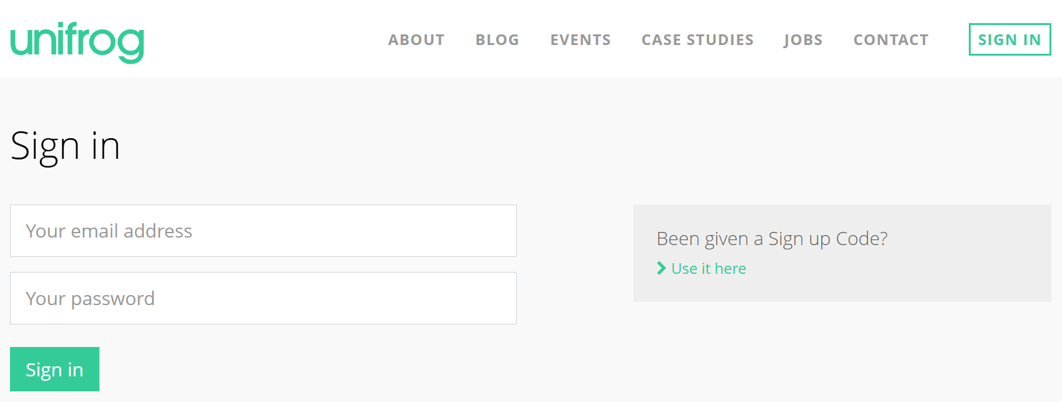
Creating your Unifrog account: Sign up Code
Go to unifrog.org/sign-in and click ‘use it here’.
Notes:
Teacher’s notes:
If your school is using welcome email method (bulk uploading students or onboarding via Wonde), deliver slides in section 1.
If your school is using the Sign up Code method, deliver slides in section 2.
Direct students to: unifrog.org/sign-in

Slide 22
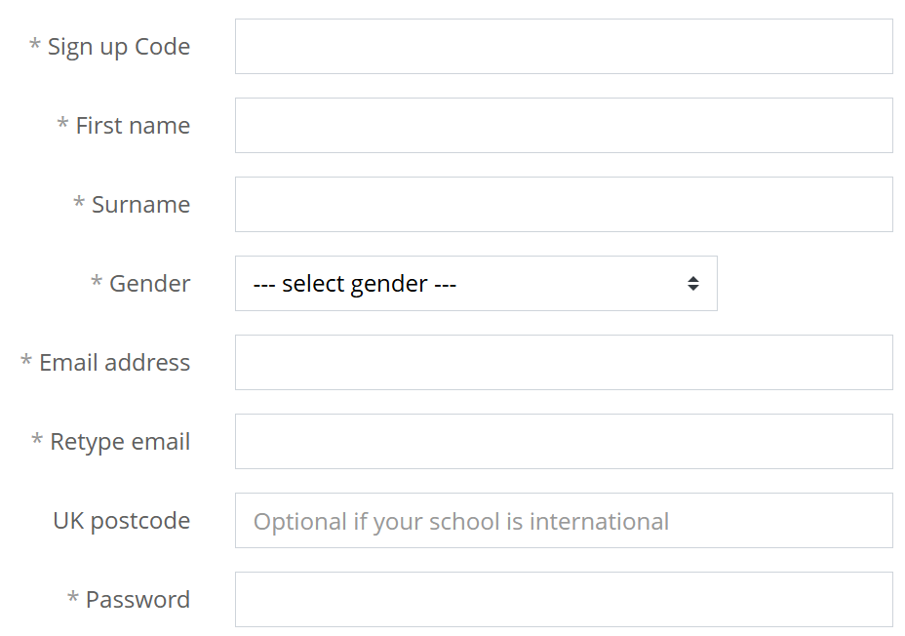
Creating your Unifrog account: Sign up Code
Enter your Sign up Code: ______________________
Use an email address that you access frequently.
Create a memorable password and make a note of it!
Notes:
Teacher’s notes:
If your school is using welcome email method (bulk uploading students or onboarding via Wonde), deliver slides in section 1.
If your school is using the Sign up Code method, deliver slides in section 2.
Edit the top text box to add the Sign up Code your students should use.
Encourage students to make a note of their Unifrog password.

Slide 23
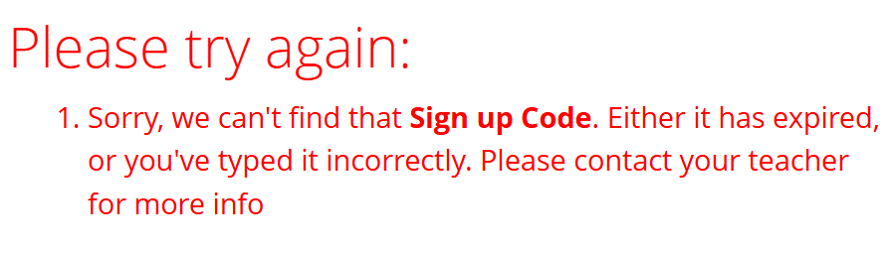
Creating your Unifrog account: Sign up Code
If you see this message, your Sign up Code may have expired or you may have typed it incorrectly.
Ask your teacher for more information.
Notes:
Teacher’s notes:
If your school is using welcome email method (bulk uploading students or onboarding via Wonde), deliver slides in section 1.
If your school is using the Sign up Code method, deliver slides in section 2.

Slide 24
Signing in to your Unifrog account
Now you’re registered, you’ll sign in to Unifrog with your email address and password.
If you forget your password, click the link to reset (remember to check your junk/spam folders just in case!)
Notes:
Teacher’s notes:
Students should use the URL they used to register (unifrog.org/sign-in) each time they want to access the Unifrog platform. Alternatively, they can go to unifrog.org and click the ‘SIGN IN’ button in the top right-hand corner.

Slide 25
Learning how to use Unifrog
From your Unifrog homepage, scroll down to ‘Exploring.’
If you don’t see the Courses tool straight away, click ‘All tools’.
Notes:
Teacher’s notes:
The next few slides show students how to navigate the platform to complete the Unifrog 101: 11-14 course. This course walks students through how to use some key tools on the platform that are well suited to their age group (Careers library, Subjects library, and Interests profile).
If students don’t see the Courses tool on their homepage initially, they’ll need to click ‘All tools’.

Slide 26
Learning how to use Unifrog
When you’re on the Courses tool, scroll down to the keyword search bar.
Type in ‘101’ and click ‘Go’.
101
You’ll then see the Unifrog 101 course! Click ‘Course page’.
Notes:
Teacher’s notes:
Students can use the keyword search bar to locate the Unifrog 101: 11-14 course. Alternatively, share this URL with students: unifrog.org/student/courses/featured/unifrog-101-11-14

Slide 27
Learning how to use Unifrog
On the course page, you can watch a short intro video about the 101 course.
Notes:
Teacher’s notes:
On the course page, students can read about the Unifrog 101: 11-14 course and click the video thumbnail image to watch a short introductory video about the course.

Slide 28
Learning how to use Unifrog
Once the video starts to play, you can turn on the captions using the three dots.
Notes:
Teacher’s notes:
If students have access to earphones, this will allow them to hear the audio in the intro video and videos throughout the 101 course. Alternatively, students can click the three dots in the bottom right-hand corner of a video, then click ‘Captions’ to turn on subtitles.

Slide 29
Learning how to use Unifrog
When you’re ready to get started, click ‘Join course’.
Notes:
Teacher’s notes:
Students don’t need to finish the course today. Joining a course will make the it appear in the carousel at the top of the page next time they use the Courses tool.

Slide 30
Learning how to use Unifrog
You’ll then have access to session 1! Click ‘Session page’.
Each session has some short videos to watch, things to read, and activities to complete to help you explore Unifrog.
Notes:
Teacher’s notes:
Students don’t need to finish the course today. Joining a course will make the it appear in the carousel at the top of the page next time they use the Courses tool.
Course session pages:
After clicking ‘Session page’ students will be able to watch videos, read text, and complete activities.
When clicking links, students should open them in a new tab (or using ‘split view’ on a tablet) so they can return to the session page easily.
Completing session 1 will allow students to then access session 2. Completing session 2 will allow students to then access session 3.
Once students have completed the full course, they can download their completion certificate.

Slide 31
Learning how to use Unifrog
Once you’ve finished the activities in the session 1, tick the checkbox and click ‘Save’.
Notes:
Teacher’s notes:
Students don’t need to finish the course today. Joining a course will make the it appear in the carousel at the top of the page next time they use the Courses tool.
Saving a session:
Students need to confirm they’ve completed the session before clicking ‘Save’.
Students’ answers will be included in their course completion certificate, so encourage them to review their answers before clicking ‘Save.’
Once ‘Save’ is clicked, students cannot edit their answers.

Slide 32
Learning how to use Unifrog
You’ll then be able to access session 2.
Keep going until you’ve completed all sessions!
Notes:
Teacher’s notes:
Students don’t need to finish the course today. Joining a course will make the it appear in the carousel at the top of the page next time they use the Courses tool.
Progressing through a course:
Once a session is marked as complete and saved, this will give students access to the next session in the course. The Unifrog 101: 11-14 course has three sessions.

Slide 33
Learning how to use Unifrog
Once all sessions are completed, you’ll be asked for some feedback and you can download your course completion certificate.
I think this course was…
Notes:
Teacher’s notes:
Students don’t need to finish the course today. Joining a course will make the it appear in the carousel at the top of the page next time they use the Courses tool.
Course completion certificate:
Students can download their certificate or push to their Unifrog Locker.
Students answers to activities will be included in their certificate.
The final page of the certificate includes follow-up activities that students can complete to explore more of the Unifrog platform.

Slide 34
Learning how to use Unifrog
Finished the Unifrog 101 course early?
Check out the last page of your completion certificate for more ways to explore what Unifrog has to offer!
Didn’t get time to finish today?
Don’t worry – you can pick up where you left off next time you log in to Unifrog.
Notes:
Teacher’s notes:
Students don’t need to finish the course today. Joining a course will make the it appear in the carousel at the top of the page next time they use the Courses tool.
Course completion certificate:
Students can download their certificate or push to their Unifrog Locker.
Students answers to activities will be included in their certificate.
The final page of the certificate includes follow-up activities that students can complete to explore more of the Unifrog platform.
Tracking student progress:
You can track who has completed courses (like Unifrog 101: 11-14) via the advanced view. We’d recommend setting a deadline for students to complete this introductory course via the interactions tool.
Quick Task PowerPoints:
If you’d like to introduce students to other platform tools today (or in future), use our ‘Quick Task’ slides for step-by-step presentations about how to use individual Unifrog tools: unifrog.org/teacher/resources/series-quick-tasks

