Slide 1

Exploring possibilities: dream jobs

Slide 2
Your dream job (5 mins)
If you could have any job in the world, what would it be and why?
If I could have any job, I’d be a _____________________ because…
Think about what appeals to you about this job, such as the…
Skills you’d develop
Responsibilities you’d have
Life it would allow you to live
Flexibility it would give you
Day-to-day tasks you’d do
People you’d work with
Salary you’d earn
Opportunities it would give you
Notes:
Teacher’s notes:
For this activity, encourage students to think about their dream job but without any constraints of practicality. It doesn’t matter if this is a job title the student has created themselves, such as ‘chief chocolate taster.’
Some students may justify their choice due to an explicit part of the job, like the day-to-day tasks or the salary. Whereas other students may choose to reflect on how a job might make them feel or how it might fit in with their values.
If time permits, allow a sample of students to share their answers with the class. Encourage students to justify their choices.
Example answers:
If I could have any job, I'd be a chocolatier because making chocolate masterpieces would combine my love of chocolate with being creative and artistic. I'd travel all over the world to run chocolate-making workshops for aspiring chocolatiers
If I could have any job, I’d be a police officer because that’s what my parent does for a job. I think it’s important to work in a job that protects people from harm, and I’d like to follow in my dad’s footsteps.
If I could have any job, I’d be a vet because I absolutely love all of my pets. I have a cat, a dog, and two rabbits. I think it would be so much fun to spend all day looking after animals and making them better. I’m also really good at science and I love learning about biology.

Slide 3
What makes a dream job appealing? (2 mins)
Read this example of Emily’s dream job:
‘If I could have any job, I'd be a chocolatier because making chocolate masterpieces would combine my love of chocolate with being creative and artistic. I'd travel all over the world to run chocolate-making workshops for aspiring chocolatiers.’
Let’s look at what it is about this job that appeals to Emily.
Notes:
Teacher’s notes:
Click to animate annotations of Emily’s dream job. Students will follow the same annotation process themselves in the next activity.

Slide 4
What makes a dream job appealing?
‘If I could have any job, I'd be a chocolatier because making chocolate masterpieces would combine my love of chocolate with being creative and artistic. I'd travel all over the world to run chocolate-making workshops for aspiring chocolatiers.’
The job requires the following skills:
Practical skills
Creativity / innovation
Artistic skills
Notes:
Teacher’s notes:
Click to animate annotations of Emily’s dream job. Students will follow the same annotation process themselves in the next activity.
Stretching activity: Before clicking to animate the skills, ask students if they can identify the skills required for this job first.

Slide 5
What makes a dream job appealing?
‘If I could have any job, I'd be a chocolatier because making chocolate masterpieces would combine my love of chocolate with being creative and artistic. I'd travel all over the world to run chocolate-making workshops for aspiring chocolatiers.’
The job covers the following themes:
Making things
Travel
Helping people
Notes:
Teacher’s notes:
Click to animate annotations of Emily’s dream job. Students will follow the same annotation process themselves in the next activity.

Slide 6
What makes your dream job appealing? (10 mins)
Read the explanation of your own dream job from the starter task.
If I could have any job, I’d be a _____________________ because…
Then annotate your explanation with…
Key skills you’d need for the job, such as:
Any job ‘themes’ that are relevant:
Teamwork
Problem solving
Creativity / innovation
Leadership
Writing
Numeracy
Digital literacy
Technical skills
Artistic skills
Communication
Independence
Digital nomad
Green jobs
Helping people
Helping society
Travel
High salary
Making things
Something different
Notes:
Teacher’s notes:
In the next activity, students will use the skills and themes they’ve identified to explore the Unifrog Careers library.
Key words:
Digital nomad. A person who works online in various locations. They can travel freely while working remotely, e.g. graphic designers.
Green jobs. Jobs that focus on restoring the natural environment, e.g. sustainability officer.

Slide 7
What makes your dream job appealing?
Look over your annotations of skills and job themes.
Then answer the following two questions…
Can you think of any other jobs that would use the same skills as your dream job?
Can you think of any other jobs that would relate to the same themes as your dream job?
Notes:
Teacher’s notes:
In the next activity, students will use the skills and themes identified to explore the Unifrog Careers library.
Example answers:
Dream job - chocolatier:
Creativity / innovation: Tattooist, theatre producer, animator, singer, art editor, DJ, personal shopper, etc.
Making things: Bookbinder, jewellery designer, wardrobe assistant, visual effects (VFX) artist, baker, ceramicist, etc.

Slide 8
Describing your dream company (10 mins)
For this activity, imagine you’re in charge of setting up your dream company.
For example:
Making customers happy by making really tasty chocolates!
For example:
It’s a small company, so you get to know your colleagues well. You get the chance to travel to deliver chocolate-making workshops.
For example:
Emily’s Chocolate Creations is a small chocolate-making business that sells chocolates and teaches aspiring bakers how to make great chocolates.
For example:
Emily’s Chocolate Creations.
Now, write a summary of your dream company.
What’s the company called?
What’s the company like? Describe it in one sentence.
What does the company value?
What’s the work environment like?
What benefits does the company offer their employees?
For example:
Competitive salaries, monthly team social events, free breakfast at the chocolate shop, etc.
Notes:
Teacher’s notes:
The purpose of this activity is to get students thinking about the characteristics of a company they’d like to work for (or run themselves) in the future. For example, what is their ideal work environment?
Encourage students to think about their dream company, without any constraints of practicality.
Click to reveal each question and an associated example.
Prompt questions;
What’s the company like? Is it a large or small company? Does it provide a product or a service? Do you run the company yourself?
What does the company value? Is it an eco-friendly company? What’s the company’s mission? Are they trying to solve a problem? Are they trying to improve people’s lives? Do they have fewer working hours than other companies?
What’s the work environment like? Where would you work? Do you work from home? Do you work outside or in an office? Would your work environment change from day to day? Would you work alone or with other people?
What benefits do they offer their employees? Do they run social events? Do they offer funds towards healthcare or fitness? Do they offer loyalty payments if you work for the company for a long time? Do they pay well?

Slide 9
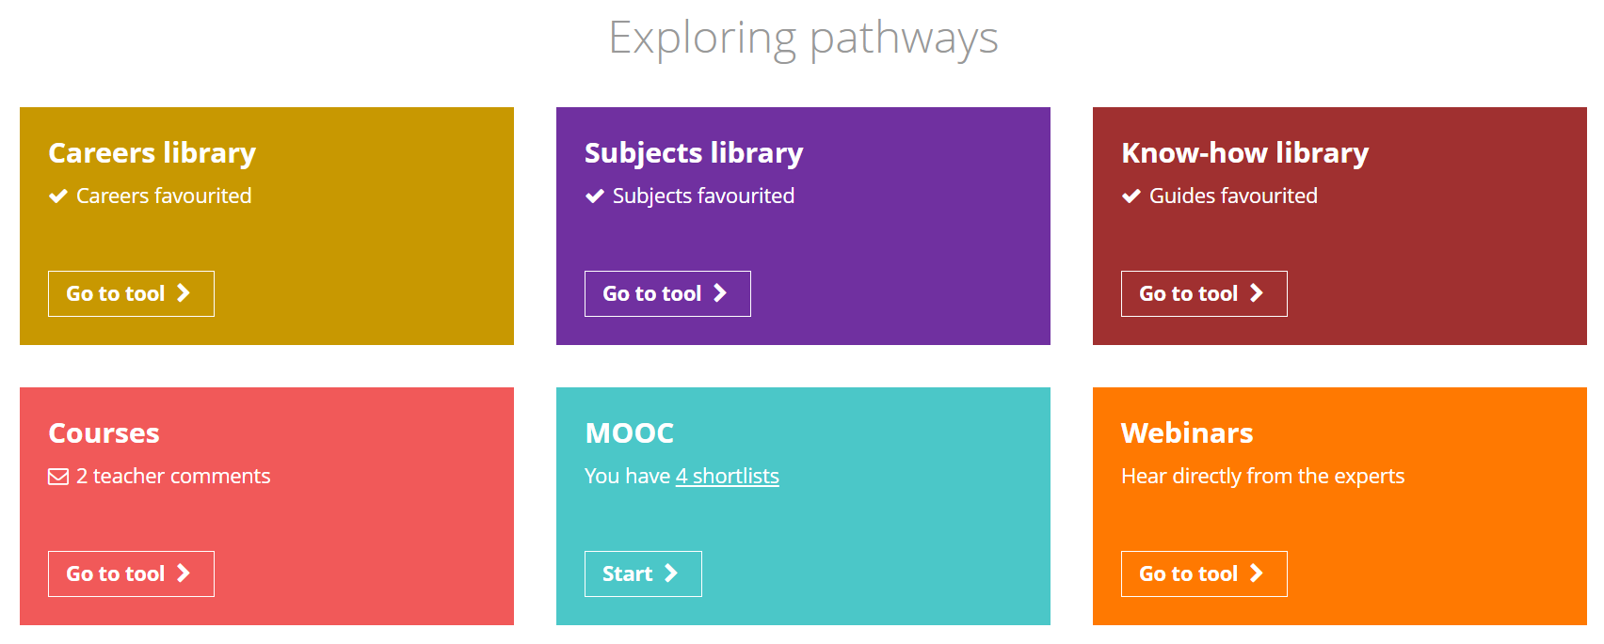
Exploring the Unifrog Careers library (10 mins)
Log in to your Unifrog account and open the Careers library.
Depending on your school, you might see the Careers Sectors library instead – you can still follow the same set of instructions.
Notes:
Teacher’s notes:
Go to Unifrog > Student side > Exploring pathways > Careers library.
If students require some more guidance, direct them to the Know-how library guide titled ‘How to… use the Careers library.’
Tracking students’ progress:
You can track student progress with favouriting career profiles by clicking Advanced>Sort by>Library profiles in Favourites.
From your homepage, you can also create charts showing the range of careers that have been favourited. Go to Usage charts you can customise>Careers library: Favouriting over time / Most popular career areas / Most popular career profiles.

Slide 10
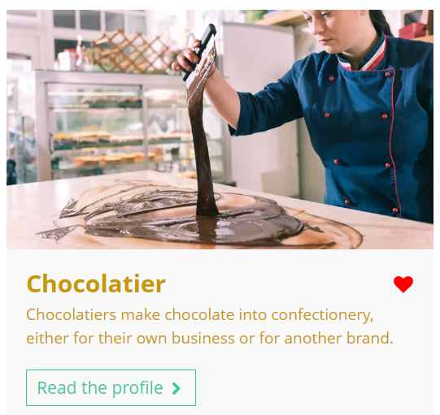
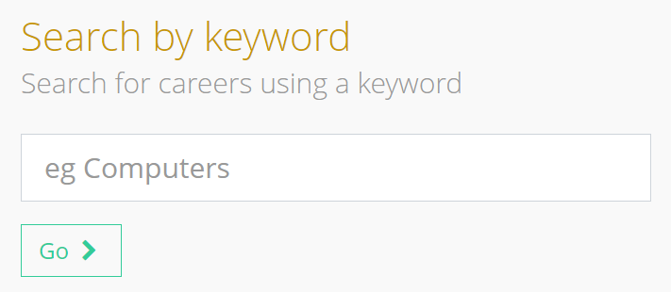
Exploring the Unifrog Careers library
Your dream job might be in Unifrog’s Careers library!
Use the keyword search function to find out.
chocolatier
Remember to click the heart icon to add a career profile to your favourites.
Notes:
Teacher’s notes:
Go to Unifrog > Student side > Exploring pathways > Careers library.
If students require some more guidance, direct them to the Know-how library guide titled ‘How to… use the Careers library.’
Tracking students’ progress:
You can track student progress with favouriting career profiles by clicking Advanced>Sort by>Library profiles in Favourites.
From your homepage, you can also create charts showing the range of careers that have been favourited. Go to Usage charts you can customise>Careers library: Favouriting over time / Most popular career areas / Most popular career profiles.

Slide 11
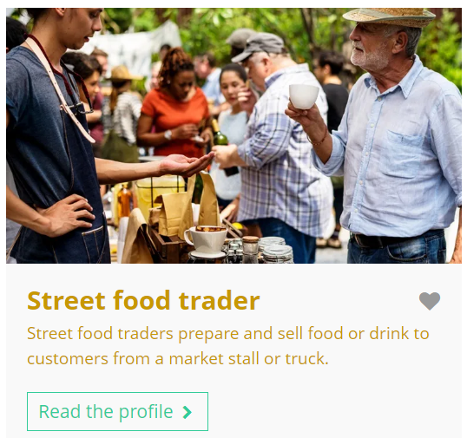
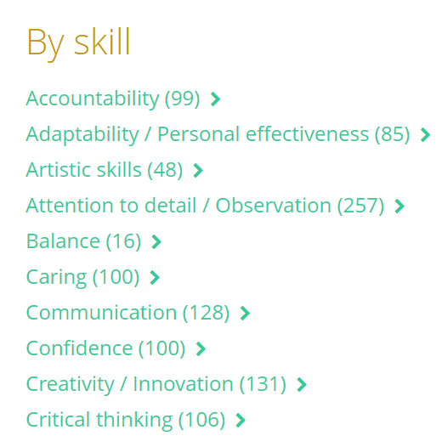
Exploring the Unifrog Careers library
You can also explore careers that use similar skills and have similar themes to your dream job.
Scroll down to search ‘by skill’ or ‘by theme.’
Notes:
Teacher’s notes:
Go to Unifrog > Student side > Exploring pathways > Careers library.
If students require some more guidance, direct them to the Know-how library guide titled ‘How to… use the Careers library.’
Tracking students’ progress:
You can track student progress with favouriting career profiles by clicking Advanced>Sort by>Library profiles in Favourites.
From your homepage, you can also create charts showing the range of careers that have been favourited. Go to Usage charts you can customise>Careers library: Favouriting over time / Most popular career areas / Most popular career profiles.

Slide 12
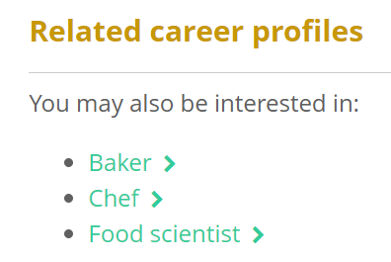
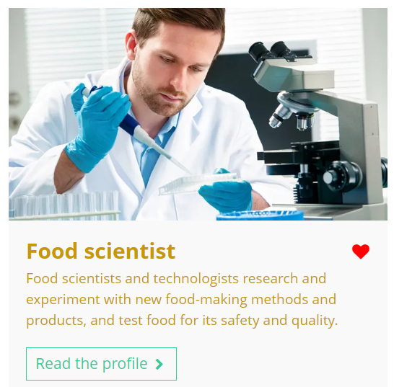
Exploring the Unifrog Careers library
You might discover related careers you haven’t thought about yet.
When you have a career profile open, scroll down to ‘related career profiles’ to explore other careers that you might be interested in too.
Notes:
Teacher’s notes:
Go to Unifrog > Student side > Exploring pathways > Careers library.
If students require some more guidance, direct them to the Know-how library guide titled ‘How to… use the Careers library.’
Tracking students’ progress:
You can track student progress with favouriting career profiles by clicking Advanced>Sort by>Library profiles in Favourites.
From your homepage, you can also create charts showing the range of careers that have been favourited. Go to Usage charts you can customise>Careers library: Favouriting over time / Most popular career areas / Most popular career profiles.

Slide 13
Exploring a career or sector profile (15 mins)
Select one of the careers / sectors you’ve favourited. This might be your dream job, or a new related career you’ve discovered today.
Then, read the profile to help you answer the following questions:
What do you think you’d enjoy the most about this career / sector and why?
What do you think you’d enjoy the least about this career / sector and why?
What do you like or dislike about the working hours and environment for this career / sector and why?
What are the entry requirements and annual median salary for this career / sector?
Notes:
Teacher’s notes:
Profile sections to focus on if using the Careers library:
Students can identify something they like from any part of the profile.
Students can identify something they dislike from any part of the profile.
Working hours and environment.
Entry requirements and Labour market information (LMI) – UK Salary or USA Salary.*
Profile sections to focus on if using the Career Sectors library:
Students can identify something they like from any part of the profile.
Students can identify something they dislike from any part of the profile.
Work environment.
How to get started and Labour market information (LMI) – UK Salary or USA Salary.*
*If you are outside of the UK or USA, you may wish to prompt students to use a currency converter website.
Example answers:
Chocolatier
I would most enjoy creating products by decorating chocolate as this part of the job would suit my artistic skills.
I wouldn’t enjoy doing repetitive tasks as I might get bored if I had to make the same products all day.
I like that you can run your own business and set your own working hours because this would give me the flexibility to balance work with other things that I enjoy, like sports.
I would need catering or cooking experience. I wouldn’t need any specific qualifications. UK annual median salary for the food preparation and hospitality trades: £23,360 (as of July 2023).

Slide 14
Exploring a career or sector profile
Based on your research, rate the career / sector out of 10 and explain your decision.
I think I’d hate it!
I think I’d love it!
I rated this career as _____ out of 10 because…
5 although it sounds fun to travel around the world, the working hours are irregular and I’d have to spend long periods of time away from my friends and family.
Notes:
Teacher’s notes:
The purpose of this activity is to allow students the opportunity to reflect on the career they’ve just researched. Any outcome that allows them to reflect on what they want from a future career is beneficial. For example:
They may have researched their dream job and realised that it actually isn’t an appealing option.
They may have researched their dream job and confirmed their aspirations.
They may have researched a new career / sector and realised that it isn’t suited to them.
They may have researched a new career / sector and discovered a career that is appealing to them.
Click to reveal an example answer on the slide.

Slide 15
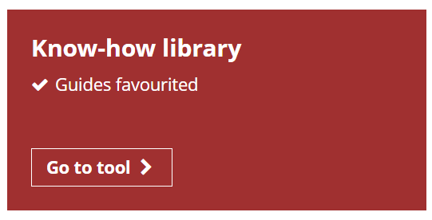
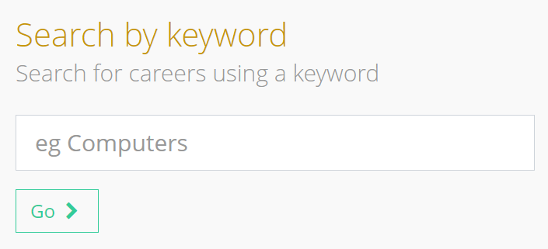
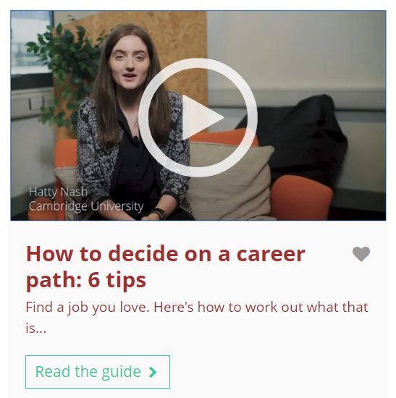
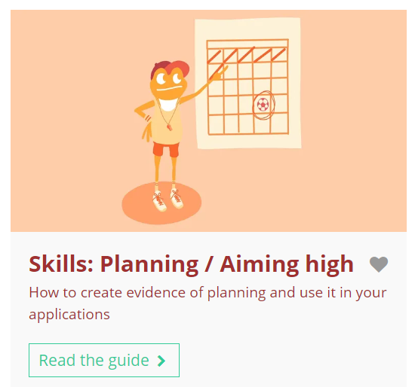

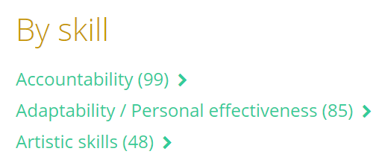
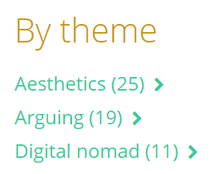
Exploring and discovering dream jobs using Unifrog
After this lesson, you may wish to explore the following Unifrog tools:
Know-how library
Careers library
Notes:
Teacher’s notes:
Know-how library
Students can favourite and read guides relating to career planning, such as:
How to decide on a career path: 6 tips
Seven careers you can go into without qualifications
How to become self-employed
Skills: Planning / Aiming high
How to… use the Careers library
You can track student progress with favouriting guides by clicking Advanced>Sort by>Library profiles in Favourites.
Careers library
Students can explore the Careers library to find out more information about their dream job or discover new careers they weren’t previously aware of.
You can track student progress with favouriting career profiles by clicking Advanced>Sort by>Library profiles in Favourites.

Slide 16
Having a dream job vs. exploring other careers (8 mins)
Discuss the questions below with the person next to you and write down at least two benefits for each.
1.
What are the benefits of identifying a dream job?
2.
What are the benefits of exploring other careers as well?
Notes:
Teacher’s notes:
If time permits, allow students a few minutes to discuss each question and then gather some ideas in a whole-class review.
Suggested answers:
Benefits to identifying a dream job
It can motivate you to reach your goals and think about your career journey.
It allows you to reflect on what’s important to you in life.
It encourages you to be aspirational and aim high.
It allows you to reflect on what you’d like the most from your career.
Benefits to exploring other careers
Your dream job might change over time – e.g. as you get older, your priorities may change.
Your dream job may not be a practical / feasible option.
There might be other careers that you’d love that you haven’t considered yet.
There might be new careers that exist when you’ve finished school that don’t exist today.

Slide 17


