Slide 1

Careers and the future

Slide 2
The future of careers (5 mins)
Read the statements below and finish the sentences next to each one.
  65% of students will be employed in careers that don’t exist yet.
This fact makes me feel…
  Digital literacy is an important skill that will be valuable in lots of future careers.
I think digital literacy will be important in my future career because…
  Creativity, problem-solving, and critical thinking are core skills that will be needed across a range of future careers.
I think these skills are going to be needed in lots of future careers because…
Notes:
Teacher’s notes:
If time is limited, students can focus on completing one of the three sentences.
If time allows, encourage a sample of students to share their ideas with the class.
Source: LinkedIn (2023)
Example answers:
This makes me feel… nervous but excited about the future.
I think digital literacy will be important in my future career because… almost all careers use an element of technology.
I think these skills are going to be needed in lots of future careers… because these are skills that technology like AI isn’t great at. They’re transferable skills useful in lots of different careers.

Slide 3
Popularity of careers and subjects (5 mins)
In 2024-2025, what do you think were the top five most favourited career profiles in Unifrog’s Careers library? Write down your predictions now!
Sports professional
Actor
Interior designer
Entrepreneur
CEO
Notes:
Teacher’s notes:
Click to reveal answers.
Sports professional – 28,752. Sports professionals are paid to train and compete in their chosen sport.
Actor – 23,492. Actors bring stories and characters to life in film and television, on the stage, in audiobooks, or on the radio.
Interior designer – 19,910. Interior designers plan, design, and decorate spaces inside buildings.
Entrepreneur – 18,559. Entrepreneurs build a business, company, or organisation on their own initiative.
CEO (Chief executive officer) – 17,612. A CEO is responsible for overseeing the overall operations, strategy, and management of an organisation.
Source: Unifrog’s Careers library – student favouriting in the 2024-2025 academic year.

Slide 4
Popularity of careers and subjects
In 2024-2025, what do you think were the top five most favourited subject profiles in Unifrog’s Subjects library? Write down your predictions now!
Psychology
Criminology
Law and legal studies
Mathematics
Business and management
Notes:
Teacher’s notes:
Click to reveal answers.
Psychology – 21,794. The scientific study of the mind and how it affects behaviour.
Criminology – 20,848. Criminology is an area of sociology that focuses on the study of crimes and their causes, effects, and social impact.
Law and legal studies – 20,002. The academic study and application of legal rules to real life scenarios, covering areas such as crime, property and human rights.
Mathematics – 17,139. The study of mathematical concepts, theories, and applications which can include pure and applied mathematics, statistics, and theoretical physics.
Business and management – 16,133. Learn how businesses are organised and managed. This is a subject area designed to develop business leaders.
Source: Unifrog’s Subjects library – student favouriting in the 2024-2025 academic year.

Slide 5
Popularity of careers and subjects
    What do you think will be the most popular careers and subjects in the future?
In 2040, I think the most popular career will be ____________ because….
In 2040, I think the most popular subject will be ____________ because….
Notes:
Teacher’s notes:
Click to reveal sentence starters.
There is no right or wrong answer to this question – the aim is to get students thinking about careers in the future.
Prompt questions:
Do you think the current most popular careers and subjects will remain the most popular choices in the future? Why or why not?
What could spark someone’s interest in a career or subject?
Could there be ‘new’ careers that don’t exist yet? Why?
What factors could motivate someone to enter a specific career sector? E.g. number of jobs available, average salary, opportunities to progress, good work-life balance, motivating roles, etc.

Slide 6
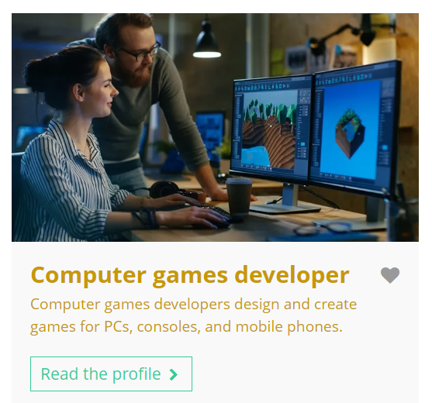
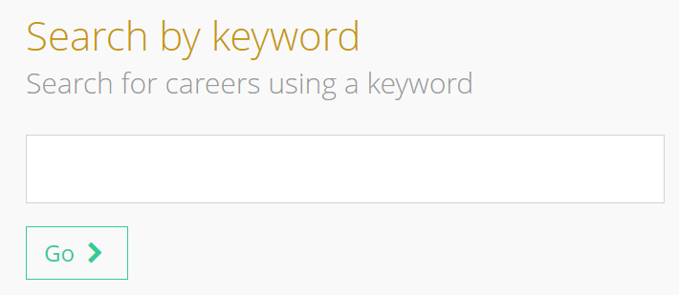

Using the Unifrog Careers library (10 mins)
Log in to your Unifrog account and go to the Careers library.
Search for the ‘Computer games developer’ profile.
Read the profile and get ready to answer questions about the career.
Computer games developer
    This is an example of a relatively ‘new’ career that has seen a lot of growth. This means there are many more computer games developers than there used to be, and it’s predicted there will be even more in the future.
Notes:
Teacher’s notes:
Go to Unifrog > Student side > Exploring pathways > Careers library. If you wish to display the profile on the board, make sure you’re logged into the student side of your Unifrog account and click the career profile thumbnail image on the slide.
If students are using the digital workbook, they can click the provided link to go directly to the career profile.
Careers sectors library:
If your school has the Careers sectors library switched on for students in year 7 / grade 6 to year 9 / grade 8, then they will need to follow the link provided in the digital workbook, rather than searching for the career in the Careers library. Alternatively, they can review the ‘Computers’ sector profile.

Slide 7
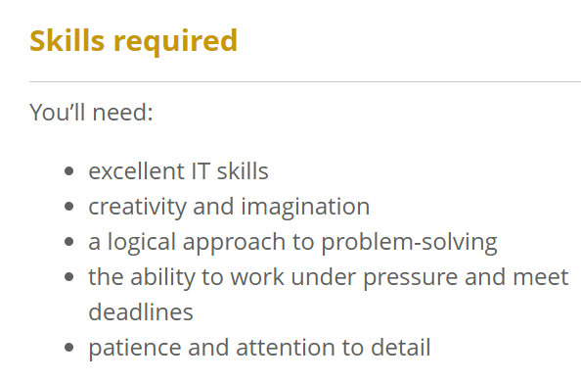
Using the Unifrog Careers library
Select one of the skills and explain why you think it’s important for a computer games developer.
Notes:
Teacher’s notes:
To answer question 1, students will need to use the section titled ‘Skills required.’

Slide 8
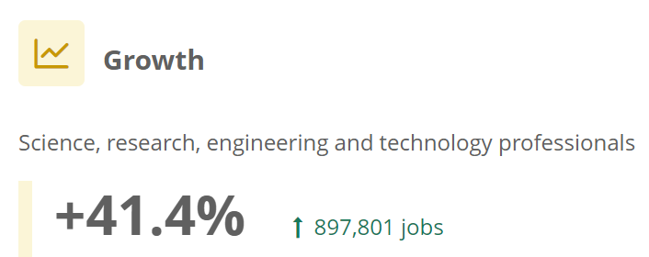
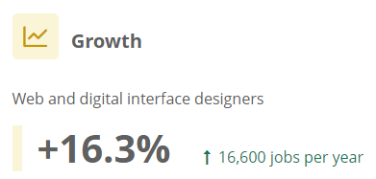
Using the Unifrog Careers library
Select one of the skills and explain why you think it’s important for a computer games developer.
UK
Why do you think there is growth in this career sector?
US
Notes:
Teacher’s notes:
To answer question 1, students will need to use the section titled ‘Skills required.’
To answer question 2, students will need to use the section titled ‘Growth’ within the ‘Labour Market Information (LMI)’ part of the profile. If you are delivering this lesson outside of the UK or USA, you may wish to provide students with local LMI about this industry (optional).

Slide 9
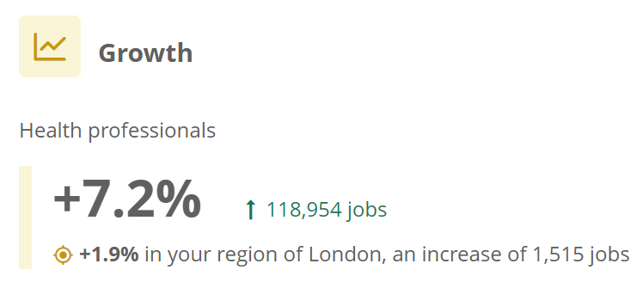

Finding out more about careers and the future
After this lesson, you might like to explore other career profiles within the Careers library.
Scroll down to ‘Labour Market Information (LMI)’ and look at the Growth section.
You can see how much different careers are predicted to ‘grow’ in the future.
Notes:
Teacher’s notes:
You can track student progress with favouriting profiles by clicking Advanced>Sort by>Library profiles in Favourites.
From your homepage, you can also create charts showing the careers that have been favourited. Go to Usage charts you can customise>Careers library: Favouriting over time / Most popular career areas / Most popular career profiles.

Slide 10
Preparing for the careers of the future (5 mins)
Remember, it’s predicted that 65% of you will be employed in a career that doesn’t exist yet!
Select one of the following skills that future employers might value.
Note down an example of how you could develop this skill now.
Digital literacy
Creativity / innovation
Critical thinking
Problem solving
Could you develop this skill at home?
Could you develop this skill at school?
Could you develop this skill through a hobby?
Notes:
Teacher’s notes:
For more information about skills, direct students to the Know-how library guide titled ‘Skills: what are they are why do they matter?’
Keywords:
Digital literacy. Effectively using digital tools like the internet and software.
Creativity / innovation. Using your imagination to come up with new ideas.
Critical thinking. Evaluating information to form your own opinion.
Problem solving. Finding a solution to a situation or challenge.
Example answer:
I could develop my creativity / innovation skills by writing short stories and coming up with interesting narratives.

Slide 11


