Slide 1

What are my interests?

Slide 2

Starter: What are you proud of? (7 mins)
Write down at least three things you’re really proud of.
Use the examples to help you.
Performing in the school play
Baking my sister’s birthday cake
Winning 100m in Sports Day
Singing my first solo at school
Being awarded a certificate in Art
Making friends at a new school
Growing plants from seeds
Learning how to code
Notes:
Teacher’s notes:

Slide 3
Starter: What are you proud of? (7 mins)
Pick one achievement and write who helped you. Explain what they did to help.
Use the example as a guide.
Winning 100m in Sports Day
  “My dad helped me practice for the 100m sprint on sports day. Every night, we would go and practice in the park. He would time me and give me tips on how to improve my running technique.”
If you have time, repeat this exercise for another achievement.
Notes:
Teacher’s notes:
Here are additional examples:
Performing in the school play
“I was really nervous to perform my solo in the school play. I spoke to my Drama teacher who suggested some techniques to overcome my stage fright.”
Baking my sister’s birthday cake
“My grandma helped me by buying ingredients and showing me her recipe book. I mostly did it all by myself, but she helped me set the oven to the right temperature and taught me how to check the cake was ready.’
Singing my first solo at school
“My music teacher helped me work on my breath control to hit the really big note in the song I was performing. We had to practice it a lot together, but over time, I became really confident that I could sing it!”

Slide 4
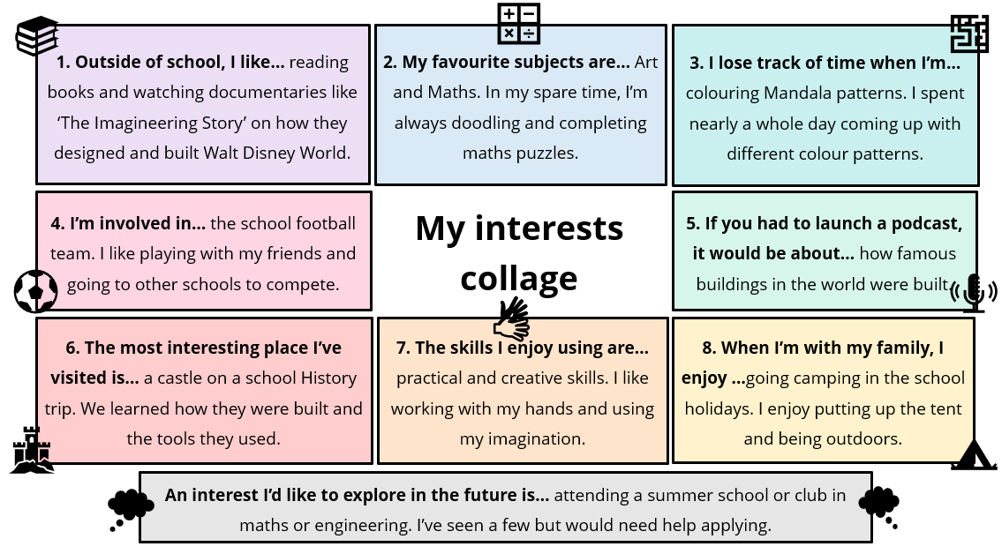
Career connections (10 mins)
Look at your interests collage. Identify and write down at least three keywords.
Use the example to help
Art
Buildings
Practical
Creative
Math
Notes:
Teacher’s notes:

Slide 5
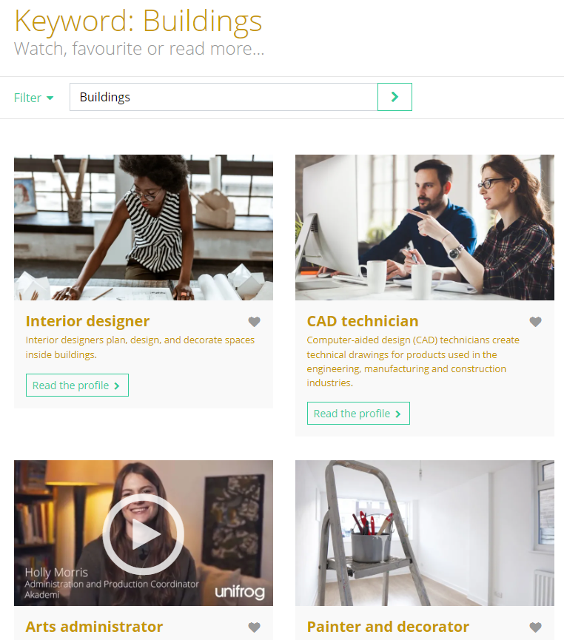

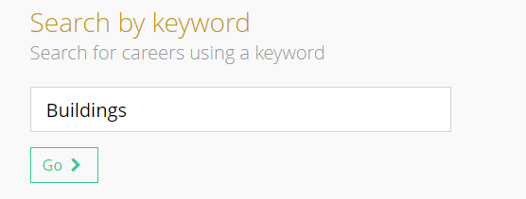
Career connections (10 mins)
Next, log in to the Unifrog Careers library and search by any of these keywords.
Art
Buildings
Practical
Creative
Math
Notes:
Teacher’s notes:

Slide 6

Career connections
Use the filter function to search for careers that interest you.
Click on the profile and read the information.
Write down at least three things that match the interests you have.
Example: Interior designer
Uses practical skills
Creates sketches and detailed drawings
Entry is through courses in art or design
Notes:
Teacher’s notes:
Remind students to heart Career profiles they like so they can come back and visit them later.

Slide 7
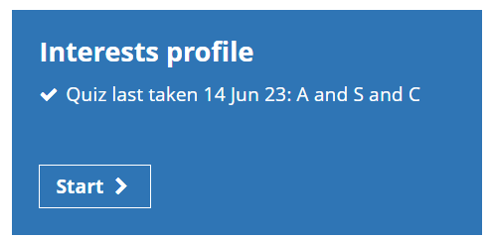
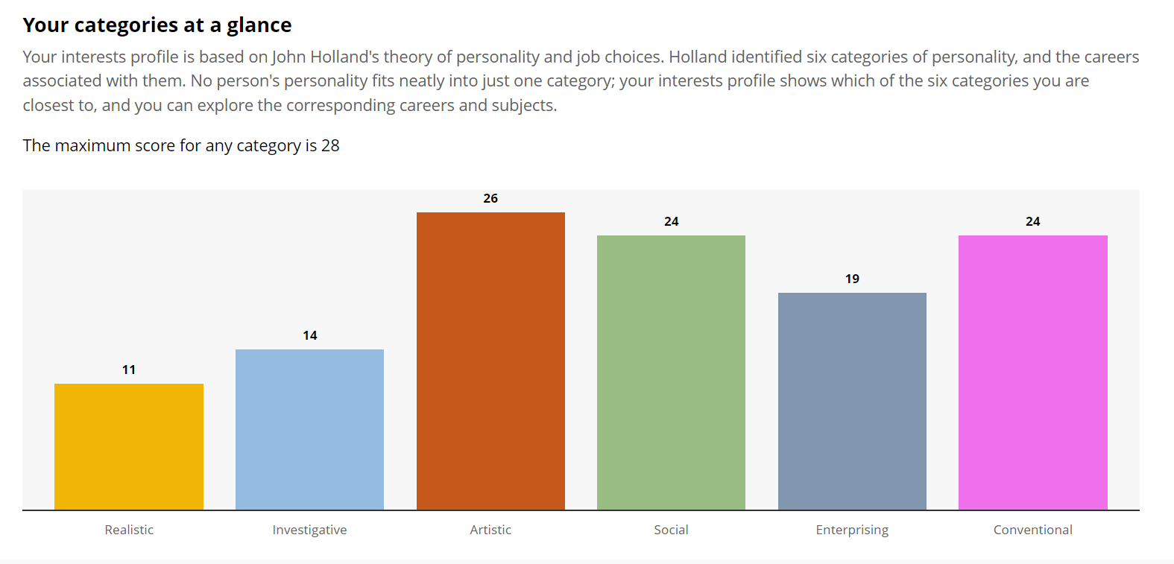

Independent learning (1 min)
In your spare time, complete the Unifrog Interests profile. You’ll find out which of the six Holland codes you match: Realistic, Investigative, Artistic, Social, Enterprising and Conventional.
Each type represents different work environments and activities that people might enjoy. Use this to help discover careers that match your interests.
Notes:
Teacher’s notes:
If you feel confident, demo the tool by going to Unifrog > Student side > Interests Profile.
To follow on from this lesson, you might choose to run the quick task: 15min platform access called ‘Taking the interests profile quiz’. You can find this on the UK Careers Year plan on the ‘Quick task: 15min platform access’ tab under ‘Quizzes’.

Slide 8
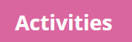
Plenary: recording your achievements (7 mins)
Activities task:
Log on to Unifrog.
Go to ‘Activities’.
Press Add an activity
Choose one thing you wrote down in this lesson to add to the tool.
Use the example to help.
Your role: Designed art project
Activity type: Independent Academic Work
Description: I created a 3D model of an imaginary island. I sketched my island design on paper. Then, I used modelling clay to create the basic shape and left it to dry. I used acrylic paints to add colour. I used fake grass and moss. I added additional structures such as trees, houses, boats, animals and bridges. I was awarded an academic excellence award in Art and Design for my model, and it is on display in the Art building.
Select skills: Creativity
Date started / finished: January 2023 – April 2023
Referee: Miss McDonald
Notes:
Teacher’s notes:
If you feel confident, demo the tool by going to Unifrog > Student side > Activities.
The example mirrors the boxes on the Unifrog Activities tool.
Additional information:
Your role:
This will depend on the specific example. Here are some other examples: Being a good sister, Looking after plants, Lead in the school play, Participant in music concerts.
What type of activity was it?
Students can use the ‘how to define the different types’ drop-down function within the Activities tool. However, encourage students not to get too hung up about selecting the ‘right’ type as their example may fit into a few types.
Description (and achievements)
Students can use the ‘following these 5 tips’ drop-down function within the Activities tool. Overall students should show measurable impact, be specific, use the present tense only if it’s something they still do and explain the significance of the activity.
Skills
Students will have to select a skill from a list including Ready, Writing, Numeracy, Planning / Aiming high, Listening, Speaking, Teamwork, Leadership, Problem-solving, Creativity / Innovation, Independence, Resilience / Staying positive.
Date started and Date finished
Students should leave the finished date blank if it’s still ongoing.
Referee
This is someone who can confirm that you did this activity. For example, a teacher, parent, coach etc.

Slide 9


