Slide 1

What type of career is best for me?

Slide 2
Talking about careers (5 mins)
Look at the statements below. Which one do you agree with most? Which one do you agree with least? Explain your answers.
To me, a career means climbing the ladder – you start off in a low paid job and then get promoted.
I can’t think of anything worse than being stuck in the same job for 40 years. I’d be so bored!
Any career I have would need to fit around my life, not the other way around.
To me, a career means not staying in one place. You move to different jobs at different organisations.
I have loads of different interests and ideas. I don’t want to have to choose just one to earn money from.
Notes:
Teacher’s notes:
The purpose of this activity is to get students thinking about the type of career that might be right for them. There are no “right” or “wrong” answers here – only personal preference.
Later in the session, students will revisit these statements and apply them to four different career types:
Single track career
Serial career
Portfolio career
Lifestyle career
There is no “correct” career type to choose – students should choose the one that fits best with their interests, personality and values.

Slide 3
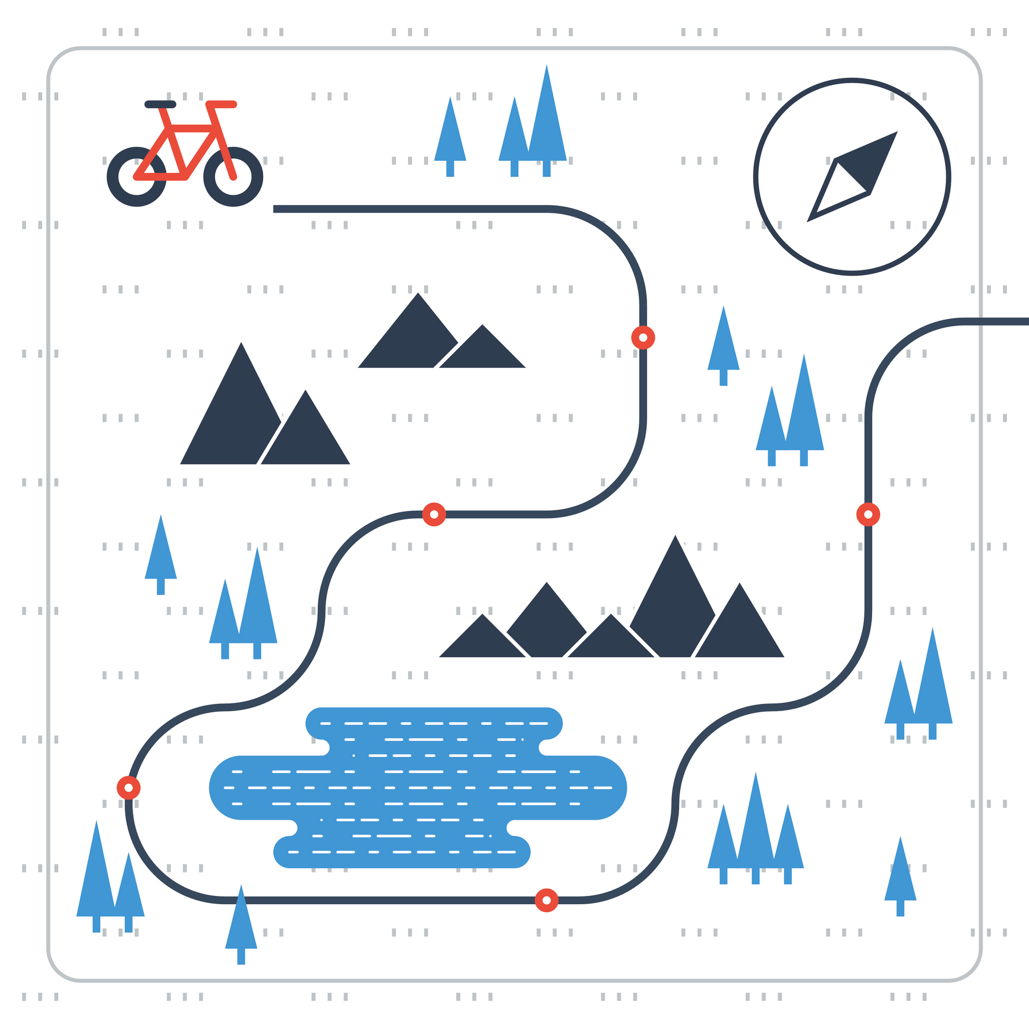
What’s the difference between a career and a job? (2 mins)
A career is the name for the journey you take through life, learning and work.
A job is a stop on that journey.
Education, training and other life experiences are tools to help you to navigate your career journey .
Alfie tells his friend, “I don’t want a career, I just want a job!”.
Write down what his friend could say to help him understand the idea of a career better.
Notes:
Teacher’s notes:
The CDI define a career as a journey through life, learning, and work. Journeys can take different directions and there are usually multiple routes that individuals can take to achieve their career goals. Career goals can change numerous times throughout your life and should not be thought of as deterministic, but instead, flexible.
The purpose of this task is to get students to recognise that the term “career” does not just apply to the professions, or that having a career has to involve climbing the ladder and progressing to the top of an organisation. The word “career” is relevant to all students as it describes their journey through life and work, and that might look different for each individual.
Suggested answers:
“A career just describes the journey you take through life and work, so getting a job (any job) is part of that journey.”
“You don’t have to climb the ladder to have a career, any job you get in your life makes up your career.”
“You don’t have to be a doctor or a lawyer to have a career, more “ordinary” jobs count as a career too!”
“A career isn’t just about joining a profession,”
“If you get a job, that’s a stop on your career journey!”

Slide 4
What are the different types of careers? (5 mins)
Match the type of career to its description:
Single track career
Moving from job to job at different companies or organisations. You might move to a promoted position, you might do a “sideways move” into a similar job, or you might step down into a role with fewer responsibilities.
Serial career
Doing two or more different jobs at the same time. This might involve a mixture of working freelance for different clients, taking on short term projects or contracts and/or running a small business.
Portfolio career
Choosing an industry, starting at the bottom and working your way up by getting promoted. Some people call this climbing the career ladder.
A career built around work/life balance. This might mean choosing a job to fit around your hobbies, such as becoming a ski instructor or a yoga teacher, or it might mean finding a job that allows you to balance your work and family roles easily.
Lifestyle career
Notes:
Teacher’s notes:
Answers on the next slide.

Slide 5
What are the different types of careers? (5 mins)
Match the type of career to its description:
Single track career
Choosing an industry, starting at the bottom and working your way up by getting promoted. Some people call this climbing the career ladder.
Moving from job to job at different companies or organisations. You might move to a promoted position, you might do a “sideways move” into a similar job, or you might step down into a role with fewer responsibilities.
Serial career
Portfolio career
Doing two or more different jobs at the same time. This might involve a mixture of working freelance for different clients, taking on short term projects or contracts and/or running a small business.
Lifestyle career
A career built around work/life balance. This might mean choosing a job to fit around your hobbies, such as becoming a ski instructor or a yoga teacher, or it might mean finding a job that allows you to balance your work and family roles easily.
Notes:
Teacher’s notes:
Remind students there is no “correct” career type – you choose the one that suits you best!

Slide 6
What are the different types of careers?
On the next slides, you’ll see the statements from the starter task again.
What type of career would you suggest for each person?
a) Single track career
Choosing an industry, starting at the bottom and working your way up.
b) Serial career
Moving from job to job at different companies or organisations.
c) Portfolio career
Doing two or more different jobs or freelance contracts at the same time.
d) Lifestyle career
A career built around work/life balance. This might be based on a hobby.
Notes:
Teacher’s notes:
If time is tight, you might want to run through the next slides verbally rather than getting students to write down their answers.

Slide 7
What are the different types of careers?
To me, a career means climbing the ladder – you start off in a low paid job and then get promoted.
What type of career would you suggest?
a) Single track career
Choosing an industry, starting at the bottom and working your way up.
b) Serial career
Moving from job to job at different companies or organisations.
c) Portfolio career
Doing two or more different jobs or freelance contracts at the same time.
d) Lifestyle career
A career built around work/life balance. This might be based on a hobby.
Notes:
Teacher’s notes:
Career suggestion(s):
Single track
Benefits:
Stable income which will increase over time.
Gaining experience and knowledge in one area, becoming an expert.
Risks:
You might get bored.
These types of careers are increasingly uncommon, so it might not be a realistic goal.

Slide 8
What are the different types of careers?
To me, a career means climbing the ladder – you start off in a low paid job and then get promoted.
a) Single track career
Choosing an industry, starting at the bottom and working your way up.
The benefits
Stable income which will increase over time.
Gaining experience and knowledge in one area; becoming an expert.
The drawbacks
You might get bored
Single track careers are increasingly rare - this might not be a realistic goal.
Notes:
Teacher’s notes:
Career suggestion(s):
Single track
Benefits:
Stable income which will increase over time.
Gaining experience and knowledge in one area, becoming an expert.
Risks:
You might get bored.
These types of careers are increasingly uncommon, so it might not be a realistic goal.

Slide 9
What are the different types of careers?
What type of career would you suggest?
Any career I have would need to fit around my life, not the other way around.
a) Single track career
Choosing an industry, starting at the bottom and working your way up.
b) Serial career
Moving from job to job at different companies or organisations.
c) Portfolio career
Doing two or more different jobs or freelance contracts at the same time.
d) Lifestyle career
A career built around work/life balance. This might be based on a hobby.
Notes:
Teacher’s notes:
Career suggestion(s):
Lifestyle
Benefits:
Great work/life balance.
You get to do something you love.
Risks:
May not be very financially rewarding.
Lack of stability.

Slide 10
What are the different types of careers?
Any career I have would need to fit around my life, not the other way around.
d) Lifestyle career
A career built around work/life balance. This might be based on a hobby.
The benefits
Great work/life balance.
You get to do something you love.
The drawbacks
May not be very financially rewarding.
Lack of stability.
Notes:
Teacher’s notes:
Career suggestion(s):
Lifestyle
Benefits:
Great work/life balance.
You get to do something you love.
Risks:
May not be very financially rewarding.
Lack of stability.

Slide 11
What are the different types of careers?
I have loads of different interests and ideas. I don’t want to have to choose just one to earn money from.
What type of career would you suggest?
a) Single track career
Choosing an industry, starting at the bottom and working your way up.
b) Serial career
Moving from job to job at different companies or organisations.
c) Portfolio career
Doing two or more different jobs or freelance contracts at the same time.
d) Lifestyle career
A career built around work/life balance. This might be based on a hobby.
Notes:
Teacher’s notes:
Career suggestion(s):
Portfolio
Benefits:
Get to pursue your interests.
Won’t get bored.
Risks:
Lack of stability
A lot to keep track of

Slide 12
What are the different types of careers?
I have loads of different interests and ideas. I don’t want to have to choose just one to earn money from.
c) Portfolio career
Doing two or more different jobs or freelance contracts at the same time.
The drawbacks
Lack of stability
No regular income
A lot to keep track of
The benefits
You get to pursue lots of different interests.
You won’t get bored.
Notes:
Teacher’s notes:
Career suggestion(s):
Portfolio
Benefits:
Get to pursue your interests.
Won’t get bored.
Risks:
Lack of stability
A lot to keep track of

Slide 13
What are the different types of careers?
What type of career would you suggest?
I can’t think of anything worse than being stuck in the same job for 40 years. I’d be so bored!
a) Single track career
Choosing an industry, starting at the bottom and working your way up.
b) Serial career
Moving from job to job at different companies or organisations.
c) Portfolio career
Doing two or more different jobs or freelance contracts at the same time.
d) Lifestyle career
A career built around work/life balance. This might be based on a hobby.
Notes:
Teacher’s notes:
Career suggestion(s):
Anything except single track
Benefits:
Opportunity to try out different roles at different organisations, developing skills and interests.
Risks:
If you don’t have a plan, you could end up losing direction.

Slide 14
What are the different types of careers?
I can’t think of anything worse than being stuck in the same job for 40 years. I’d be so bored!
b) Serial career
Moving from job to job at different companies or organisations.
c) Portfolio career
Doing two or more different jobs or freelance contracts at the same time.
d) Lifestyle career
A career built around work/life balance. This might be based on a hobby.
The benefits
Try out different roles and organisations, developing skills and interests.
The drawbacks
If you don’t have a plan, you could end up losing direction.
Notes:
Teacher’s notes:
Career suggestion(s):
Anything except single track
Benefits:
Opportunity to try out different roles at different organisations, developing skills and interests.
Risks:
If you don’t have a plan, you could end up losing direction.

Slide 15
What are the different types of careers?
To me, a career means not staying in one place. You move to different jobs at different organisations.
What type of career would you suggest?
a) Single track career
Choosing an industry, starting at the bottom and working your way up.
b) Serial career
Moving from job to job at different companies or organisations.
c) Portfolio career
Doing two or more different jobs or freelance contracts at the same time.
d) Lifestyle career
A career built around work/life balance. This might be based on a hobby.
Notes:
Teacher’s notes:
Career suggestion(s):
Serial
Benefits:
Sense of momentum and direction
Experience lots of different organisations, taking skills and experience from each
Risks:
No obvious career progression route - have to decide for yourself what to do next

Slide 16
What are the different types of careers?
To me, a career means not staying in one place. You move to different jobs at different organisations.
b) Serial career
Moving from job to job at different companies or organisations.
The benefits
You can experience lots of different organisations, taking skills and experience from each.
The drawbacks
There is no obvious career progression route - you have to decide for yourself what to do next.
Notes:
Teacher’s notes:
Career suggestion(s):
Serial
Benefits:
Sense of momentum and direction
Experience lots of different organisations, taking skills and experience from each
Risks:
No obvious career progression route - have to decide for yourself what to do next

Slide 17
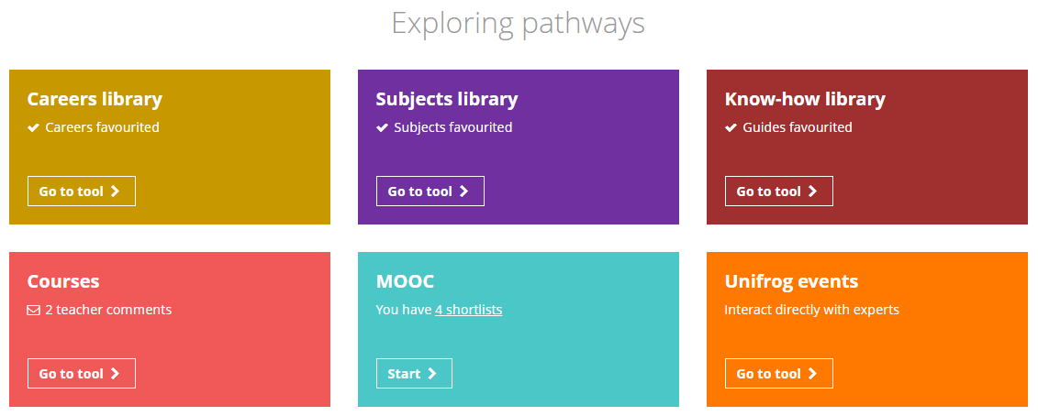
The Unifrog Careers library tool
After this lesson, if you want to browse careers related to your interests, you can log in to your Unifrog account and open the Careers library tool.
Notes:
Teacher’s notes:
Go to Unifrog > Student side > Exploring pathways > Careers library.
If time allows, you could model this for students. If time is tight, you can simply signpost the tool.
Tracking students’ progress:
You can track student progress with favouriting career profiles by clicking Advanced>Sort by>Library profiles in Favourites.
From your homepage, you can also create charts showing the range of careers that have been favourited. Go to Usage charts you can customise>Most popular career profiles.

Slide 18
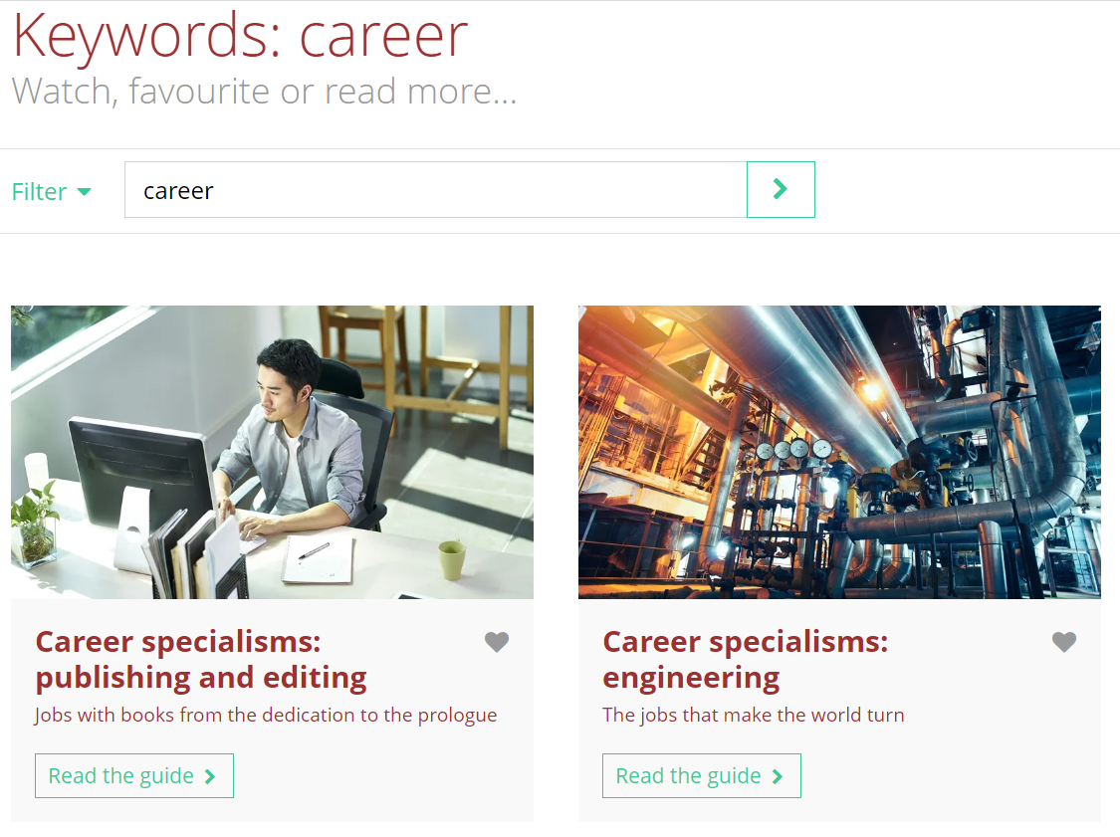
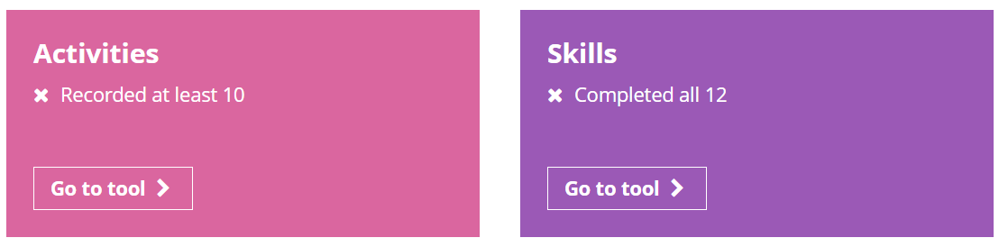
Finding out more about careers
If you want to find out more about careers you can use the Know-how library tool and search ‘career’. You can read guides on lots of different career specialisms.
You can also keep track of things you’re doing to support your career journey, such as you activities, achievements and skills. Visit the Activities tool and Skills tool on your Unifrog homepage.
Notes:
Teacher’s notes:
Students can find out more about careers on:
The Know how library (search ‘career’ or specific jobs)
Students can keep track of their career journey by:
Adding awards, achievements and activities to the Activities tool
Adding skills and on the Skills tool and keep track of how they’re developing their skill set through different levels.

Slide 19
What type of career is right for me? (3 mins)
Having a positive career means:
a) being happy with how you spend your time
b) having a decent standard of living
c) being able to make a contribution to your community
With this in mind, what type of career do you think would suit you best, and why?
Single track career
Portfolio career
Lifestyle career
Serial career
I think a ___________________________ career would suit me best, because… _______________________________________________________________________________
Lifestyle career
having a good work life balance is really important to me.
Notes:
Teacher’s notes:
Remind students that there are no “correct” career paths. This activity simply helps them to think about which option might work best for them.
A reminder of definitions:
Single track career: Choosing an industry, starting at the bottom and working your way up by getting promoted. Some people call this climbing the career ladder.
Serial career: Moving from job to job at different companies or organisations. You might move to a promoted position, you might do a “sideways move” into a similar job, or you might step down into a role with fewer responsibilities.
Portfolio career: Doing two or more different jobs at the same time. This might involve a mixture of working freelance for different clients, taking on short term projects or contracts and/or running a small business.
Lifestyle career: A career built around work/life balance. This might mean choosing a job to fit around your hobbies, such as becoming a ski instructor or a yoga teacher, or it might mean finding a job that allows you to balance your work and family roles easily.

Slide 20


