Slide 1

Quick task: Shortlisting colleges and sixth forms

Slide 2
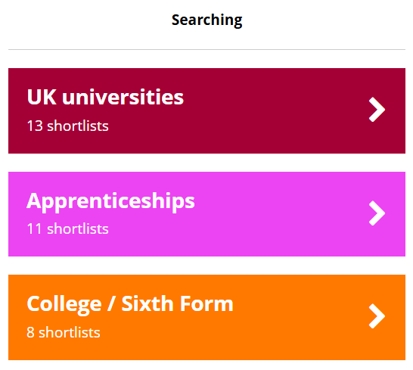

Using the Unifrog College / Sixth Form tool
The next few slides will show you how to use the College / Sixth Form tool.
After logging into your Unifrog account, scroll down to ‘Searching.’
If you don’t see the College / Sixth Form tool straight away, click ‘All tools’.
Notes:
Teacher’s notes:
The next few slides will teach students how to navigate the platform to use the College / Sixth Form tool.
Ask students to log into their Unifrog accounts and open the College / Sixth Form tool. You can demonstrate this on a smart board by clicking Student side>College / Sixth Form.

Slide 3
Using the Unifrog College / Sixth Form tool
You can use the College / Sixth Form tool to find the following types of courses:
Entry – level 2
Level 3
Level 4
Levels 5 - 6
Up to and including GCSEs and equivalent
A levels, T levels, and equivalent
HNCs and equivalent
HNDs, foundation degrees, bachelor’s and equivalent
Notes:
Teacher’s notes:
The next few slides will teach students how to navigate the platform to use the College / Sixth Form tool.
Unifrog has numerous other shortlisting tools, if students are interested in a pathway that is not a UK college or sixth form.

Slide 4
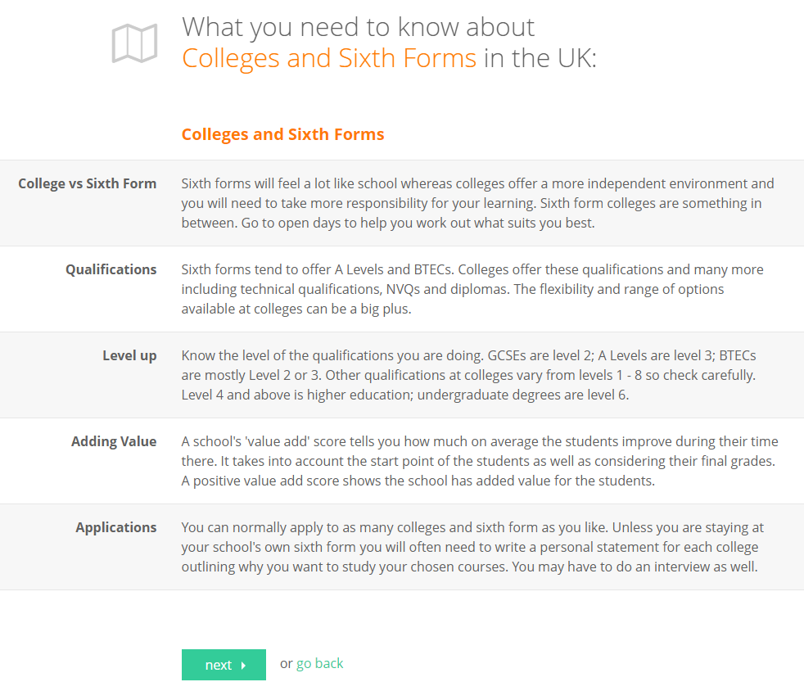
Using the Unifrog College / Sixth Form tool
You’ll see some information about colleges and sixth forms to read first.
To get started with your search, click ‘next.’
Notes:
Teacher’s notes:
The next few slides will teach students how to navigate the platform to use the College / Sixth Form tool.
Students can read information about UK colleges and sixth forms, under the following headings:
College vs Sixth Form
Qualifications
Level up
Adding value
Applications
Students are to click ‘next’ to begin their search.

Slide 5
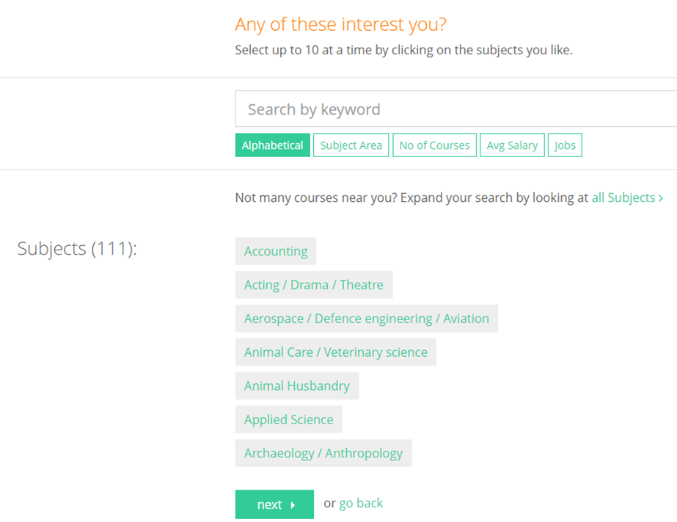
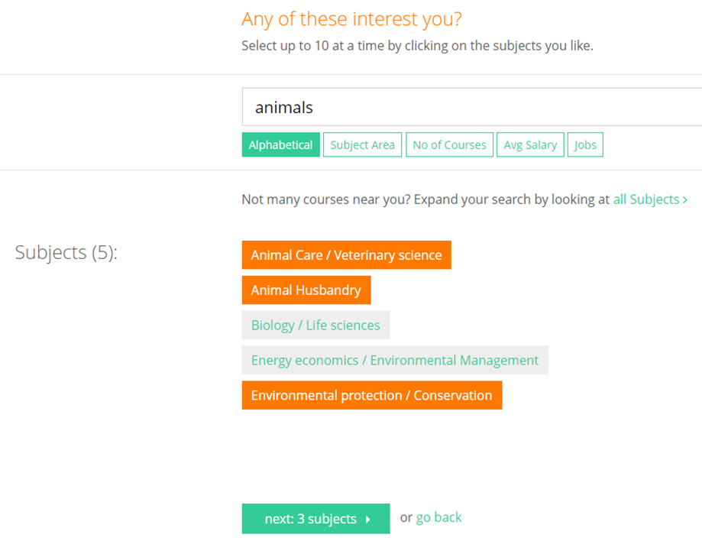
Using the Unifrog College / Sixth Form tool
Select up to 10 of the subjects that interest you and click ‘next: X subjects’.
Notes:
Teacher’s notes:
The next few slides will teach students how to navigate the platform to use the College / Sixth Form tool.
Students are to select up to 10 subjects, before clicking ‘next: X subjects.’
Students can create multiple shortlists, so they can repeat the process for different subjects if they’re still deciding what they’d like to study at college / sixth form.

Slide 6
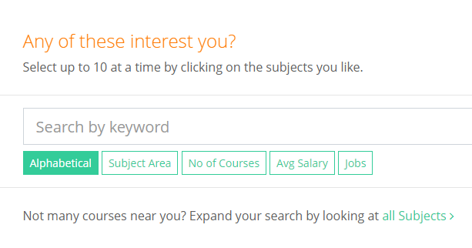
Using the Unifrog College / Sixth Form tool
Or click ‘all Subjects’ to explore all the courses available in your area.
Notes:
Teacher’s notes:
The next few slides will teach students how to navigate the platform to use the College / Sixth Form tool.
Students are to select up to 10 subjects, before clicking ‘next: X subjects.’
Students can create multiple shortlists, so they can repeat the process for different subjects if they’re still deciding what they’d like to study at college / sixth form.

Slide 7
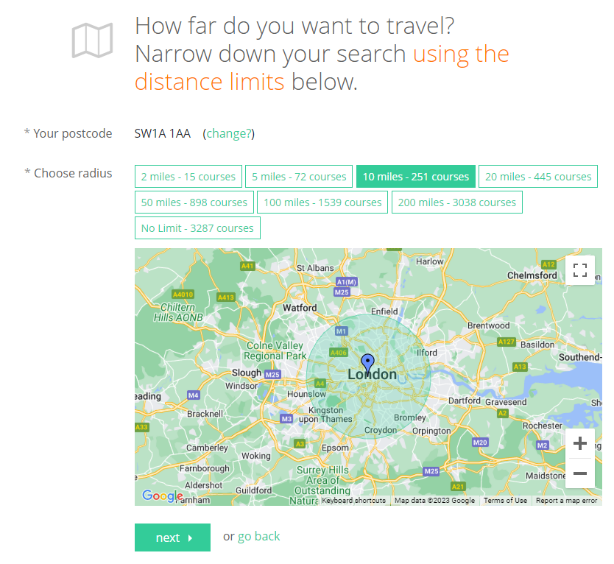
Using the Unifrog College / Sixth Form tool
Select the maximum distance you’d be prepared to travel to a college / sixth form.
Which mode of transport will you use?
Notes:
Teacher’s notes:
The next few slides will teach students how to navigate the platform to use the College / Sixth Form tool.
Students are to check that their postcode is correct, or click ‘change?’ to update.
Students are then to select the radius: 2 miles, 5 miles, 10 miles, 20 miles, 50 miles, 100 miles, 200 miles, or no limit.
Encourage students to consider how they would travel to a college or sixth form.

Slide 8
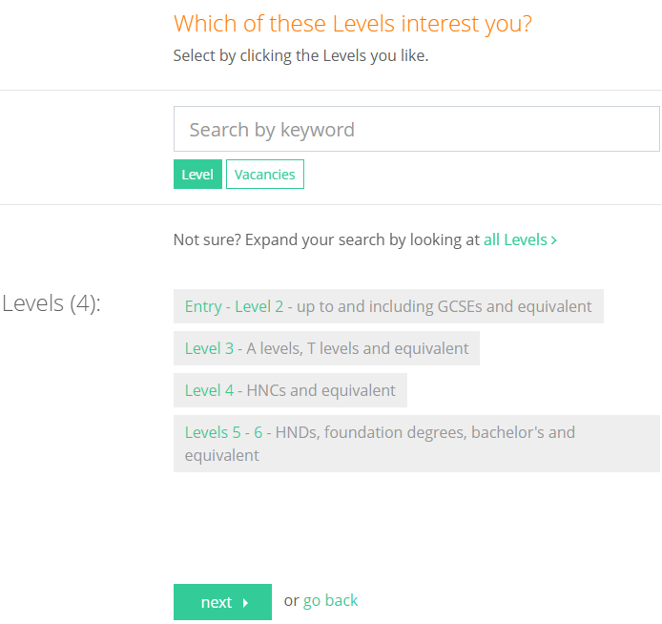
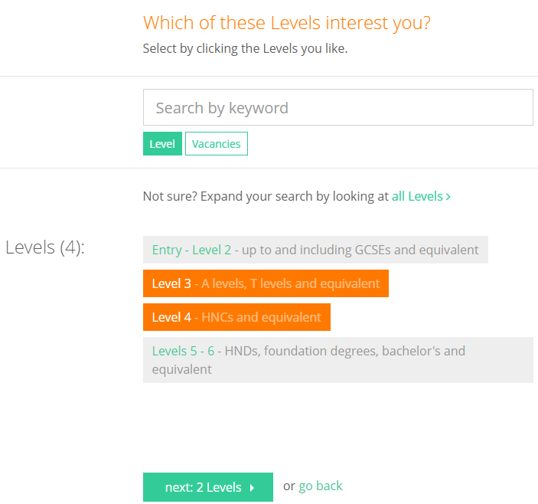
Using the Unifrog College / Sixth Form tool
Select the course levels you’re interested in and click ‘next: X Levels’ to create your longlist.
Or click ‘all Levels’ to explore all courses available in your area.
Notes:
Teacher’s notes:
The next few slides will teach students how to navigate the platform to use the College / Sixth Form tool.
Students are to select the course levels they’re looking for, before clicking ‘next: X Levels.’
Students can choose to view any combination of entry – level 2 courses, level 3 courses, level 4 courses, level 5 courses, or they can click ‘all Levels’.

Slide 9
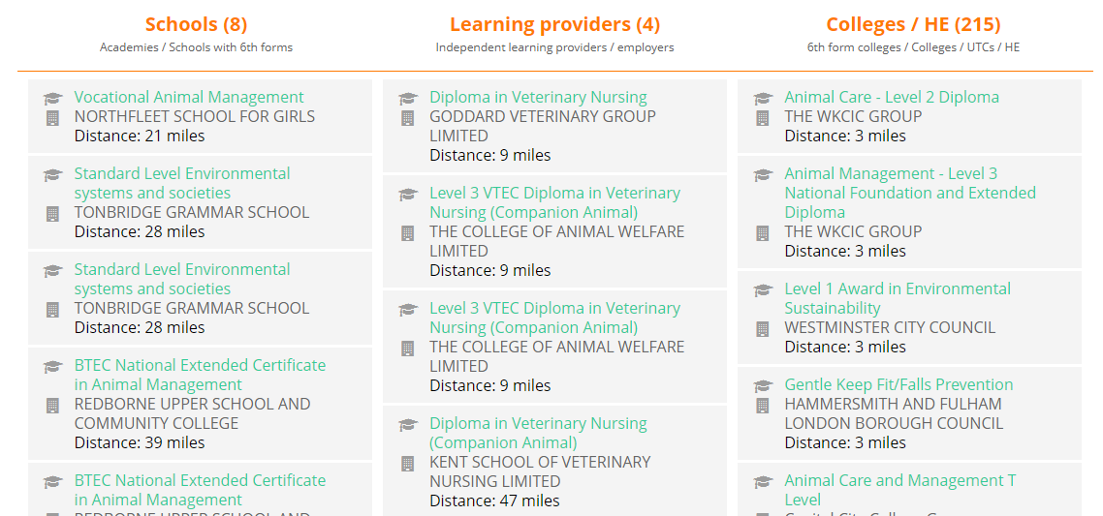
Using the Unifrog College / Sixth Form tool
Your longlist will be divided into three columns:
Schools
Learning providers
Colleges / HE
Notes:
Teacher’s notes:
The next few slides will teach students how to navigate the platform to use the College / Sixth Form tool.
At the top of the page, students can click ‘glossary’ to see definitions of terminology relating to colleges and sixth forms.
Students will see their longlist organised into three categories:
Schools (Academies / Schools with 6th forms)
Learning providers (Independent learning providers / employers)
Colleges / HE (6th form colleges / Colleges / UTCs / HE)
Students can filter their longlist by:
Keyword search
Distance
Qualification
Study mode (e.g. full time)
Attendance mode (e.g. daytime)
Delivery mode (e.g. classroom)
Level
Type (e.g. college)
Duration
Students can rank their longlist by several different criteria, such as duration, average grade, size of college/6th form, etc.
Students can select up to 10 courses to include in their final shortlist. You may wish to remind students that they can create and save multiple shortlists.

Slide 10
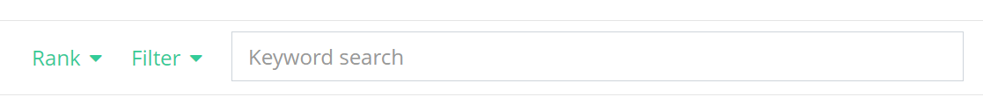
Using the Unifrog College / Sixth Form tool
Remember to use the ranks and filters to refine your longlist, so that you can review the courses that are most relevant to you.
Notes:
Teacher’s notes:
The next few slides will teach students how to navigate the platform to use the College / Sixth Form tool.
At the top of the page, students can click ‘glossary’ to see definitions of terminology relating to colleges and sixth forms.
Students will see their longlist organised into three categories:
Schools (Academies / Schools with 6th forms)
Learning providers (Independent learning providers / employers)
Colleges / HE (6th form colleges / Colleges / UTCs / HE)
Students can filter their longlist by:
Keyword search
Distance
Qualification
Study mode (e.g. full time)
Attendance mode (e.g. daytime)
Delivery mode (e.g. classroom)
Level
Type (e.g. college)
Duration
Students can rank their longlist by several different criteria, such as duration, average grade, size of college/6th form, etc.
Students can select up to 10 courses to include in their final shortlist. You may wish to remind students that they can create and save multiple shortlists.

Slide 11
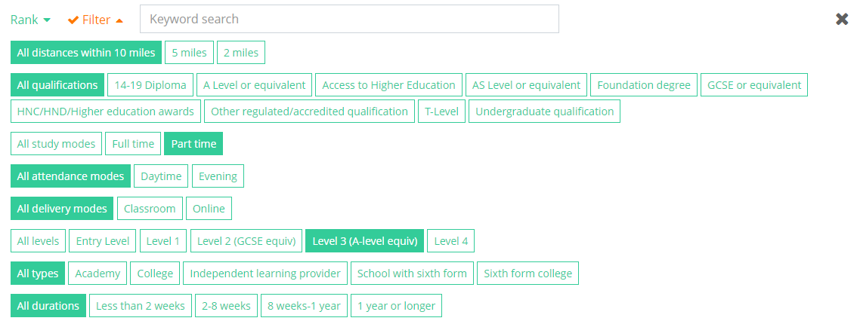
Using the Unifrog College / Sixth Form tool
e.g. you might want to filter to only show part time level 3 courses (A level or equivalent).
Notes:
Teacher’s notes:
The next few slides will teach students how to navigate the platform to use the College / Sixth Form tool.
At the top of the page, students can click ‘glossary’ to see definitions of terminology relating to colleges and sixth forms.
Students will see their longlist organised into three categories:
Schools (Academies / Schools with 6th forms)
Learning providers (Independent learning providers / employers)
Colleges / HE (6th form colleges / Colleges / UTCs / HE)
Students can filter their longlist by:
Keyword search
Distance
Qualification
Study mode (e.g. full time)
Attendance mode (e.g. daytime)
Delivery mode (e.g. classroom)
Level
Type (e.g. college)
Duration
Students can rank their longlist by several different criteria, such as duration, average grade, size of college/6th form, etc.
Students can select up to 10 courses to include in their final shortlist. You may wish to remind students that they can create and save multiple shortlists.

Slide 12
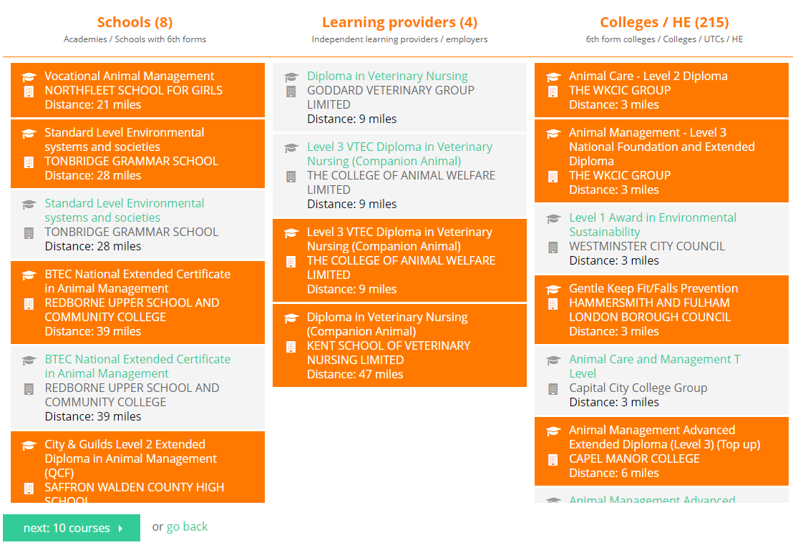

Using the Unifrog College / Sixth Form tool
Once you’ve selected the courses that interest you, click ‘next: X courses.’
Notes:
Teacher’s notes:
The next few slides will teach students how to navigate the platform to use the College / Sixth Form tool.
At the top of the page, students can click ‘glossary’ to see definitions of terminology relating to colleges and sixth forms.
Students will see their longlist organised into three categories:
Schools (Academies / Schools with 6th forms)
Learning providers (Independent learning providers / employers)
Colleges / HE (6th form colleges / Colleges / UTCs / HE)
Students can filter their longlist by:
Keyword search
Distance
Qualification
Study mode (e.g. full time)
Attendance mode (e.g. daytime)
Delivery mode (e.g. classroom)
Level
Type (e.g. college)
Duration
Students can rank their longlist by several different criteria, such as duration, average grade, size of college/6th form, etc.
Students can select up to 10 courses to include in their final shortlist. You may wish to remind students that they can create and save multiple shortlists.

Slide 13
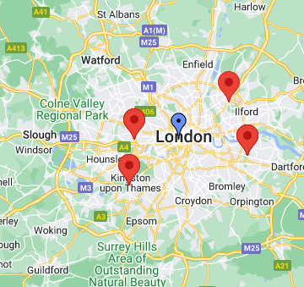
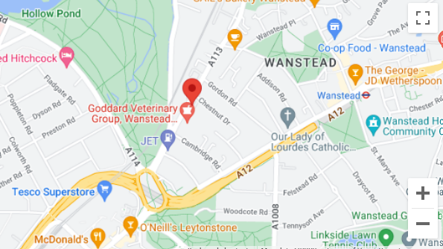
Using the Unifrog College / Sixth Form tool
At the top of your shortlist, you’ll see a map of the colleges and sixth forms you’ve selected.
Click the + symbol to zoom in,
to see exact locations.
Notes:
Teacher’s notes:
The next few slides will teach students how to navigate the platform to use the College / Sixth Form tool.
At the top of their shortlist, students will see an interactive map of their selected colleges and sixth forms.

Slide 14
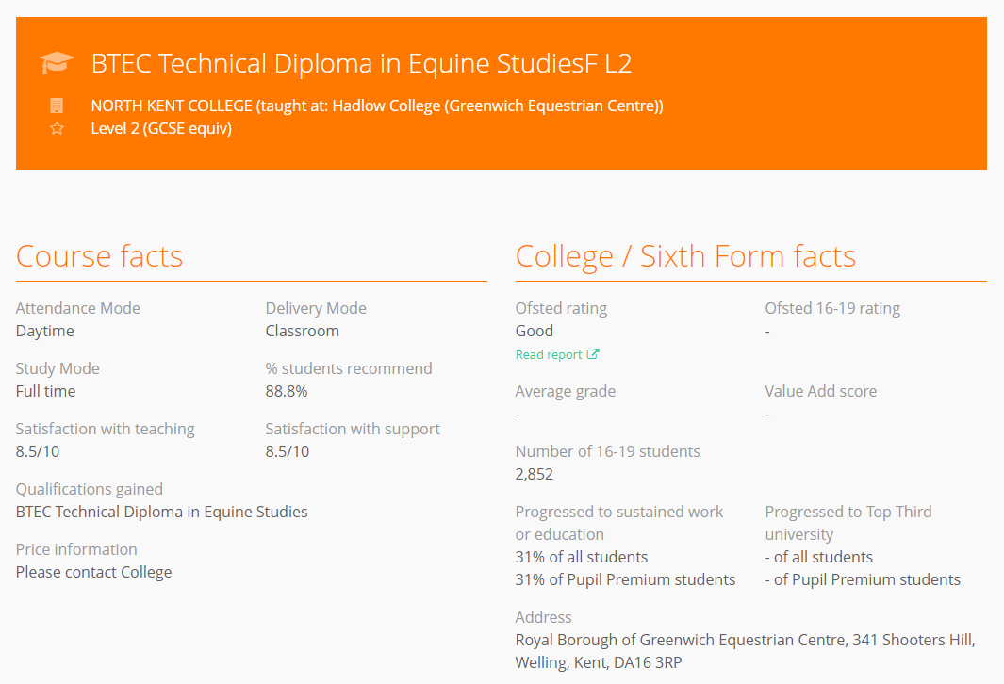
Using the Unifrog College / Sixth Form tool
In your shortlist, you’ll see more information about each course, including the entry requirements.
Notes:
Teacher’s notes:
The next few slides will teach students how to navigate the platform to use the College / Sixth Form tool.
In their shortlist, students will be able to read:
Overview
Course facts
College / Sixth Form facts
Entry requirements
Key dates
If they are no longer interested in a course, students can click ‘delete’ to remove the course from the shortlist.

Slide 15
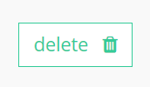
Using the Unifrog College / Sixth Form tool
If you’ve changed your mind about any courses, you can click ‘delete’ to remove them from your shortlist.
When you’re ready, click ‘save’ to finalise your shortlist of up to 10 courses.
Notes:
Teacher’s notes:
The next few slides will teach students how to navigate the platform to use the College / Sixth Form tool.
If they are no longer interested in a course, students can click ‘delete’ to remove the course from the shortlist.
Students can select up to 10 courses to include in their final shortlist. You may wish to remind students that they can create and save multiple shortlists.
Students are to click ‘save’ to finalise their shortlist.
If students do not click ‘save’ then they will not be able to come back to their shortlist.

Slide 16
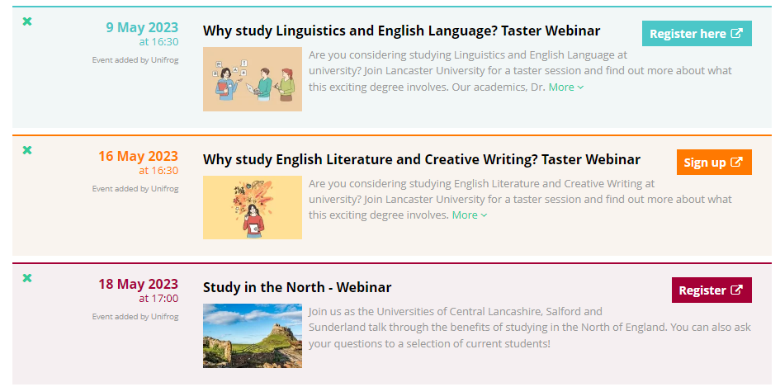
Using the Unifrog College / Sixth Form tool
It’s really important to save your shortlist!
Your shortlist doesn’t commit you to making an application. You can also make multiple shortlists. So don’t worry if you haven’t decided on your course(s) yet!
Saving your shortlist means you’ll see the most relevant opportunities for you on your Unifrog homepage, like upcoming webinars.
Notes:
Teacher’s notes:
The next few slides will teach students how to navigate the platform to use the College / Sixth Form tool.
Students are to click ‘save’ to finalise their shortlist.
If students do not click ‘save’ then they will not be able to come back to their shortlist.

Slide 17
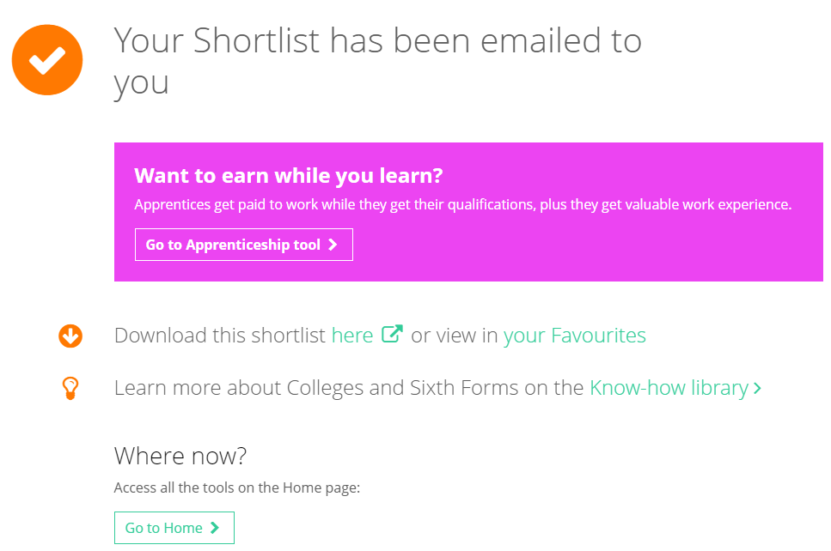
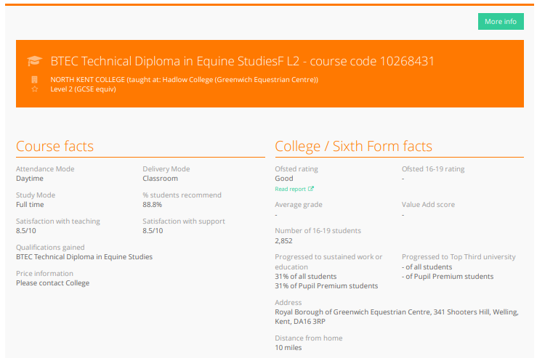
Using the Unifrog College / Sixth Form tool
When viewing your shortlist, you can click the ‘More info’ link at the top of each course.
Notes:
Teacher’s notes:
The next few slides will teach students how to navigate the platform to use the College / Sixth Form tool.
Students can access their shortlist:
By clicking ‘here’ on this screen
By email
By clicking Favourites > Destination tools > Filter by: UK College / Sixth Form
Tracking students’ progress:
You can track student progress with creating apprenticeship shortlists by clicking Advanced>Sort by>UK college shortlists.
From your homepage, you can also create charts showing shortlists that have been made. Go to Usage charts you can customise>UK pathways shortlisting.

Slide 18
Creating a Further Education shortlist
Now it’s your turn to create a shortlist!
Select up to 10 subjects
What would you like to study at college / sixth form?
Browse your longlist
Select up to 10 courses
Save your shortlist
Notes:
Teacher’s notes:
Following the instructions in the last few slides, students will be able to create a Further Education shortlist (Student side>College / Sixth Form).
Remind students to click ‘save’ when they have finalised their shortlist. This will enable them to revisit the shortlist in the future and access links to the college and sixth form websites.
Tracking students’ progress:
You can track student progress with creating apprenticeship shortlists by clicking Advanced>Sort by>UK college shortlists.
From your homepage, you can also create charts showing shortlists that have been made. Go to Usage charts you can customise>UK pathways shortlisting.

Slide 19


