Slide 1

What type of career is best for me?

Slide 2
Talking about careers (5 mins)
Look at the statements below. Which one do you agree with most? Which one do you agree with least? Explain your answers.
To me, a career means climbing the ladder – you start off in a low paid job and then get promoted.
I can’t think of anything worse than being stuck in the same job for 40 years. I’d be so bored!
Any career I have would need to fit around my life, not the other way around.
To me, a career means not staying in one place. You move to different jobs at different organisations.
I have loads of different interests and ideas. I don’t want to have to choose just one to earn money from.
Notes:
Teacher’s notes:
The purpose of this activity is to get students thinking about the type of career that might be right for them. There are no “right” or “wrong” answers here – only personal preference.
Later in the session, students will revisit these statements and apply them to four different career types:
Single track career
Serial career
Portfolio career
Lifestyle career
There is no “correct” career type to choose – students should choose the one that fits best with their interests, personality and values.

Slide 3
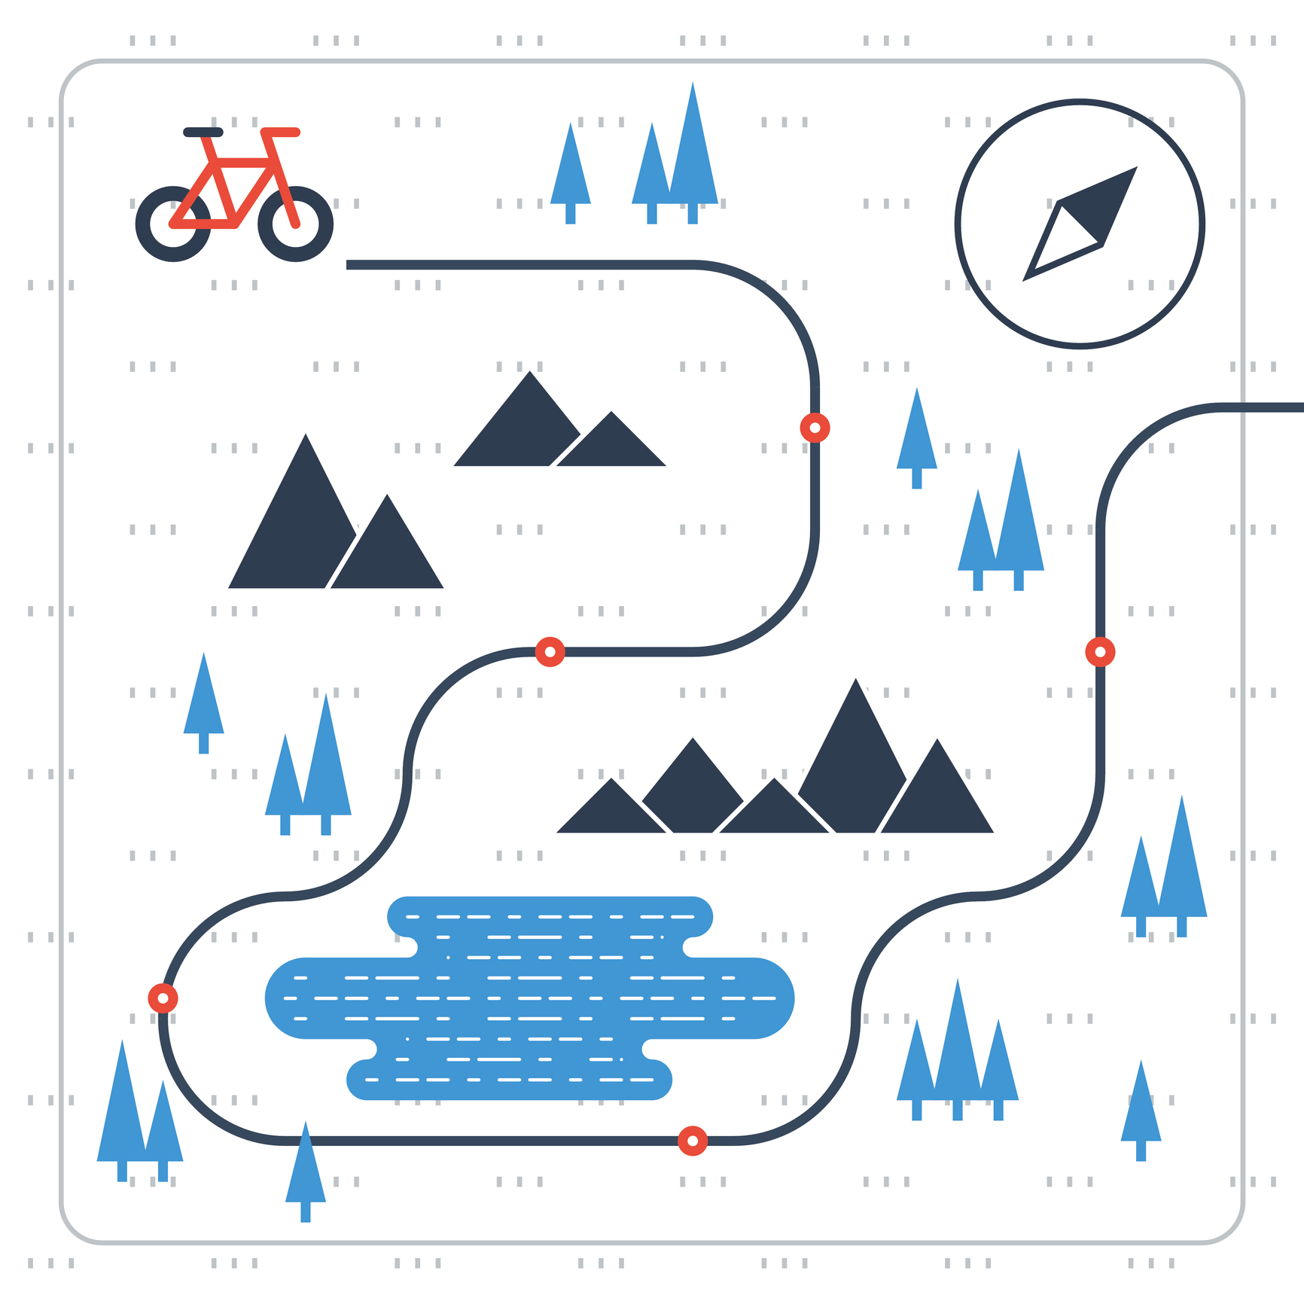
What’s the difference between a career and a job? (5 mins)
A career is the name for the journey you take through life, learning and work.
A job is a stop on that journey.
Education, training and other life experiences are tools to help you to navigate your career journey .
Alfie tells his friend, “I don’t want a career, I just want a job!”.
Write down what his friend could say to help him understand the idea of a career better.
Notes:
Teacher’s notes:
The CDI define a career as a journey through life, learning, and work. Journeys can take different directions and there are usually multiple routes that individuals can take to achieve their career goals. Career goals can change numerous times throughout your life and should not be thought of as deterministic, but instead, flexible.
The purpose of this task is to get students to recognise that the term “career” does not just apply to the professions, or that having a career has to involve climbing the ladder and progressing to the top of an organisation. The word “career” is relevant to all students as it describes their journey through life and work, and that might look different for each individual.
Suggested answers:
“A career just describes the journey you take through life and work, so getting a job (any job) is part of that journey.”
“You don’t have to climb the ladder to have a career, any job you get in your life makes up your career.”
“You don’t have to be a doctor or a lawyer to have a career, more “ordinary” jobs count as a career too!”
“A career isn’t just about joining a profession,”
“If you get a job, that’s a stop on your career journey!”

Slide 4
What are the different types of careers? (5 mins)
Match the type of career to its description:
Single track career
Moving from job to job at different companies or organisations. You might move to a promoted position, you might do a “sideways move” into a similar job, or you might step down into a role with fewer responsibilities.
Serial career
Doing two or more different jobs at the same time. This might involve a mixture of working freelance for different clients, taking on short term projects or contracts and/or running a small business.
Portfolio career
Choosing an industry, starting at the bottom and working your way up by getting promoted. Some people call this climbing the career ladder.
A career built around work/life balance. This might mean choosing a job to fit around your hobbies, such as becoming a ski instructor or a yoga teacher, or it might mean finding a job that allows you to balance your work and family roles easily.
Lifestyle career
Notes:
Teacher’s notes:
Answers on the next slide.

Slide 5
What are the different types of careers? (5 mins)
Match the type of career to its description:
Single track career
Choosing an industry, starting at the bottom and working your way up by getting promoted. Some people call this climbing the career ladder.
Moving from job to job at different companies or organisations. You might move to a promoted position, you might do a “sideways move” into a similar job, or you might step down into a role with fewer responsibilities.
Serial career
Portfolio career
Doing two or more different jobs at the same time. This might involve a mixture of working freelance for different clients, taking on short term projects or contracts and/or running a small business.
Lifestyle career
A career built around work/life balance. This might mean choosing a job to fit around your hobbies, such as becoming a ski instructor or a yoga teacher, or it might mean finding a job that allows you to balance your work and family roles easily.
Notes:
Teacher’s notes:
Remind students there is no “correct” career type – you choose the one that suits you best!

Slide 6
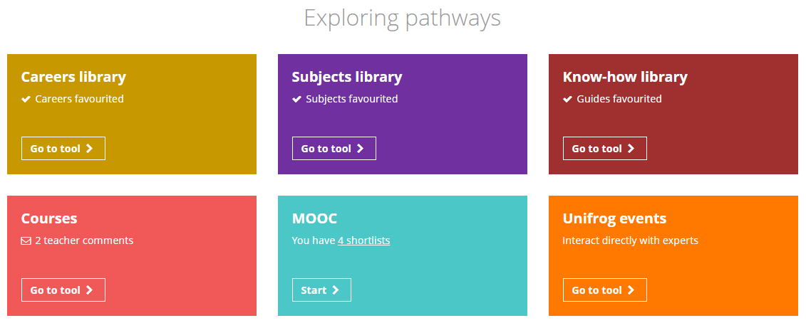
Using the Unifrog Careers library tool (15 mins)
Log in to your Unifrog account and open the Careers library tool.
Notes:
Teacher’s notes:
Go to Unifrog > Student side > Exploring pathways > Careers library.
Tracking students’ progress:
You can track student progress with favouriting career profiles by clicking Advanced>Sort by>Library profiles in Favourites.
From your homepage, you can also create charts showing the range of careers that have been favourited. Go to Usage charts you can customise>Most popular career profiles.

Slide 7

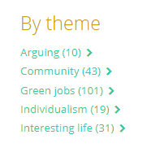
Using the Unifrog Careers library tool
First, use the search and filter tools to find and favourite:
One example of a lifestyle career that interests you
(Remember, these are often careers related to hobbies – or try searching by the theme ‘interesting life’)
One example of a more traditional career that interests you
Notes:
Teacher’s notes:
Go to Unifrog > Student side > Exploring pathways > Careers library.
Tracking students’ progress:
You can track student progress with favouriting career profiles by clicking Advanced>Sort by>Library profiles in Favourites.
From your homepage, you can also create charts showing the range of careers that have been favourited. Go to Usage charts you can customise>Most popular career profiles.

Slide 8
Using the Unifrog Careers library tool
Now, use information from the career profiles to answer the questions for each job:
If you did this job…
1. …how might you spend your time? Think about what kinds of activities you’d do during work time and leisure time.
2… what kind of standard of living would you have? What could you afford to have/do?
3…. would doing this job enable you to make a contribution to your community? If so, how?
Notes:
Teacher’s notes:
Students should use the information on the two career profiles they’ve chosen to answer these questions.
For question 1, they should consider
What the job entails
The working conditions/number of hours per week they’d be working
The typical salary and what this would allow for in terms of leisure activities
For question 2, they should consider
Typical salary
The median average salary for the country where they live (e.g. in the UK, the median average salary for those working full-time is £33,000 – ONS 2023)
Living costs in the area they want to live
For question 3, they should consider
What the job entails
What the job might allow them to do in their free time

Slide 9
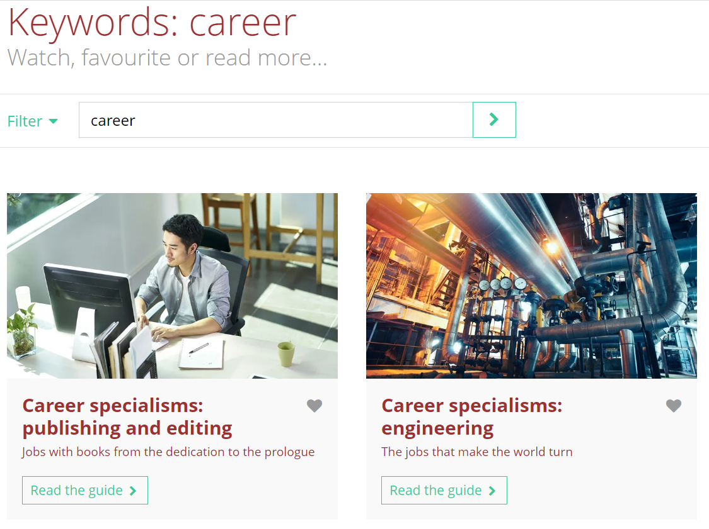

Finding out more about careers
If you want to find out more about careers you can use the Know-how library tool and search ‘career’. You can read guides on lots of different career specialisms.
You can also keep track of things you’re doing to support your career journey, such as your activities, achievements and skills. Visit the Activities tool and Skills tool on your Unifrog homepage.
Notes:
Teacher’s notes:
Students can find out more about careers on:
The Know how library (search ‘career’ or specific jobs)
Students can keep track of their career journey by:
Adding awards, achievements and activities to the Activities tool
Adding skills and on the Skills tool and keep track of how they’re developing their skill set through different levels.

Slide 10
What type of career is right for me? (5 mins)
Having a positive career means:
being happy with how you spend your time
having a decent standard of living
being able to make a contribution to your community
With this in mind, what type of career do you think would suit you best, and why?
Single track career
Portfolio career
Lifestyle career
Serial career
I think a ___________________________ career would suit me best, because… _______________________________________________________________________________
Lifestyle career
having a good work life balance is really important to me.
Notes:
Teacher’s notes:
Remind students that there are no “correct” career paths. This activity simply helps them to think about which option might work best for them.
A reminder of definitions:
Single track career: Choosing an industry, starting at the bottom and working your way up by getting promoted. Some people call this climbing the career ladder.
Serial career: Moving from job to job at different companies or organisations. You might move to a promoted position, you might do a “sideways move” into a similar job, or you might step down into a role with fewer responsibilities.
Portfolio career: Doing two or more different jobs at the same time. This might involve a mixture of working freelance for different clients, taking on short term projects or contracts and/or running a small business.
Lifestyle career: A career built around work/life balance. This might mean choosing a job to fit around your hobbies, such as becoming a ski instructor or a yoga teacher, or it might mean finding a job that allows you to balance your work and family roles easily.

Slide 11


