Slide 1

Work experience:
Researching possible placements

Slide 2

Work experience (5 mins)
It can difficult to know where to start looking for work experience and find a workplace that you’re interested in. This session is here to help though!
Why is work experience important?
With the person next to you, think of three reasons why work experience is important!
Notes:
Teacher’s notes:
Pairs discussion: The purpose of this introductory discussion is to reassure students that they will be able to find work experience with the help of Unifrog and careers guidance at their school or college. You will also be able to gauge student’s understanding of why work experience is valuable to them through the answers to the discussion topic.
Once pairs have had a chance to discuss, encourage them to share with the rest of the class, or come up and write it on the whiteboard.
Why is work experience important?
It will allow you to learn about a job, company, or career sector. Confirming your interest in a career or deciding it’s not for you are equally useful.
It can help you to decide whether you want to choose a particular pathway – a decision that might influence your subject choices!
Having the experience on your CV will set you apart from other applicants to jobs, apprenticeships, and university courses as someone who is motivated and committed.
You’ll be able to use the time to develop your competencies, and watch other professionals use competencies in the workplace.
It will build your confidence in interacting with adults.
You’ll be able to reflect on your experience and use it as evidence of your interest in future interviews, cover letters, or personal statements.
Keyword: Work experience is a short period of time spent in a workplace learning about a job, company, or career area. Most placements are unpaid and usually range from a couple of days to weeks in length. Shadowing professionals in their workplaces will let you see how they use their knowledge, skills, and competencies in their day-to-day tasks. You can use the time to ask questions and understand why things are done in a certain way. In the UK, students will usually do work experience in year 10, 11, or 12 (S4, S5, S6 in Scotland), depending on their school or college’s policy.

Slide 3
Choosing your work experience placement (5 mins)
Your placement will give you the chance to explore a workplace of interest to you. That way, you’ll find out whether you it could suit you in the future!
What might you consider when you start looking for work experience?
Researching the work experience options in your area is great way to figure out what you are interested in learning about.
Notes:
Teacher’s notes:
Class discussion: Students will have a range of answers to the question posed. The purpose of the discussion is that students understand that they should consider their personal interests and career aspirations when choosing a work experience placement. That way, the work experience will give them an idea of whether the job, company, or career area would suit them in future!
What might you consider when you’re looking for work experience?
What are your school or college’s policies on work experience? Ask your teachers if you’re in any doubt about the help offered or the term time set aside for work experience.
Whether you’ll be able to use the work experience to get a better understanding of a particular job or career that is actually of interest to you. Researching different industries or career areas ahead of your search can help you get an idea of what you’re interested in experiencing.
Will a particular work experience be helpful to you in future applications that you’re planning to make.
Whether your parents or family friends can help you to find work experience in their workplace (The downside of this is that what they do for a job may not be what you are interested in!)
Whether the work experience will be virtual or in person.
How much time you’ll be able to dedicate to work experience. This may vary depending on your school/college work, exams, or term dates.
Whether you’ll be able to use the opportunity to learn about an interest or favourite subject area during the experience.
What kind of skills or competencies you would like to develop or observe during your placement (And remember to record these in your Competencies tool afterwards! Click Student side>Competencies tool>Add example to demonstrate this to students).
Stretching exercise: A number of students may have completed work experience already. Can they share one thing that they learned? And one thing that they recommend to other students who are just starting to look for work experience?

Slide 4
Did you know…? (5 mins)
The Unifrog Apprenticeships tool isn’t just for looking for apprenticeships!
The tool can help you to:
Search for businesses to approach for work experience
Get an idea of the types of industries that are available in your area
The Apprenticeship tool also shows you businesses that you’re interested in on a map, so you can see how far they are from home!
Notes:
Teacher’s notes: Explain to students that you can use Unifrog to search for all kinds of opportunities. One of our tools is the Apprenticeship tool. While they may not be looking for an apprenticeship just yet, using this tool to search for businesses to approach for work experience will give students an idea of the types of industries that are available their your area.
The following slides will give your class a step-by-step tutorial on how to use the tool for work experience research.
In addition to using the Apprenticeships tool, students can also use the Unifrog Opportunities tool to find work experience relating to subjects that interest them. Demonstrate this to students from your teacher account by clicking Student side>Special opportunities>Next>Select location>Rank subjects by ‘Activities’>Select up to 10 subjects. Work experience will be listed in this tool as an ‘Activity’.
Once students have found work experience opportunities from their longlist, they can create a shortlist, read about how to get each work experience placement, and save it in a shortlist for future reference. Track students’ shortlists by clicking Advanced>Sort by>Special opportunities shortlists.

Slide 5

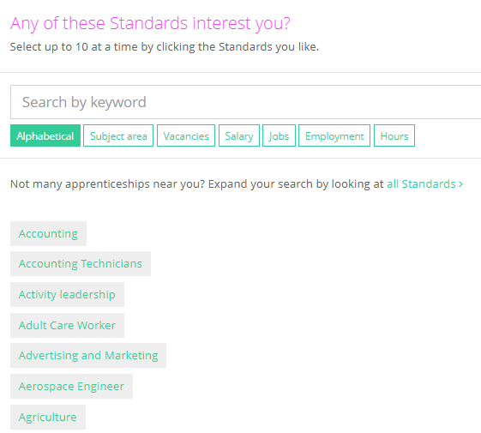
Apprenticeships Tool (10 mins)
Start by logging into your Unifrog account. Find the Apprenticeships tool on your homepage.
Once you have opened the tool, you’ll be able to search across the many different industries listed.
You can select up to ten of these at a time to explore!
Notes:
Teacher’s notes:
Unifrog instructions: Students will be introduced to the Unifrog Apprenticeships tool and how they can use it for work experience research over the next few slides. Demonstrate this page to your class by clicking Student side>Apprenticeships.
Encourage the class to log into their Unifrog accounts and click into the Apprenticeships tool. Students will be able to see a list of industries (or Standards, as they are referred to for apprenticeships). Students can select or search for the industries in the list. Once they have chosen a handful (up to ten!) they can click through to the next page to find out more.
Standards - Apprenticeships are split into different Standards which define the skills, knowledge and behaviours required in a particular role. These Standards have been developed by expert employer groups known as 'trailblazers’. There are lots of Standards to choose from - from Beauty Therapy to Recruitment, or Chartered Management! Don’t worry too much about the meaning of Standards while you’re using the Apprenticeships tool for work experience research.

Slide 6
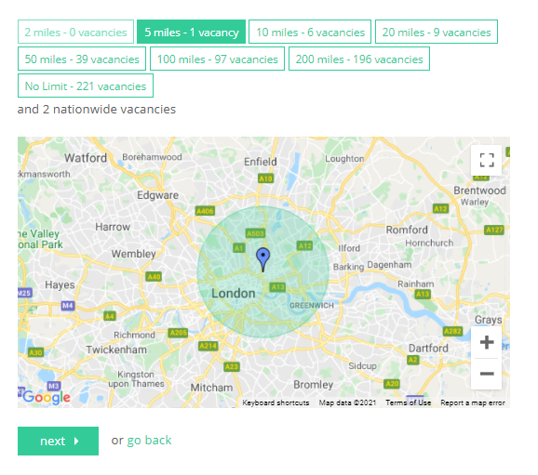
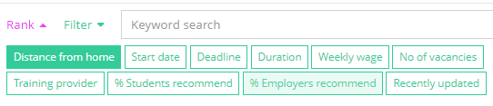
Apprenticeships Tool
Distance from home is the most important factor when you’re searching on the Apprenticeships tool.
Filter your results by the distance you’re willing to travel for work experience using the map.
Once you click through to the next page, you’ll be able to rank your longlist of results by ‘Distance from home’.
Notes:
Teacher’s notes:
Unifrog instructions: Once students have selected a number of different industries to explore, they will arrive on a page with a map. This map will show them the distance of different apprenticeship opportunities from home. Distance from home will be the most relevant filter on the Apprenticeships tool for students looking for work experience. Students will filter by the distance they are willing to travel for work experience. Demonstrate this process to your class by clicking Student side>Apprenticeships.
On the next page, students will be able to rank their results by ‘Distance from home’. This will already be starting to give them an idea of the number of opportunities in their area across different industries.

Slide 7

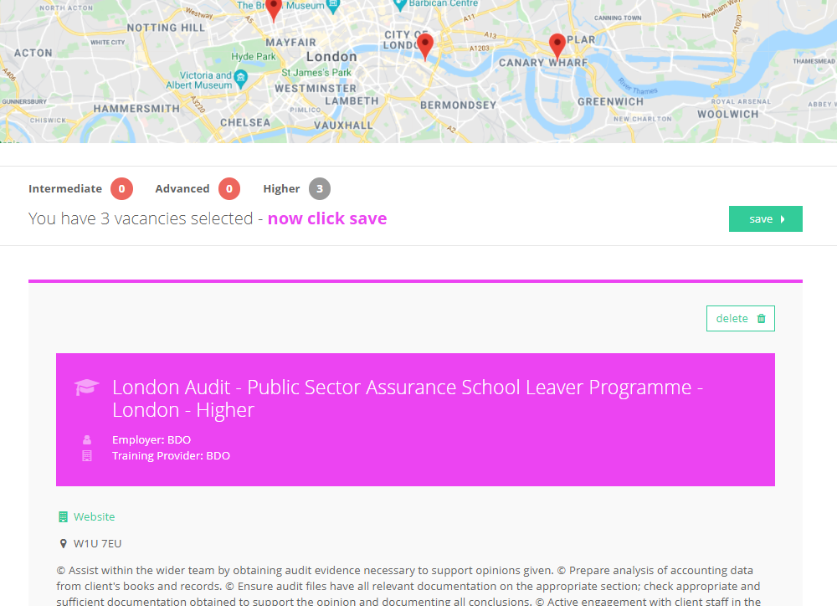
Apprenticeships Tool
Select the opportunities from your longlist that interest you the most.
You’ll be taken through to a shortlist of your favourites.
This page will give you information about the employer, the skills involved, and the job location on a map.
Notes:
Teacher’s notes:
Unifrog instructions: Now that students have a longlist of opportunities ranked by distance from home, they can select the ones that catch their eye! Once they have chosen these, they will be able to click through to a shortlist page. This page will give students lots of information about the employer.
Encourage students to look at the map and see how far companies are from their home. Are there any similar companies in the same industry that are closer to home?
Students will also be able to read about the kinds of skills and competencies needed to work at a particular company. Are these skills ones that they would like to learn about during work experience?

Slide 8
Researching possible placements (10 mins)
Well done for finding your way around the Apprenticeships tool! You’re all ready to start using it to find work experience that suits you.
Use the Apprenticeships tool to find employers or companies that you’d like to approach for work experience.
Make a note of the company names and the reasons they catch your interest.
You can then do further research to find out a contact name and exact address before you approach the company for work experience. Remember to save to your Locker!
Notes:
Teacher’s notes: Students are now familiar with the Apprenticeships tool. The purpose of this activity is for students to practise using the tool to figure out their industries of interest and identify possible work experience opportunities.
Setup: Ask students to open a Word document. They will use this to record the name of each employer that catches their interest, the contact details, and the reason they find them interesting.
Once students have finished the activity, ask them to save their document and upload it to their Unifrog Locker (Locker>Upload new item>Open file picker). Check students’ Locker uploads after they’ve completed the lesson (Manage>School leaving year>Locker).
Stretching exercise: Students may be comfortable using the Apprenticeships tool and making a list of a number of possible work experience options. Ask them to share the reasons those employers or companies appeal to them. How will that work experience be helpful in finding out about a workplace, industry, or subject they’re interested in?
Supporting exercise: Demonstrate using the Apprenticeships tool to find work experience options a number of times. One at a time, ask students to direct you through the steps according to what they are interested in. This will allow other students to see how choices are made at each step.
Once students start contacting employers and arranging work experience, encourage them to fill out Work Experience Journals with their thoughts before, during, and after their placements. Find the Work Experience Journal from your Unifrog teacher account by clicking Resources Library>Filter by Logistics: Work experience>Work Experience Journal.

Slide 9
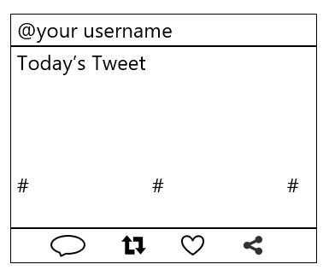
Today’s tweet (5 mins)
Using all the information today, write a tweet to explain why work experience is important.
Keep it under 280 characters.
Think about what you have understood from today’s lesson.
Add in 3 hashtags that you would use for this lesson.
Notes:
Teacher’s notes:
Plenary activity: Ask students to write a tweet or message explaining why work experience is important. The must keep their summary under 280 characters though!
The purpose of the brief exercise is to remind students of the discussion around choosing work experience earlier in the lesson.
Homework: If students are keen to learn more, encourage them to read ‘A guide to work experience’ in the Know-how library (Student side>Know-how library>Search ‘A guide to work experience’)

Slide 10


