Slide 1

Preparing to go on work experience

Slide 2













Health and safety (2 mins)
Match the health and safety symbol to the definition.
A) Danger: Obstacles
E) First aid
I) Eye protection must be worn
B) Emergency exit
F) No naked flames
J) No access for pedestrians
C) No smoking
G) Safety boots must be worn
K) Flammable material
D) Fire extinguisher
H) Safety helmet must be worn
L) Danger: Electricity
Notes:
Teacher’s notes:
Answers on the next slide.

Slide 3
Health and safety
Here are the answers:
E) First aid
A) Danger: Obstacles
C) No smoking
L) Danger: Electricity
G) Safety boots must be worn
K) Flammable material
I) Eye protection must be worn
J) No access for pedestrians
H) Safety helmet must be worn
F) No naked flames
B) Emergency exit
D) Fire extinguisher
Notes:
Teacher’s notes:

Slide 4
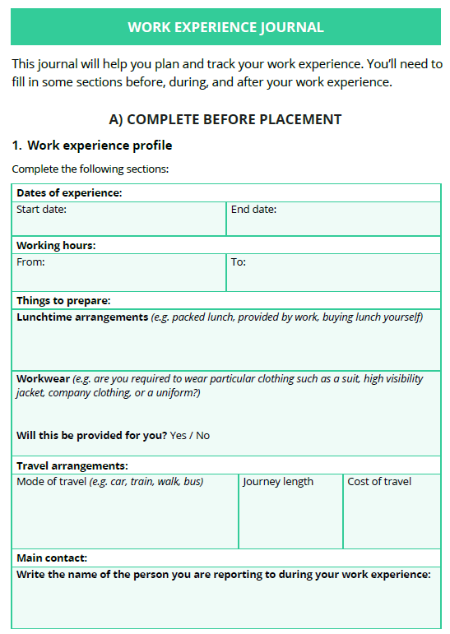
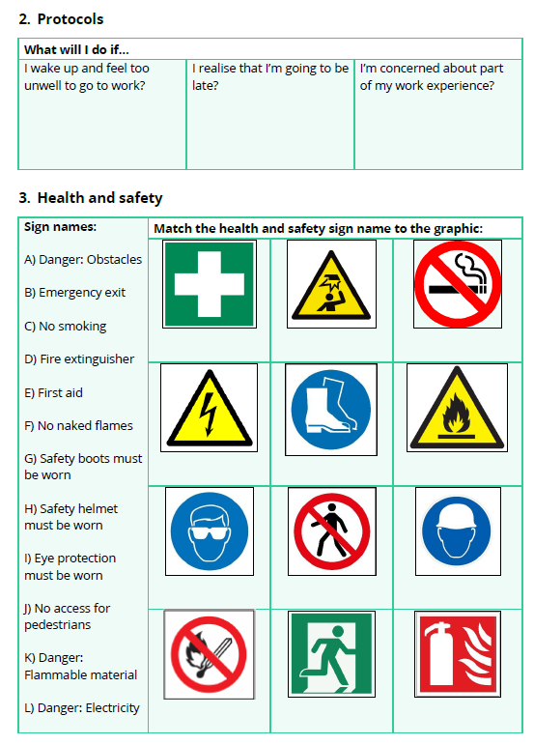
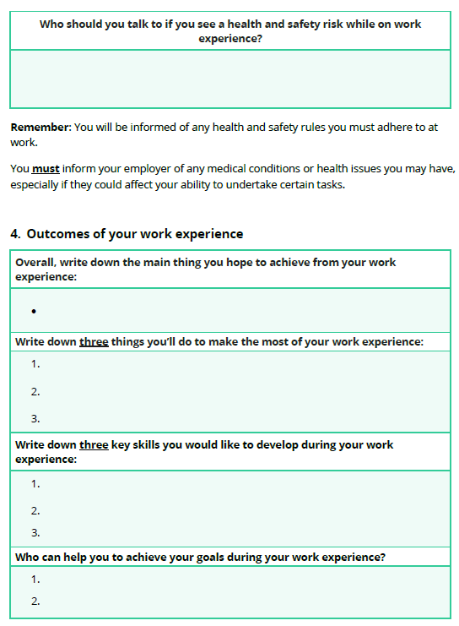
Work experience admin (1 min)
Complete the following sections of your work experience journal at the following times:
Section A: before your work experience.
Section B: during your work experience
Section C: after work experience.
Submit your journal by INSERT DATE.
Notes:
Teacher’s notes:
Share the work experience journal by setting it as an interaction. Click Advanced view>Sort by school leaving year>[filter for specific students]>+interaction. Attach the work experience journal to this interaction.
If you use the Unifrog placements tool, remind students when they need to have completed their ‘Student initial form’. Students could complete it in the lesson if you have time. Demo how to access the tool by going to Unifrog > Student side > Placements tool.
If you don’t use the Unifrog placements tool, delete the ‘top tip’ and ‘Placements’ screenshots if your school does not use the Unifrog Placements tool. Talk to your Unifrog Account Manager if you’re interested in subscribing to the Unifrog Placements tool to help manage your work experience administration.

Slide 5
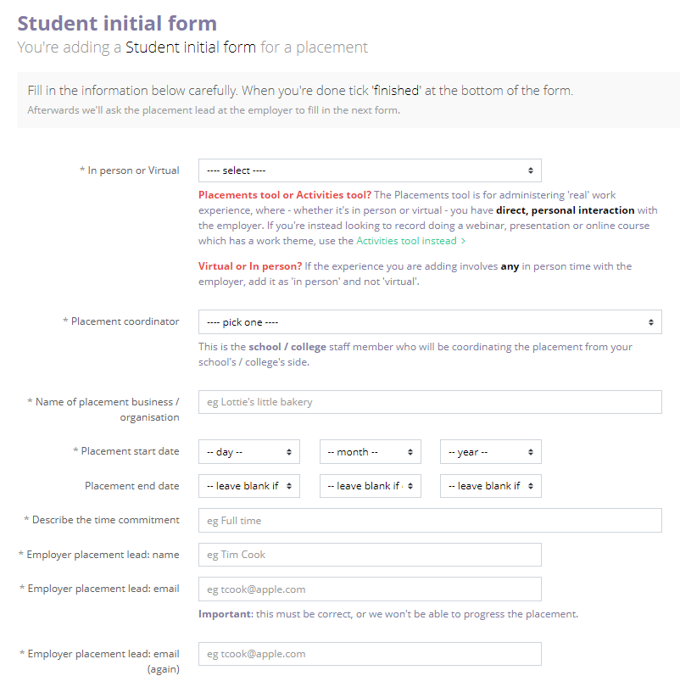
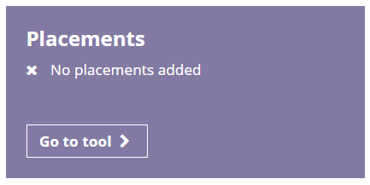
Placements tool reminder (delete if not applicable)
Have you completed your Student initial form on the Unifrog Placements tool? If not, complete this by INSERT DATE.
Notes:
Teacher’s notes:
Share the work experience journal by setting it as an interaction. Click Advanced view>Sort by school leaving year>[filter for specific students]>+interaction. Attach the work experience journal to this interaction.
If you use the Unifrog placements tool, remind students when they need to have completed their ‘Student initial form’. Students could complete it in the lesson if you have time. Demo how to access the tool by going to Unifrog > Student side > Placements tool.
If you don’t use the Unifrog placements tool, delete the ‘top tip’ and ‘Placements’ screenshots if your school does not use the Unifrog Placements tool. Talk to your Unifrog Account Manager if you’re interested in subscribing to the Unifrog Placements tool to help manage your work experience administration.

Slide 6
Work experience protocol: what should you do? (5 mins)
Read the scenario and answer what you think the student should do:
Scenario 1
Tim has a great day on his first day of placement. He can’t wait to go back. He wakes up the next day and is sick. He doesn’t feel well enough to go to work but is too scared to tell them he isn’t well enough. He’s worried that they’ll think he’s faking.
What should Tim do?
a) Go to work unwell - the employer will think he’s dedicated.
b) Get his mum to call school - they'll tell the employer.
c) Just don't go - it's not like he's a "proper" employee.
d) Email them and explain that he's too ill to come to work.
e) Something else.
Notes:
Teacher’s notes:
Answers on next slide.

Slide 7
Work experience protocol: what should you do?
Read the scenario and answer what you think the student should do:
Scenario 1
Tim has a great day on his first day of placement. He can’t wait to go back. He wakes up the next day and is sick. He doesn’t feel well enough to go to work but is too scared to tell them he isn’t well enough. He’s worried that they’ll think he’s faking.
What should Tim do?
a) Go to work unwell - the employer will think he’s dedicated.
b) Get his mum to call school - they'll tell the employer.
c) Just don't go - it's not like he's a "proper" employee.
d) Email them and explain that he's too ill to come to work.
e) Something else.
He should personally call the employer and report his absence to school in the usual way.
Notes:
Teacher’s notes:
Tim should contact his placement and his school to explain. He will be marked as sick. You should always call and not send a text message. It’s not ok to not turn up to work experience without telling anyone.

Slide 8
Work experience protocol: what should you do?
Read the scenario and answer what you think the student should do:
Scenario 2
Sarah is on day three of her placement at a bank. One of her colleagues shows Sarah that she can access people’s private information and asks if Sarah would like to search for someone she knows; she can see how much money they have in their account!
What should Sarah do?
a) Look up the information – it’ll be fun to find out how much money they have!
b) Say no thank you. Later, report it to the manager and her school.
c) Tell the colleague that it’s wrong and that she’s going to report her. Her behaviour is incredibly unprofessional.
Notes:
Teacher’s notes:

Slide 9
Work experience protocol: what should you do?
Read the scenario and answer what you think the student should do:
Scenario 2
Sarah is on day three of her placement at a bank. One of her colleagues shows Sarah that she can access people’s private information and asks if Sarah would like to search for someone she knows; she can see how much money they have in their account!
What should Sarah do?
a) Look up the information – it’ll be fun to find out how much money they have!
b) Say no thank you. Later, report it to the manager and her school.
c) Tell the colleague that it’s wrong and that she’s going to report her. Her behaviour is incredibly unprofessional.
Notes:
Teacher’s notes
Sarah should not look up the information as it breaks the confidentiality rules of her placement. However, Sarah should not put herself in a risky position by threatening the colleague who is breaking the rules. Saying no thank you and reporting the behaviour at a quiet time is the safest option.

Slide 10
Work experience protocol: what should you do?
Read the scenario and answer what you think the student should do:
Scenario 2
Sarah is on day three of her placement at a bank. One of her colleagues shows Sarah that she can access people’s private information and asks if Sarah would like to search for someone she knows; she can see how much money they have in their account!
What should Sarah do?
b) Say no thank you and report it to the manager and her school.
Write down:
Why shouldn’t Sarah confront her colleague?
How is Sarah’s colleague being a bad role model?
What do you think a good leader would do if Sarah was honest and told them about what happened?
Notes:
Teacher’s notes
Suggested answers are on the next slide.

Slide 11
Work experience protocol: what should you do?
Why shouldn’t Sarah confront her colleague?
Sarah should not put herself in a risky position by threatening the colleague who is breaking the rules. Saying no thank you and reporting the behaviour at a quiet time is the safest option.
How is Sarah’s colleague being a bad role model?
Sarah’s colleague is breaking customer confidentiality and leading Sarah into breaking the rules of the workplace.
What do you think a good leader would do if Sarah was honest and told them about what happened?
A good leader would be thankful and impressed with Sarah’s honesty. A good leader would discreetly address the issue without putting Sarah in a difficult situation.
Notes:
Teacher’s notes:
Sarah’s colleague is breaking customer confidentiality and leading Sarah into breaking the rules of the workplace.
A good leader would be thankful and impressed with Sarah’s honesty. A good leader would discreetly address the issue without putting Sarah in a difficult situation.

Slide 12
Making the most of your work experience (5 mins)
To make the most out of work experience, you should:
1. Research the company: learn as much as you can beforehand.
2. Arrive on time: let them know if you’ll be late or are unwell.
3. Follow the rules: such as health and safety, working hours, social media use.
4. Listen: and absorb as much information as you can!
5. Ask questions: there is no such thing as a silly question.
6. Complete your work experience journal: submit it by INSERT DATE.
  Read the following two scenarios and use these six tips to help you answer the questions.
Notes:
Teacher’s notes:
Update the date you’d like student to submit their work experience journal.

Slide 13
Making the most of your work experience
Scenario 1:
Ahmed is working at his local post office. He wants to be a car mechanic and thinks this is boring. He turns up late and has been caught sitting on his phone at the back of the store. On his last day, his work experience manager asks if he has any questions or needs any help with his work experience journal. He says no and asks to leave early. Ahmed thought the whole week was pointless.
Write down at least two ways Ahmed could have engaged more with his work experience. Use the icons as clues.
Notes:
Teacher’s notes:
Possible answers:
Research: Ahmed could have done some research before starting his work experience to be more prepared.
Arrive on time: Ahmed could have not turned up late to his placement.
Follow the rules: Ahmed could have followed the rules about not using his phone at work or within the store.
Ask questions: Ahmed could have asked questions and listened to the answers.
Complete his work experience journal: Ahmed could have completed his work experience journal to reflect on what he learned and assess why it wasn’t the best opportunity for him.

Slide 14
Making the most of your work experience
Scenario 1:
Ahmed is working at his local post office. He wants to be a car mechanic and thinks this is boring. He turns up late and has been caught sitting on his phone at the back of the store. On his last day, his work experience manager asks if he has any questions or needs any help with his work experience journal. He says no and asks to leave early. Ahmed thought the whole week was pointless.
Write at least one thing Ahmed has missed out on by not engaging with his work experience.
Good references
Developing transferrable skills
Clear understanding on why some work environments aren’t for him
Notes:
Teacher’s notes:
Stretching question: Write at least one thing Ahmed has missed out on by not engaging with his work experience.
Good references – this would be useful if he wanted to apply for car mechanic training or apprenticeships in the future.
Opportunities to develop transferrable skills – this would be useful if he needed to attend an interview or complete an application form for car mechanic training or apprenticeships in the future.
Opportunity to reflect and list clear reasons why this type of work environment isn’t suitable for him – this would be useful for his own benefit, but also to answer interview questions such as ‘why is working as a car mechanic suitable for you?’ in the future. He could say things like ‘based on my experience working at Post Office, I identified that it didn’t suit me because of XYZ. Instead, I know I need to work in an environment that is more hands-on and practical.’

Slide 15
Making the most of your work experience
Scenario 2:
Polly is working at her old primary school. She researches what’s changed at the school. On her first day, Polly arrives 10 minutes early. She keeps her phone in her bag and doesn’t get it out during class. Polly receives an induction and listens intently. During the week, Polly keeps a list of questions and goes through them in her daily catch-ups with her supervisor. Polly asks if they could spend time completing her work experience journal. Polly leaves feeling confident about a career in primary school teaching. She records her skills on Unifrog. Her supervisor asks if she’d like to volunteer with their summer school to gain more experience!
Write down at least two ways Polly engaged with her work experience. Use the icons as clues.
Notes:
Teacher’s notes:
Possible answers:
Research: Polly researched the school the week before starting her work experience. Polly did this even though she was already familiar with the school as she wanted to learn anything that had changed.
Arrive on time: Polly arrived early and allowed herself time in case of delays. This made a good impression on her supervisor.
Follow the rules: Polly followed the rules in relation to using her phone during the classroom; she kept it in her bag and didn’t get it out during classes.
Listen: Polly makes sure to listen and take notes in her daily catch-ups. This allows her to learn more.
Ask questions: Polly is confident to ask her supervisor if they can allocate some time to completing her journal.
Complete her work experience journal: Polly completes her journal and records the skills she’s gained on Unifrog.

Slide 16
Making the most of your work experience
Scenario 2:
Polly is working at her old primary school. She researches what’s changed at the school. On her first day, Polly arrives 10 minutes early. She keeps her phone in her bag and doesn’t get it out during class. Polly receives an induction and listens intently. During the week, Polly keeps a list of questions and goes through them in her daily catch-ups with her supervisor. Polly asks if they could spend time completing her work experience journal. Polly leaves feeling confident about a career in primary school teaching. She records her skills on Unifrog. Her supervisor asks if she’d like to volunteer with their summer school to gain more experience!
Write down at least one benefit Polly gained from engaging with her work experience.
Developed her skills
Increased confidence about her future
Offered an additional opportunity to further develop her skills
Notes:
Teacher’s notes:
Polly was able to develop her skill set which will improve her application for teaching.
Polly increased her confidence about the future. She can use this experience to evidence why she knows this career could be suitable for her during teaching training applications.
Polly was offered an additional opportunity because her work experience provider was so impressed with her. This will develop her skills further and look impressive on her CV or future applications.

Slide 17
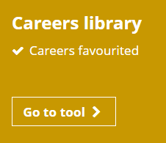
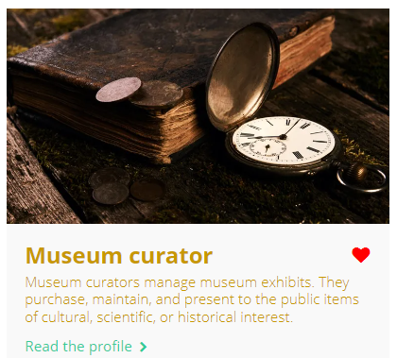

Independent learning
To continue preparing for your work experience, you can:
Visit the company website.
Use the Careers library to research job roles that you’ll encounter.
Read relevant Know-how library guides about work experience.
Notes:
Teacher’s notes:
Students could visit the company website of their work experience provider.
Students could use the Careers library to research job roles that they’ll encounter.
Students can find Know-how library guides by logging into their Unifrog accounts and scrolling down to ‘Exploring pathways’ on the Home page until they find the Know-how library. Once they click ‘Go to tool’ they can search by keyword, e.g. ‘work experience’ or ‘placement’.
Students’ favourited guides will be shown in the Know-how library banner every time they click on the page (Student side>Know-how library). They will also be able to see a full list of their favourite profiles by going to the top of their webpage and clicking Favourites>Library tools>Know-how.
You can track guides favourited by students by clicking Advanced view>Sort by>Library profiles in Favourites.

Slide 18
Work experience admin: a reminder
Complete the following sections of your work experience journal at the following times:
Section A: before your work experience.
Section B: during your work experience
Section C: after work experience.
Submit your journal by INSERT DATE.
Notes:
Teacher’s notes:
Share the work experience journal by setting it as an interaction. Click Advanced view>Sort by school leaving year>[filter for specific students]>+interaction. Attach the work experience journal to this interaction.
If you use the Unifrog placements tool, remind students when they need to have completed their ‘Student initial form’. Students could complete it in the lesson if you have time. Demo how to access the tool by going to Unifrog > Student side > Placements tool.
If you don’t use the Unifrog placements tool, delete the ‘top tip’ and ‘Placements’ screenshots if your school does not use the Unifrog Placements tool. Talk to your Unifrog Account Manager if you’re interested in subscribing to the Unifrog Placements tool to help manage your work experience administration.

Slide 19
Plenary: Reflection (2 mins)
It’s normal to have mixed feelings about going on work experience.
The key to succeeding on work experience is to be prepared.
Complete the tasks below:
If you feel comfortable, share your answers with those sitting near you.
1. Write at least one thing you’re looking forward to about your work experience
3. Write at least one way your work experience will be different from school
2. Write at least one thing you’re worried about relating to your work experience
4. Write at least one professional relationship you’ll develop on work experience
Notes:
Teacher’s notes:

Slide 20


