Slide 1


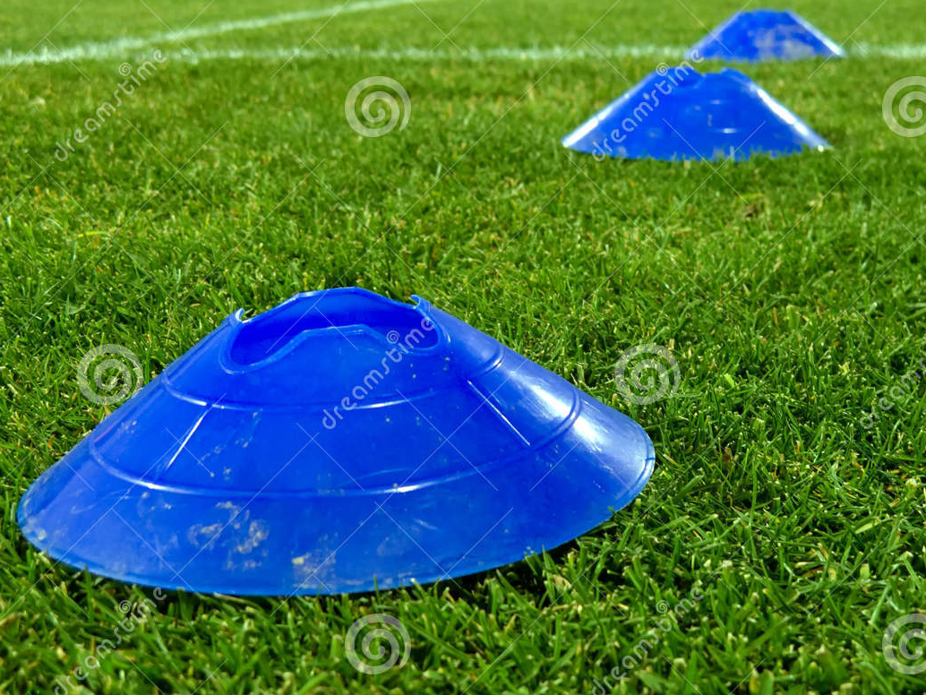
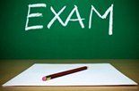
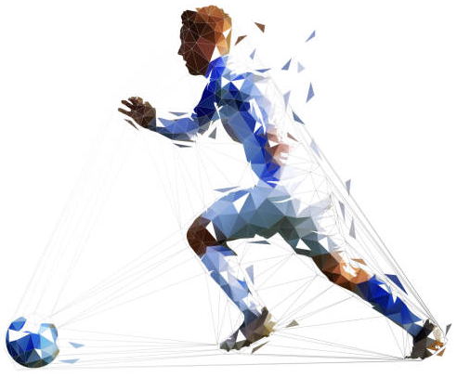


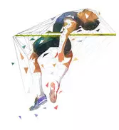
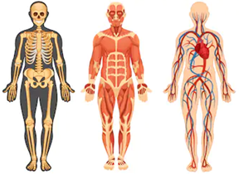
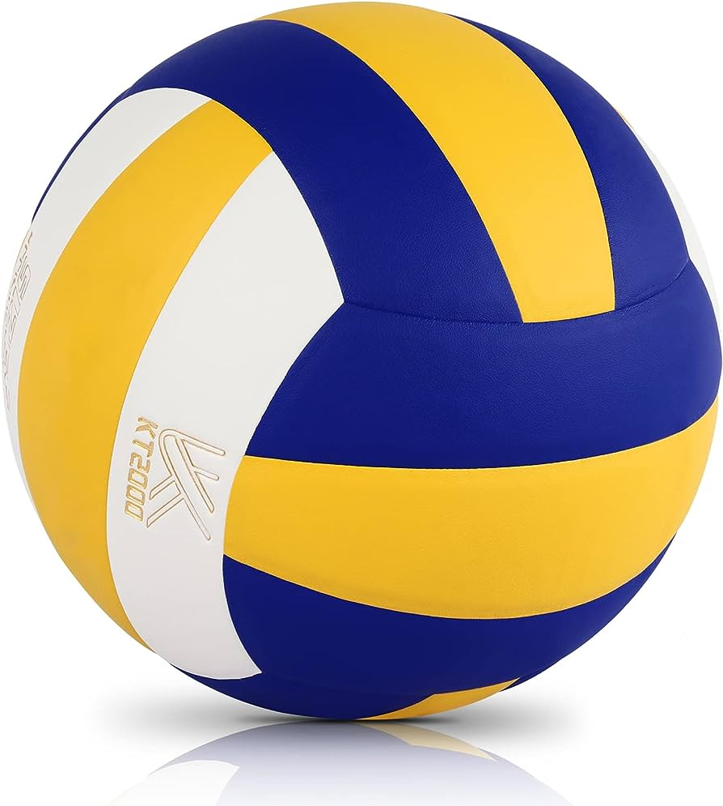
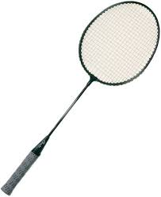
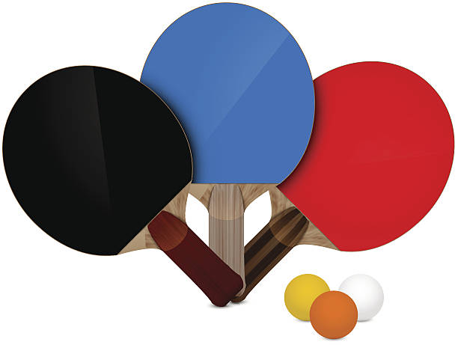

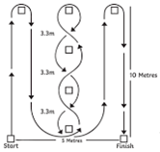
GCSE PE
Learning Journey at Hurstmere School
EXAMINATIONS
Paper 1: Applied Anatomy & Physiology and Physical Training.
Paper 2: Socio-Cultural Influences, Sports Psychology & Health, Fitness & Well-Being
GCSE PE External Moderation
Mock Exams
GCSE PE: NEA Coursework hand in
SHORT/LONG TERM EFFECTS OF EXERCISE
Students will develop knowledge of the short and long-term effects of exercise on the body systems, and how these effects can impact on physical fitness and performance.
Movement analysis
Students should develop knowledge and understanding of the basic principles of movement and their effect on performance in physical activity and sport.
PHYSICAL ACTIVITY & PARTICIPATION
Students will develop their knowledge and understanding of factors affecting
participation and strategies to
promote participation across
a range of different groups
in society.
End of Year 10 Exams
DIET & NUTRITION
Students will develop an understanding of the components of a balanced diet, and hydration on performers.
Football Practical
11
Athletics Practical
Mock Exams
GCSE PE:
NEA Coursework
HEALTH, FITNESS & WELL-BEING
Students will understand the benefits of participating in physical activity to health, fitness and well-being. Physical, emotional and social benefits as well as the consequences of a sedentary lifestyle.
ANATOMY & PHYSIOLOGY
Students will develop knowledge and understanding of the body systems, bones, muscles and movement planes that are important to physical activity
Volleyball Practical
Badminton Practical
Participation in core PE lessons
Ethical & Socio-Cultural Issues
Students will understand the ethics in sport including sportsmanship, gamesmanship and deviance. The effects of drugs in sport and reasons for player violence.
SPORT PSYCHOLOGY
Students will understand the psychological factors that can affect performers. Knowledge of the characteristics and classification of skilful movements, along with goal setting, guidance, feedback, and mental preparation.
COMMERCIALISATION
Students will develop an understanding of commercialisation in sport, along with the influences of media on participation and performances in sport.
Table Tennis Practical
Football Practical
PHYSICAL TRAINING / TRAINING METHODS
Students will develop their knowledge and understanding of the components of fitness required for practical activities and how each can be measured. Be able to apply principles of training to different types of training and prevent injury
FITNESS TESTING
Student's complete fitness tests for each of the components of fitness.
Refine skills in core PE lessons
10
GCSE PHYSICAL EDUCATION BREAKDOWN
Examination – 60%
Practical Assessment – 30%
Analyse and Evaluate Performance – 10%
PRACTICAL ASSESSMENT – 30%
For GCSE PE, you will need to select THREE sports, with a maximum of two from either the Individual or Team category.
You will need to keep a competitive logbook of all the events that you do within your chosen sports. Your teacher will assess you in these sports. Any ‘off-site’ sports will need video evidence.
The List of available sports and more information can be found on the website.
ANALYSE AND EVALUATE PERFORMANCE – 10%
For one of your chosen sports, you will need to create a piece of coursework to demonstrate your ability to analyse and evaluate your own performance.
Learners will need to include:
Analyse aspects of personal performance in a practical activity
Evaluate the strengths and weaknesses of the performance and components of fitness
Produce an effective action plan which aims to improve the quality and effectiveness of the performance

